Slide 1
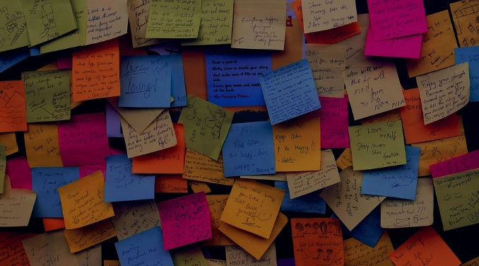
Shortbread and Sticky Notes: Taking a Personal Approach to Student Experience at University of Worcester Library Services
Tuesday 13th June 2017, Gregynog Colloquium
Madalene George
Student Engagement Co-ordinator
University of Worcester Library Services
m.george@worc.ac.uk

Slide 2
The context of Library Services at Worcester: The Hive
Unique fully integrated public and university service model
Presents both advantages and challenges for student experience and satisfaction
Notes:
University of Worcester Library Services are based at The Hive, a fully integrated university and public library incorporating university and county council collections, county council archives and archaeology service and the county council hub.
This service model brings with it many benefits and opportunities for our students: access to a greater number of resources on site; students are able to put into practise their learnt skills in voluntary roles or work placement projects; the building acts as a ‘shop front’ for our students’ achievements.
The model presents some challenges when it comes to student experience: in particular, it can be more difficult to encourage students to have a sense of ownership over their library environment.

Slide 3
Increasing importance of satisfaction surveys
Notes:
The introduction and subsequent augmentation of tuition fees means students are increasingly concerned about receiving value for money from their university. Universities also rely ever-heavily on the satisfaction rating of our students and, in particular, those gathered by the National Student Survey to grow.
Equally, our students’ opinions matter to us: we want our students to feel happy with the service they receive from us.

Slide 4
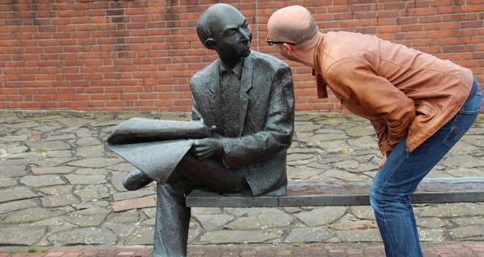
Proactive approach to student experience talking to students year-round to involve them students in service decisions
Notes:
University of Worcester Library Services have, some time, been taking a proactive approach to student satisfaction. We’ve been actively engaging with students throughout the year and involving students in some of our key decisions: monitoring overall student satisfaction by gathering qualitative and quantitative data; trusting our students to help us decide how best to grow the service e.g. including current students in the selection new student-facing staff members.
As a result, we’ve seen a rapid rise in student satisfaction: last year we hit our target, receiving our highest NSS score to date.

Slide 5
Who is missing from the headline result?
Notes:
Despite last year’s NSS results suggesting that students were very happy with their experience of Library Services, we wanted to see if there were any particular groups of students whose voices weren’t being heard in the headline result.
Analysis of the figures revealed that a small number of student groups were still not entirely happy with their experience; when compared to our engagement records it became clear that students from these groups were also less likely to attend focus groups or take part in our year-round engagement activities.

Slide 6
Notes:
It seemed clear to us that the global approach of the NSS, and of some of our own data gathering techniques, did not reveal the whole picture of student experience: we needed to stop looking at the student body en masse and, instead, approach our students as individuals.

Slide 7
Focus your approach
Notes:
We decided to take an approach that directly contradicted that of the NSS and other internal surveys. We focused in on these ‘hard to reach’ students. Using the data from 2016 NSS, we identified the subject groups that had given us low or lower than anticipated satisfaction scores and contacted individual students to invite them to come and share their experience of Library Services in small, informal focus groups.

Slide 8
Shortbread...
Incentivise student attendance- the promise of shortbread works well
Be honest: let students know why you want to talk to them
Be clear about structure of the focus group and what you hope to achieve
Be flexible: run focus groups at times to suit students
Notes:
To ensure that the focus group experience was positive for all attendees, we followed four simple steps:
We were honest with students from the outset and explained why we wanted to meet with them.
We were flexible when arranging focus groups and tried hard to work around students’ varied schedules.
We incentivised student attendance with the promise of an open forum in which to air their views and, crucially, plenty of biscuits to fuel the discussion.
We began each focus group with recap of why we had invited students to speak with us, an overview of the format of the focus group and, most importantly, what we expected to achieve from the

Slide 9
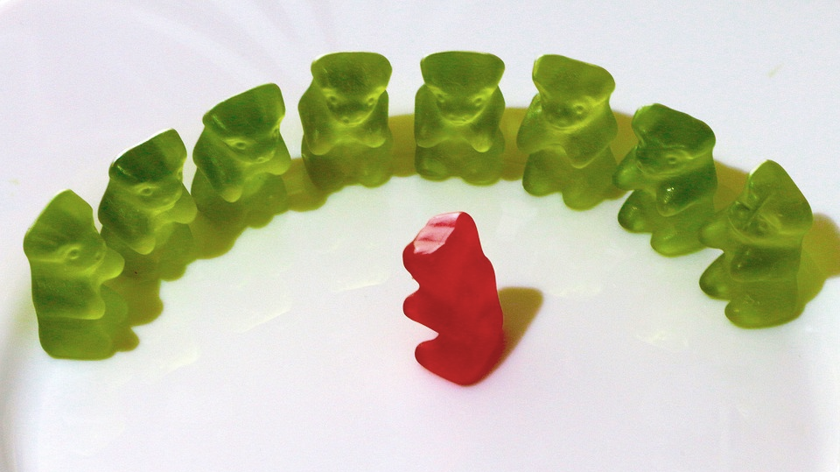
Sticky notes...
Make it clear what will happen with students’ feedback
Give students space for individual contemplation to coax multiple responses
Allow free discussion but challenge misconceptions and knowledge gaps as they arise
Record everything
Notes:
Students were asked to record at least 7 comments, queries or complaints they had about their experience of Library Services in a five minute time period. By allowing the students space for individual contemplation, we were able to coax a number of responses from every student and allow all attendees to express their concerns.
All students were given plenty of time to talk and all queries were taken seriously. All knowledge gaps or misconceptions concerning Library Services were dispelled through peer-to peer discussion or by the staff member leading the focus group.
All points raised during the discussion were recorded and included in the final report. We recorded student queries with a flip chart and multi-coloured pens, but an audio recording of the focus group could also have be used to give further insight into the precise nature of topics discussed.
At the close of the focus group, attendees were told exactly where the information would be going and what would happen next.

Slide 10
Take action...
Short term
Medium term
Long term
Notes:
Immediately after the focus groups, I compiled a list of the issues raised by students and forwarded them to senior members of Library Services management and Academic Liaison Librarians.
Short terms actions:
Academic Liaison Librarians tackled knowledge gaps in Course Management Committees.
Library Services stepped up promotion of a series of Youtube videos assisting with the effective use of eresources and introduced a student-led project to create a video guide to The Hive.
As a result of students identifying a need for additional space to study with their own devices, we were purchased a collection of laptop tables and created over 120 more non-PC based study spaces over the assessment period.
Medium term actions:
To tackle these issues surrounding investment and value for money, we devised and launched a University-wide campaign focusing on our financial and personal investment in our students.
Longer term actions:
History students had complained that their books were not available on the shelf because members of the public frequently borrowed them.
Public borrowing of University texts does not represent a significant proportion of the loan activity; however, we investigated and found that the public borrowing rate of history books was disproportionately higher than for any other subject.
We are now using this information to inform our purchasing choices for the coming academic year.
These changes are yet to be made; however, by trusting the feedback students gave us and confirming that students were right, we have already gone a long way in restoring satisfaction amongst our history students.

Slide 11
Broadcast your actions
Notes:
Completing the feedback loop was an essential aspect of the project.
Within days of the focus groups, I had contacted students to thank them for their input and let them know what had happened to their feedback. Within weeks I had circulated the full project report detailing all the concerns raised and Library Services’ proposed actions to all students involved in the focus groups.
When more complex actions were planned, students were again contacted to explain the developments taking place.
This stream of communication demonstrated our openness to student feedback and gave students a sense of ownership over the information they had provided.

Slide 12
What difference did it make?
Gaps in knowledge and misconceptions were challenged
Students felt their opinion was valued & feedback acted upon
Provided target areas for future campaigns
Upturn in student satisfaction amongst first and second years from targeted student groups
A plan for targeting student satisfaction for the future
Improved NSS results?
Notes:
Short term impacts:
students were made aware of Library Services taking a special interest in their concerns and, crucially, acting upon them.
Focus groups provided the opportunity for staff to fill gaps in student knowledge, combat misinformation and allow peer to peer information sharing.
Medium term:
The focus groups have given us target areas for current and future campaigns and provided library staff with confirmation of anecdotal findings.
The results from this year’s internal University of Worcester student survey shows a rise in satisfaction from a number of the groups targeted.
Longer term:
The success of this project has given us a model for effectively targeting student satisfaction that we now plan to implement on a yearly basis as an integral element of our student engagement campaign.
With the annual implementation of the programme we also hope to assure that, when NSS satisfaction rates rise, they do so across the board.

Slide 13
A more structured plan for student recruitment
Build the project into the student engagement programme
Notes:
Encouraging students to engage with activities outside of their course is not always easy and take up amongst students was still relatively low.
Next year I hope to be able to implement a far more structured plan for student recruitment, engaging with target student groups as early as induction and possibly collaborating with teaching staff earlier in the process.
By including this project as an integral element of our student engagement programme, we will be better placed to ensure that focus group sessions are timed ahead of other university-wide engagements, for example Course Management Committees, so that our liaison librarians have the best possible opportunity to respond to feedback gathered on a more general level.

Slide 14
Do try this at home
Simple
Effective
Cheap & easy to replicate
Notes:
It is highly effective: we have already experienced a measurable upturn in student satisfaction amongst first and second year students.
This method is cheap and requires very few sophisticated resources.
The strength of the project is its simplistic, analogue nature.

Slide 15
Madalene George
Student Engagement Co-ordinator
University of Worcester Library Services
m.george@worc.ac.uk
All images CC0 public domain licensed for public use

