Slide 1
Improving the user experience for University of Worcester library users
Ruth Graham
ruth.graham@worc.ac.uk

Slide 2
The department formerly known as ILS
ICT splits from ILS
The Hive opens
2012
2014
2015
Notes:
We have an unusual setup. The Hive, our library, is the first integrated public and academic library in Europe. Public books are shelved alongside University stock, and we have one library management system, with separate tenancies for the public and University catalogues. We also have a discovery layer for our online resources, which are of course restricted to University users. The Hive’s website is aimed at the public, University users have always been routed elsewhere for searching resources and also accessing support. And it’s not just a library, it is also the home of Worcestershire Archive and Archaeology, and local council customer services.
Our department at the time was called Information and Learning Services, ILS for short. This was a converged service with ICT, and in 2014, ICT became a separate entity.
For a little while we had no name. I joined the University in 2015, in the middle of this existential crisis. It seemed the perfect opportunity to improve our online user experience by understanding who we are.

Slide 3
Who are we?
Notes:
Who are we – we couldn’t answer this question without looking at… What we do. And we couldn’t answer this question without knowing…

Slide 4
What do we do?
Notes:
Who are we – we couldn’t answer this question without looking at… What we do. And we couldn’t answer this question without knowing…

Slide 5
What do our users need?
Notes:
What our users need. So we put a number of students from different institutes in a room, and asked them how they would find information that we considered core to our service.

Slide 6
Finding our services in the first place
The Hive and our services
Online resources
Research and subject specific information
Who to ask for help
Notes:
We had five landing pages – ILS, The Hive, catalogue, discovery layer and libguides. Understandably, students were confused.

Slide 7
DEATH BY SEARCH glitches DOESN’T ALWAYS WORK complicated BROKEN LINKS can’t find anything CLUTTERED LibGuides is new, isn’t it? WHERE’S THE LANDING PAGE?
Notes:
The overall picture – unlike our web presence – was clear. An overhaul was desperately needed. So we put together wireframes, based on our favourite academic library websites (Manchester, Cornell, Canterbury Christ Church) and asked for comments.

Slide 8
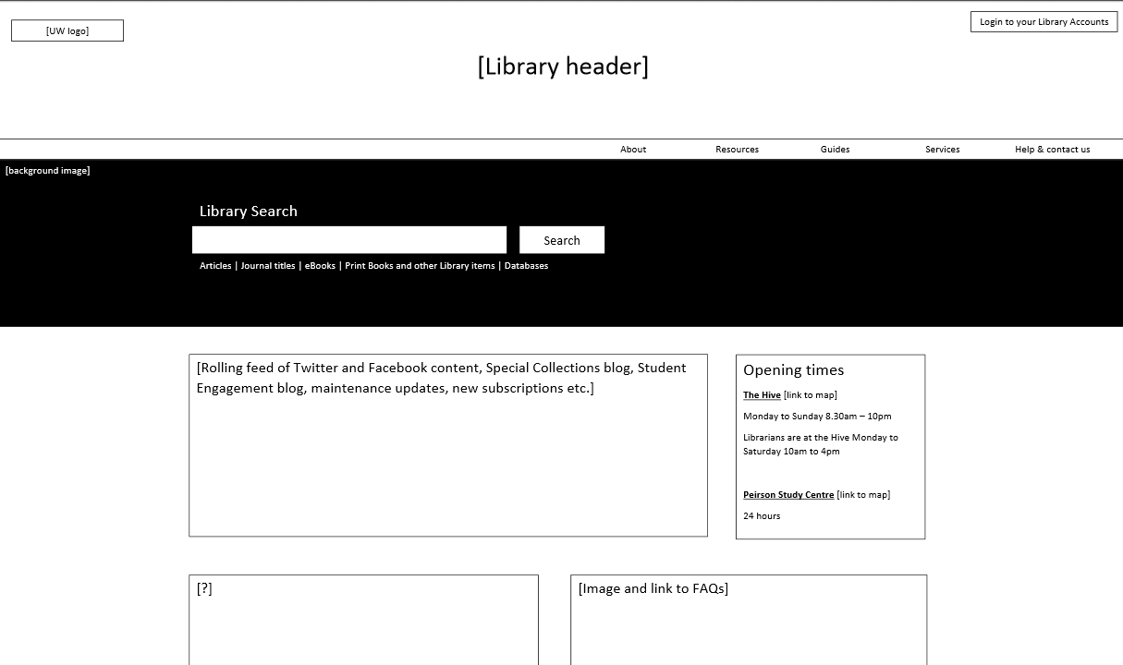
Notes:
Firstly, a single landing page, with consistent navigation and visual identity.

Slide 9
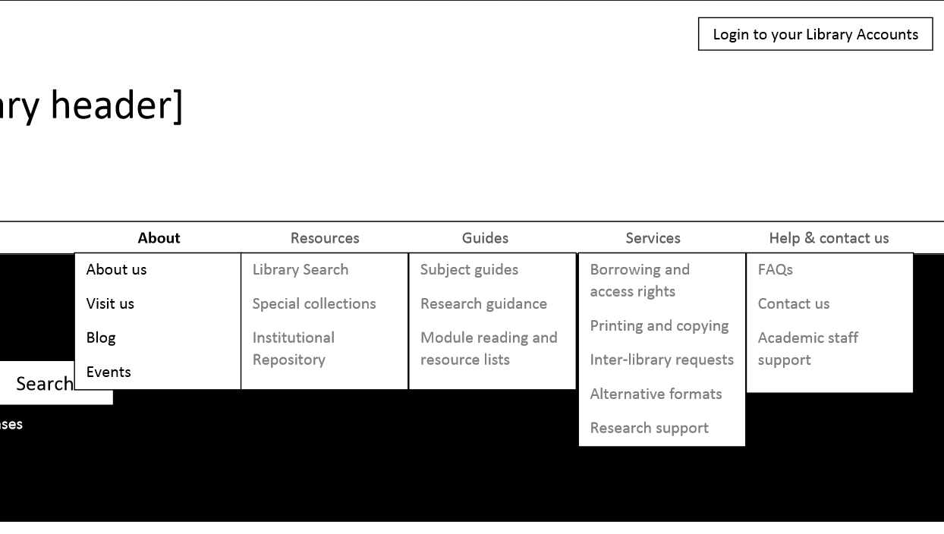
Notes:
All of our services would be accessible from the menu, with wording that made sense to the user, rather than following the departmental structure.

Slide 10
Notes:
Rather than having an alphabetical list of subject guides, we arranged them by institute. This was really important, as some of the existing guides covered a range of subjects which didn’t match course titles – for example, accounting students were supposed to use the business and management guide, which was difficult to find in an alphabetical list. This guide was eventually renamed as business, management and finance.

Slide 11
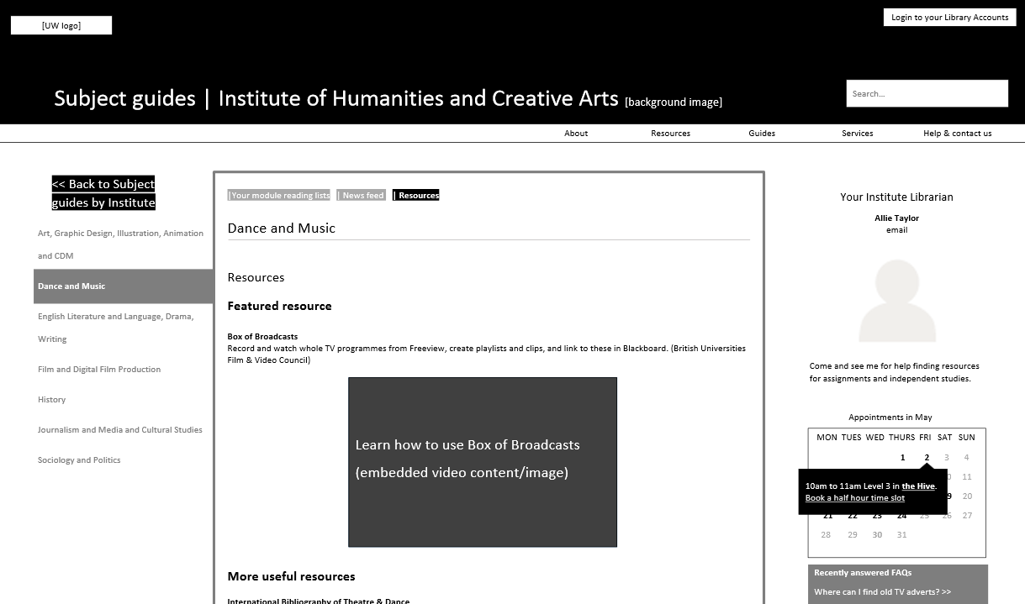
Notes:
Subject guides would only contain information specific to the subject, removing the replicated content on referencing, plagiarism etc.

Slide 12
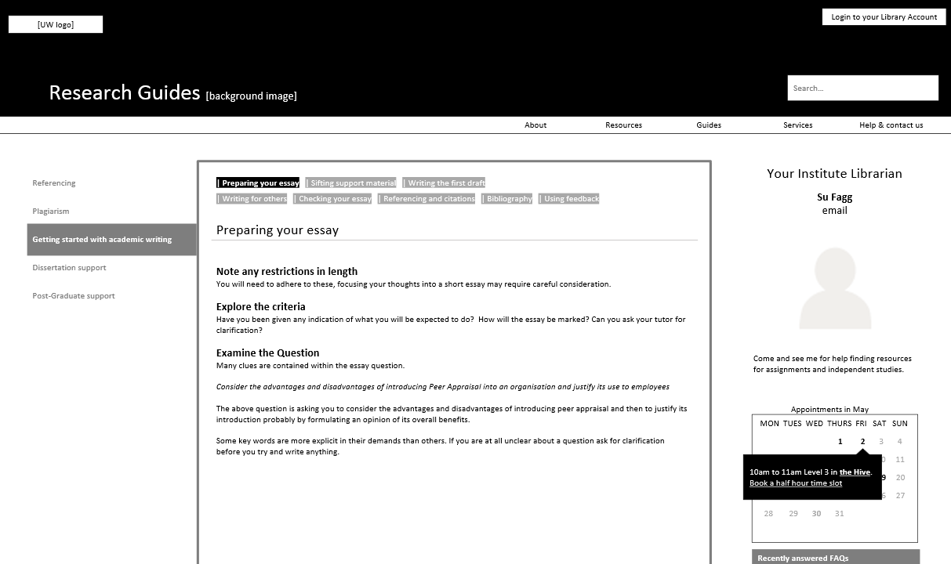
Notes:
Study skills information would be kept in one place.

Slide 13
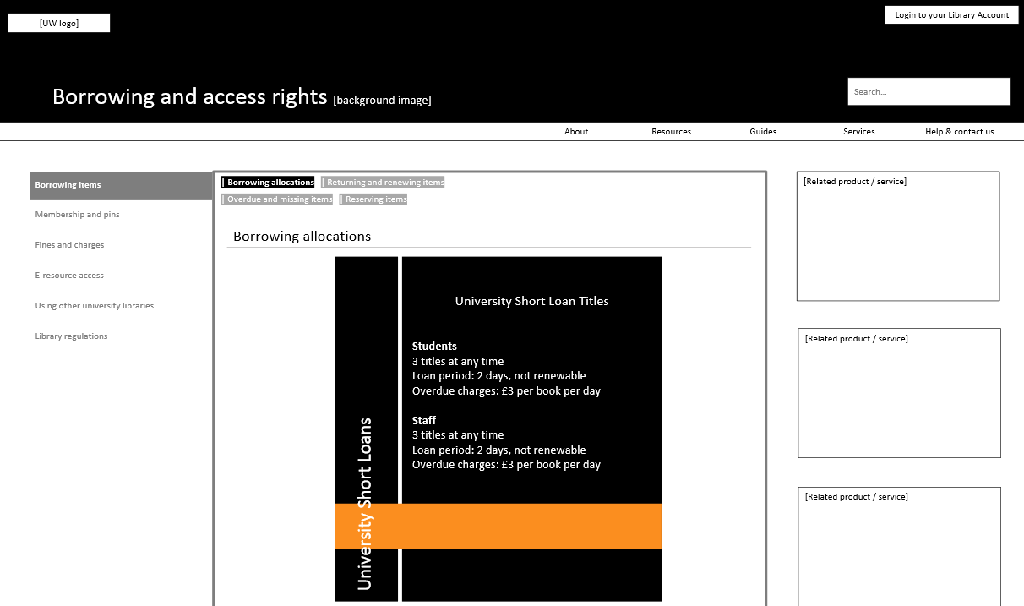
Notes:
Borrowing information would be ordered in a way that again, makes sense to the user.

Slide 14
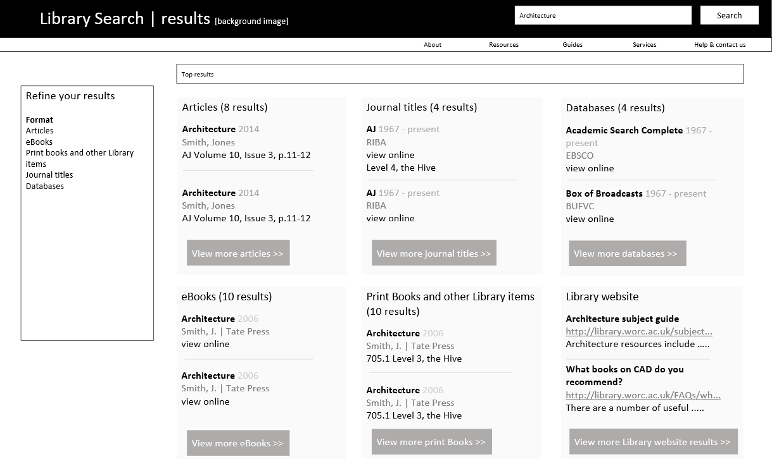
Notes:
Rather than expecting users to understand that Summon was a general search of both online resources and Hive holdings, and that the catalogue was better for Hive holdings, and if they wanted a journal they should use the journal A-Z – we decided to package the whole thing up as Library Search, with searches determined by item type. We dearly wanted a bento box interface, a la Cornell, but realized this would have to wait.

Slide 15
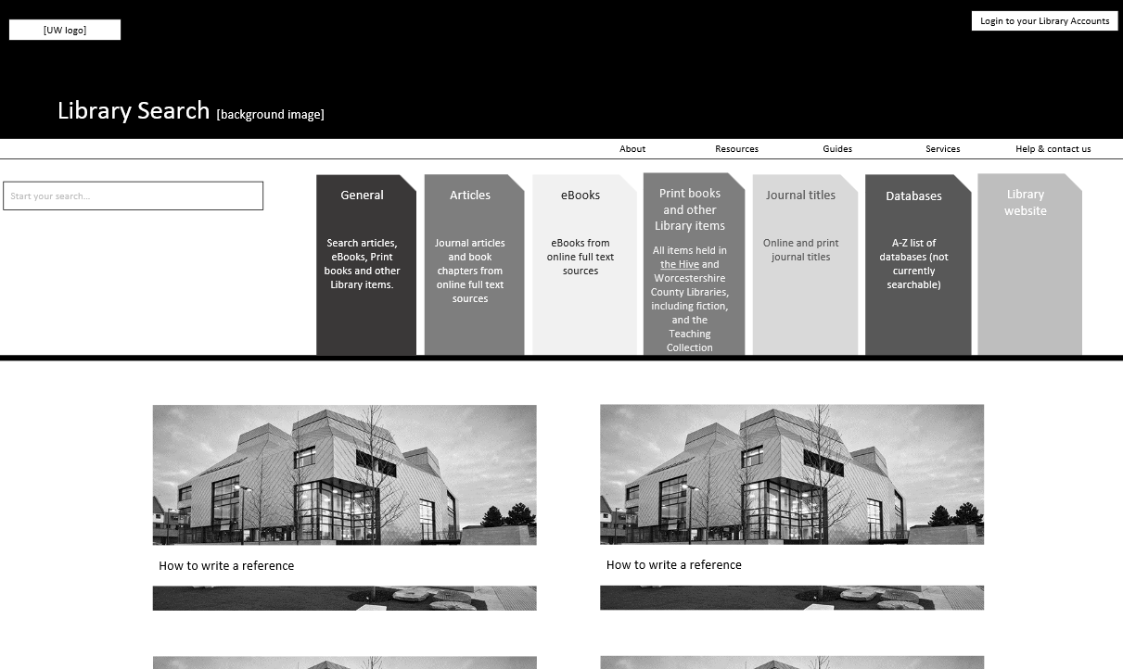
Notes:
This was our first Library Search prototype. A single entry point to our different searches, with each search dedicated to a resource type, such as articles, ebooks and journal titles. There are six systems behind Library Search.

Slide 16
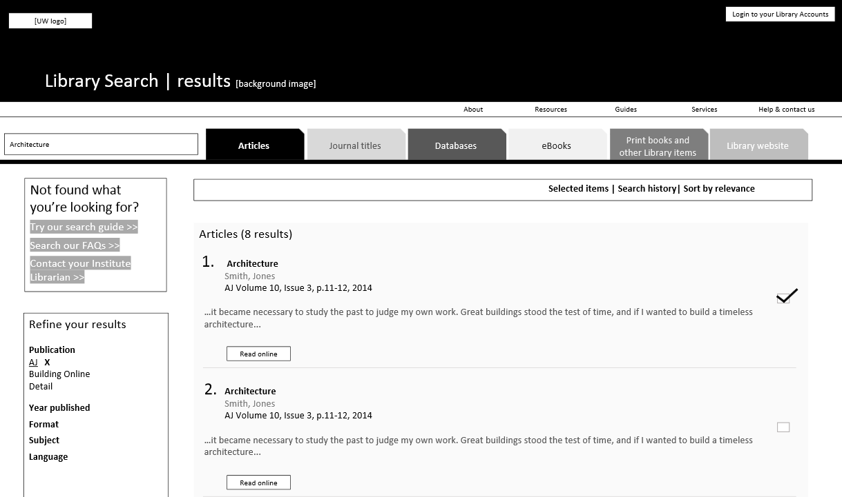
Notes:
The idea was for users to click the tabs to move between searches. Sadly this also wasn’t possible with the time we had.

Slide 17
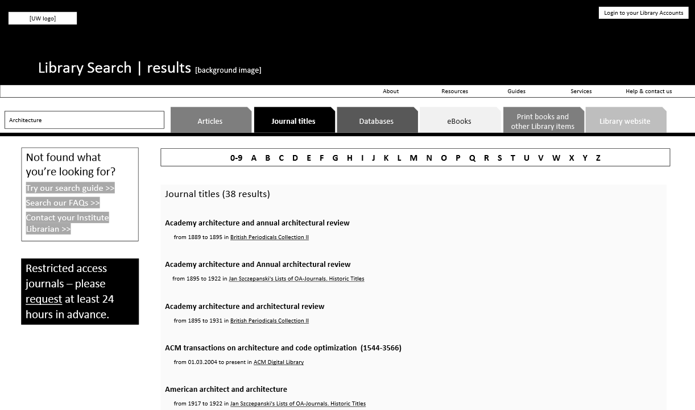

Slide 18
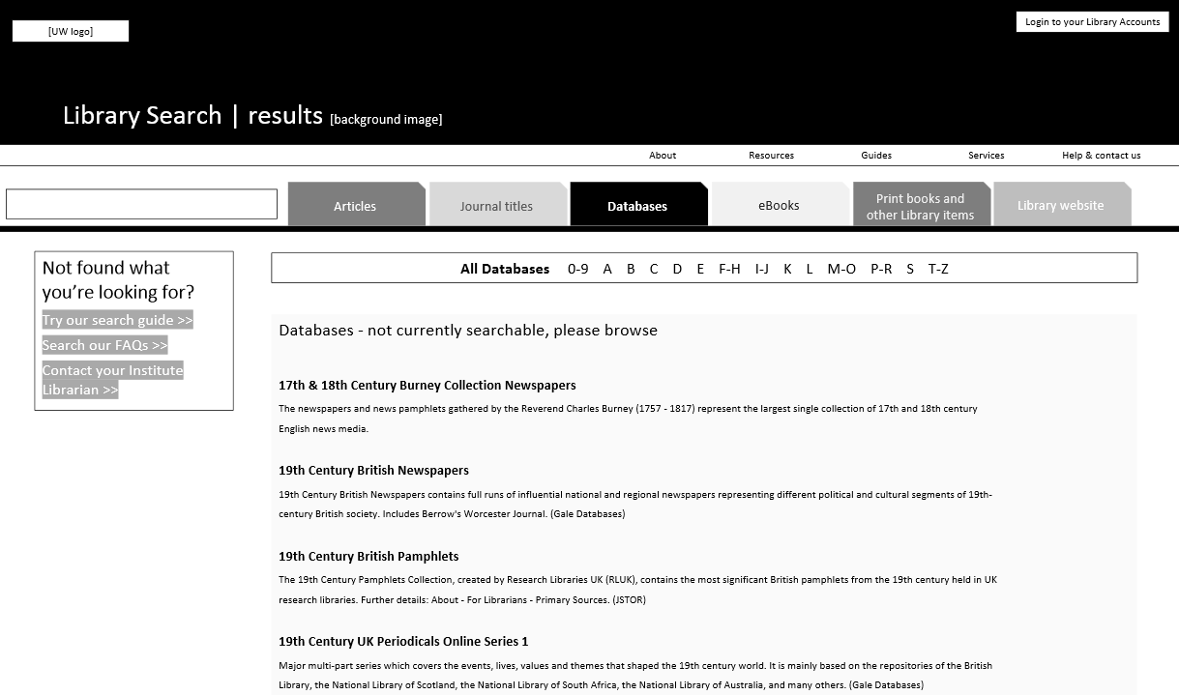

Slide 19
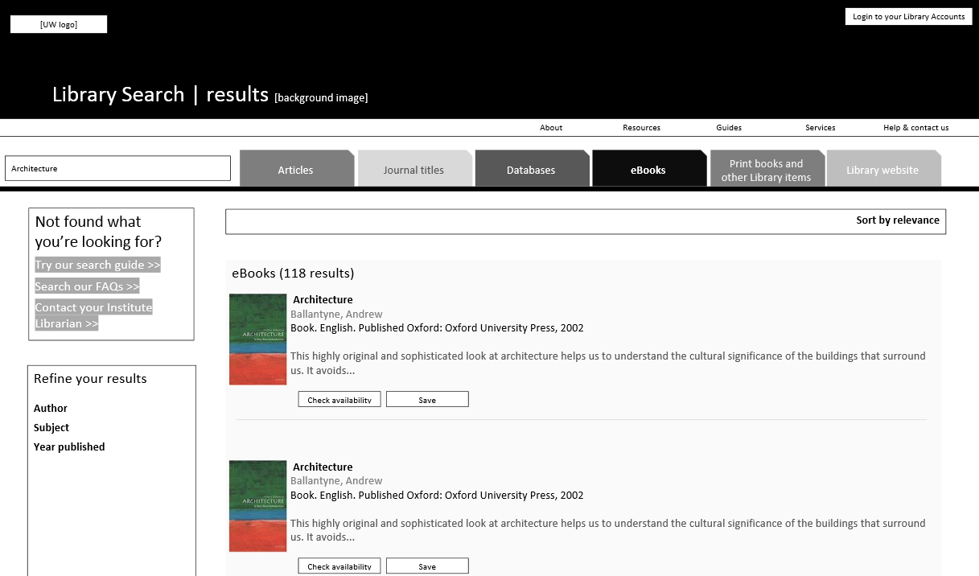

Slide 20
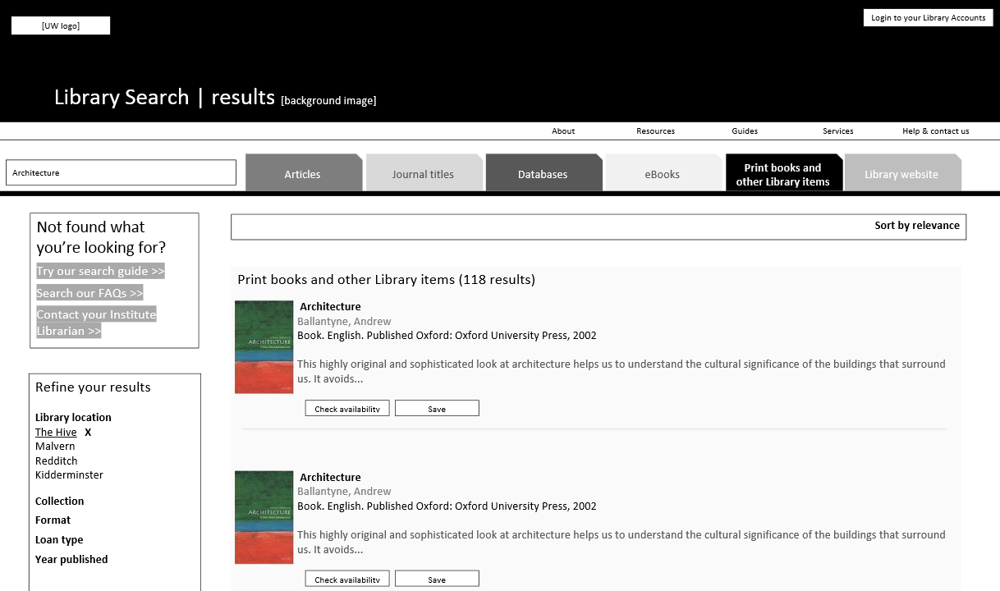

Slide 21
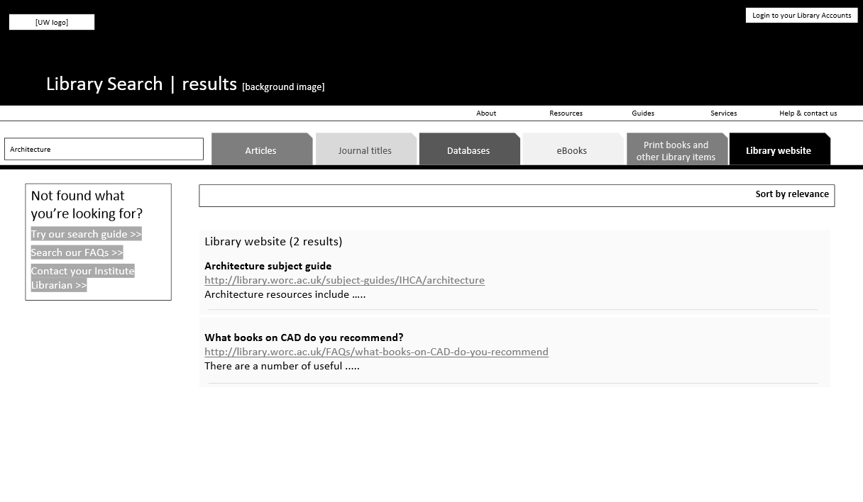

Slide 22
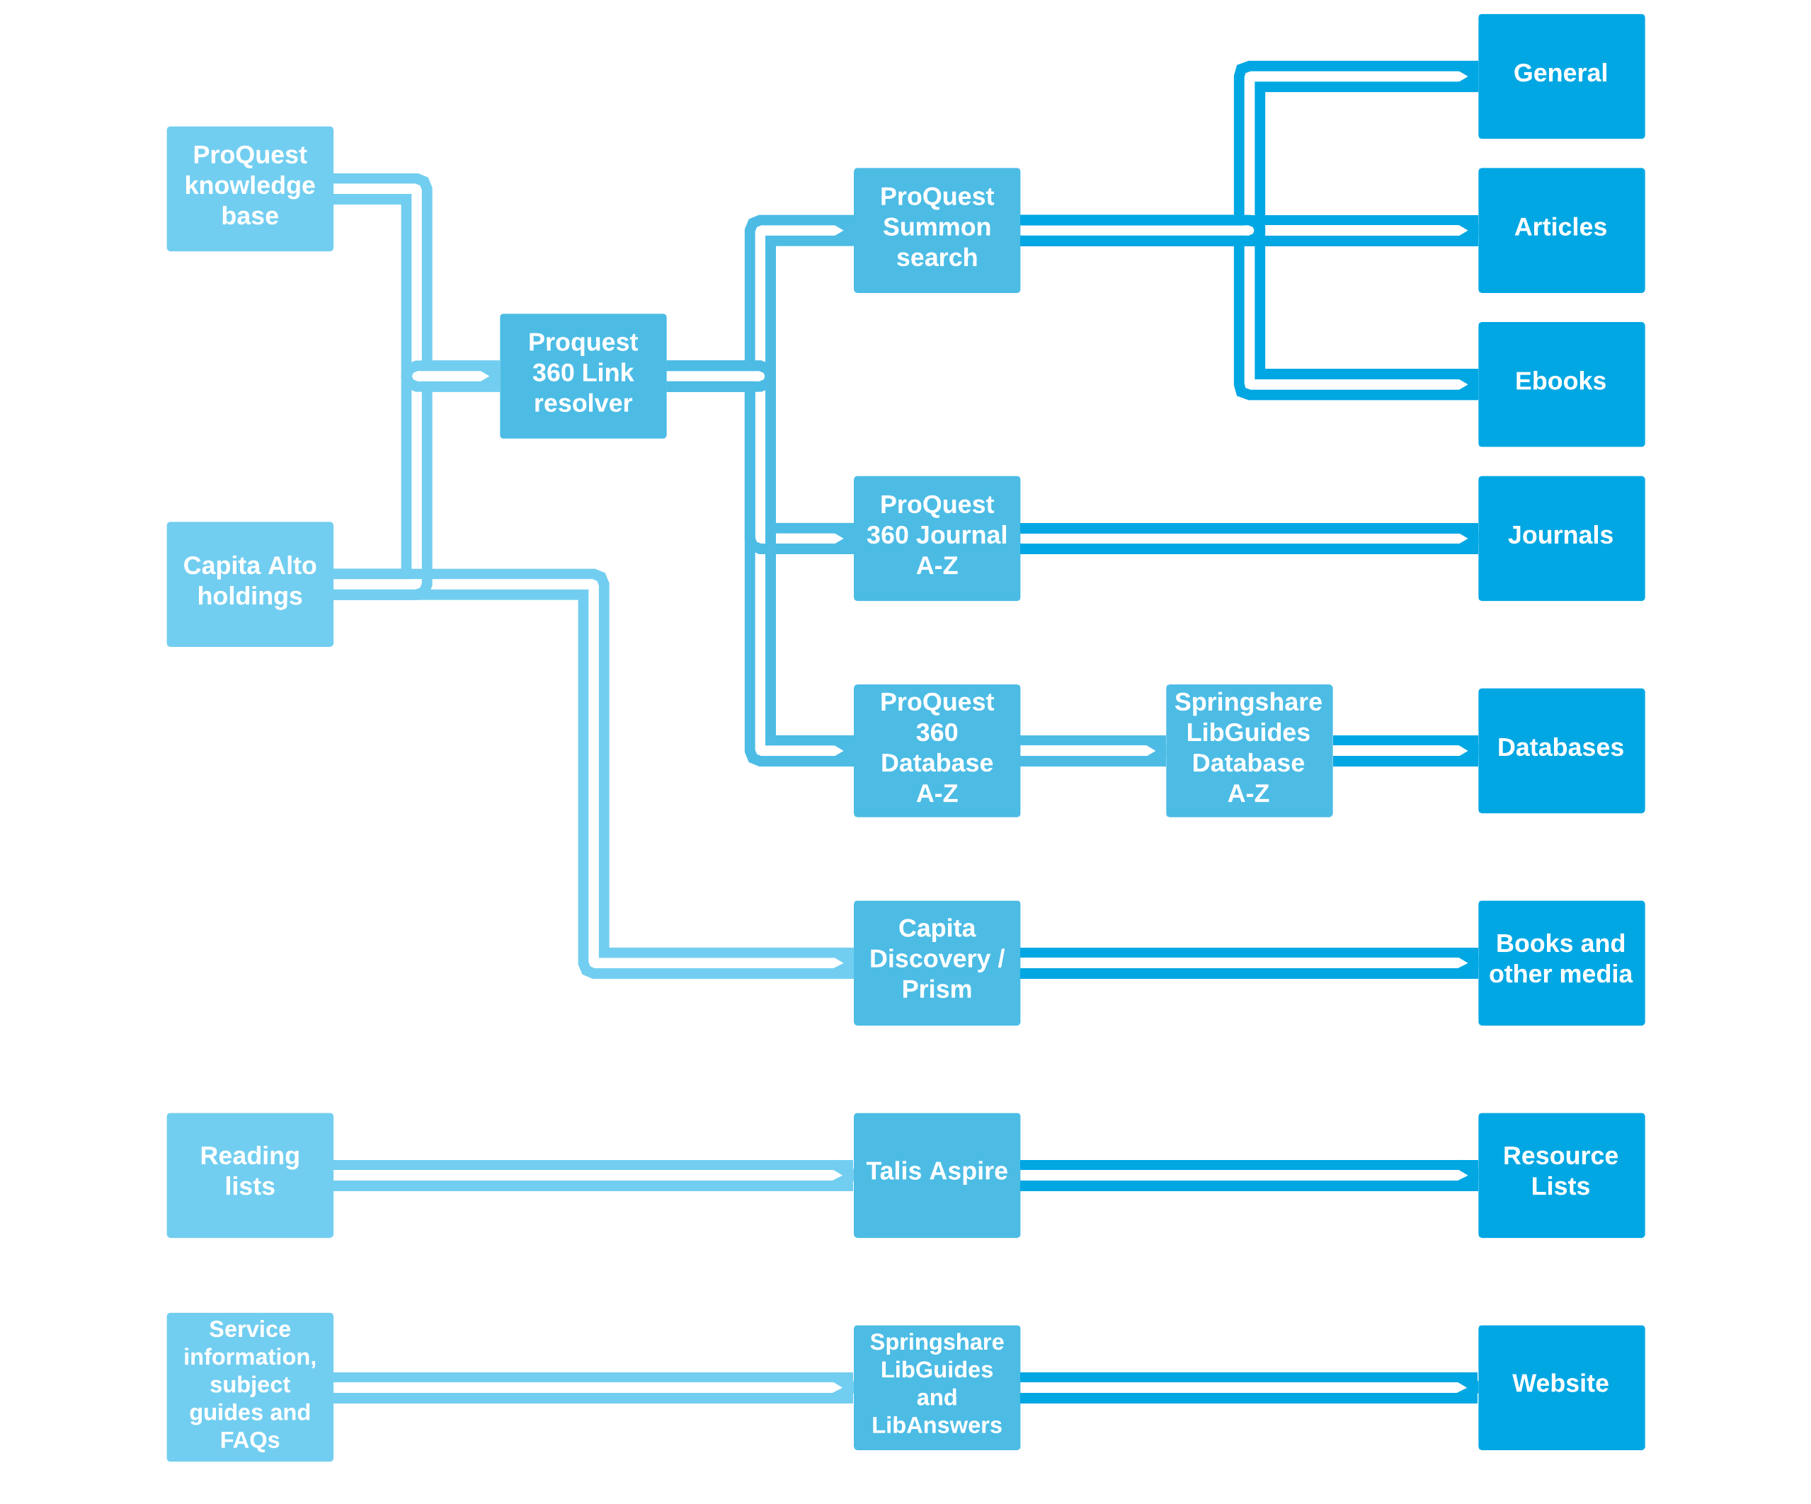
Sources Systems Library Search
Notes:
But by thinking about what the user needed, we were able to organise Library Search in a sensible way. This diagram shows the flow of information through our six systems into Library Search. We have ebooks in subscription packages and also individually purchased titles. The former are indexed in ProQuest’s knowledge base, the latter are catalogued in Alto, and both are fed through to Summon. Books and other Hive holdings, while also available in Summon, can only be reserved in the catalogue, which is why the books and other media search uses the catalogue.

Slide 23
Notes:
This is what we ended up with. We kept the tabs with dedicated resource type searches, but clicking search takes you to the relevant system, pre-faceted for each item type. We were able to add style sheets and top level navigation to two of the systems, further work needs to be done on the remaining four.

Slide 24
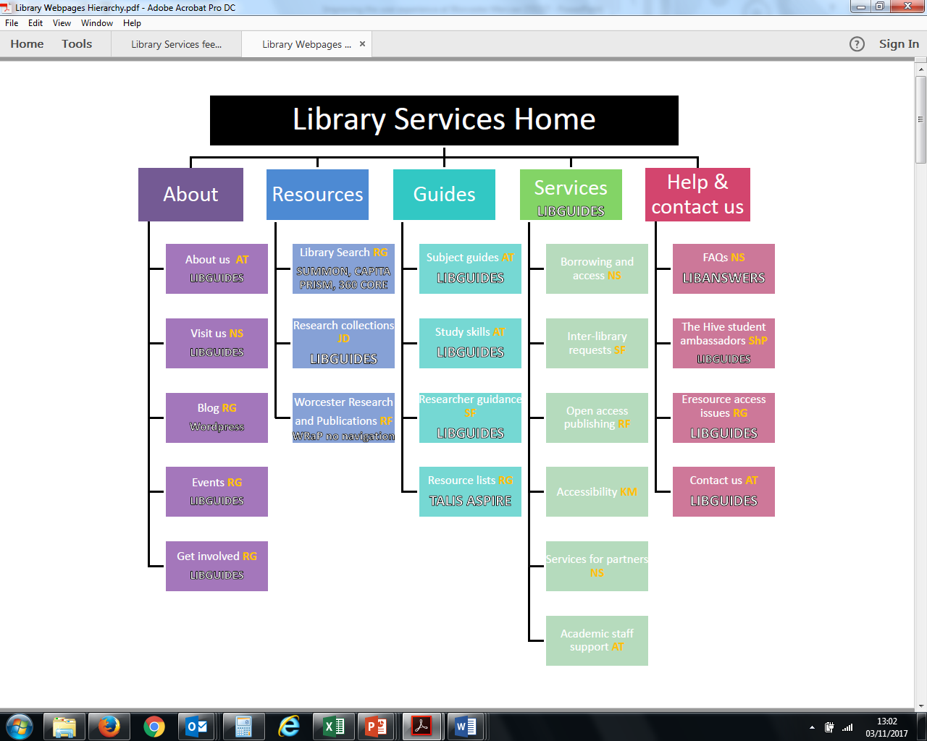
Notes:
But we still had to sort out the rest of the webpages. We created a working group, with a member from each team, and divvied up the website between us.

Slide 25
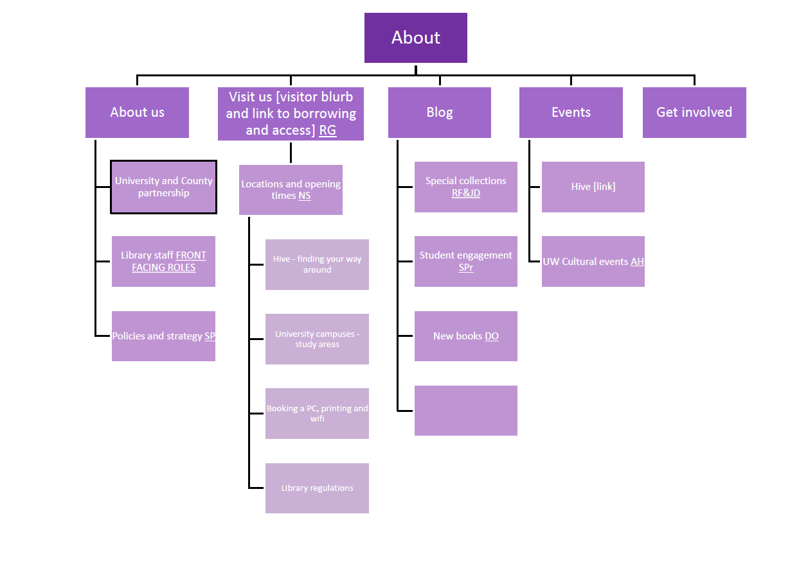
Notes:
As coordinator, it was my job to discuss each page with the lead to make sure it met best practice guidelines. The lead would then delegate pages to the relevant people.
At the same time, we arranged for writing for the web training to be delivered by some of our academics. Anyone who would be involved in maintaining a page had to attend.

Slide 26
Library Services supports University of Worcester students, staff and the local community on & off campus and in The Hive. The Hive is a joint university and public library with Worcestershire County Council.
Notes:
Through conversation, we were able to define ourselves as Library Services. We were finally able to articulate what our users needed and offer services that support them. By calling ourselves Library Services, we could communicate ourselves as a set of services that operates in and out of The Hive. We also decided to brand our website as worc.ac.uk/library, rather than libguides.worc.ac.uk, again for clarity.

Slide 27
Notes:
Creating content for the webpages was the most challenging aspect for the department. It meant a radical change in thinking about how best to present information, and we got some complaints, such as ‘this is dumbing down’, ‘ I want to sound more scholarly’. Again, this is where having lots of one on one conversations were helpful to making everyone feel comfortable – as much as possible. In addition to lots of conversations, I also put together best practice documents and examples on editing for the web, which helped everyone to understand the benefits of writing this way.

Slide 28
Notes:
I then put together a content form template, which each author would complete for each page. These pages were then reviewed by a lead from the working group, with a final check by me.

Slide 29
Notes:
Alongside all of this activity in the department, I was working with ICT to get the website actually created. We decided to use LibGuides because it had several really helpful features, such as a database a-z that updated in real time, and also, library services staff were comfortable using it.
These are the mock ups that informed the final design.

Slide 30
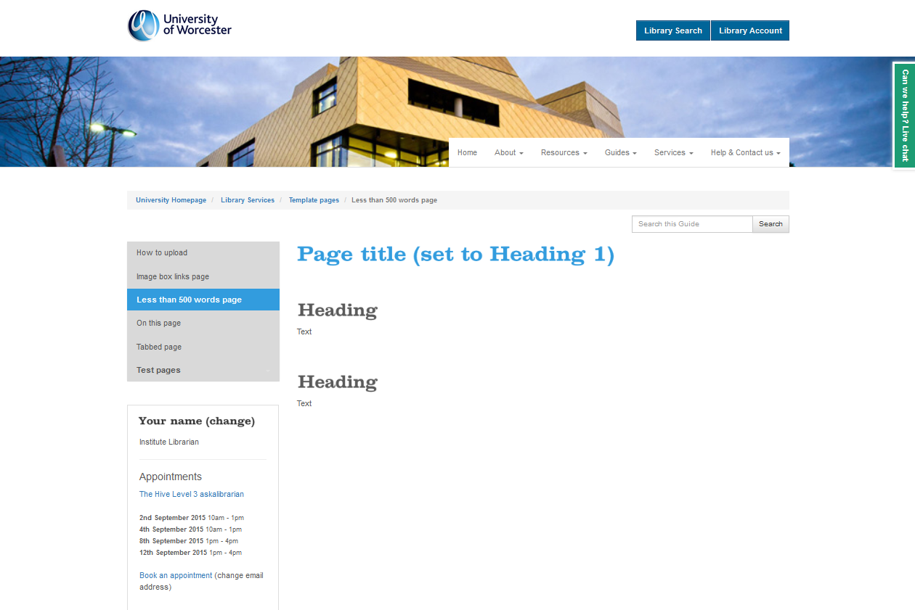
Notes:
And this is one of the templates, we created four in total on LibGuides, which we uploaded to a private set of pages alongside step-by-step instructions on how to upload.

Slide 31
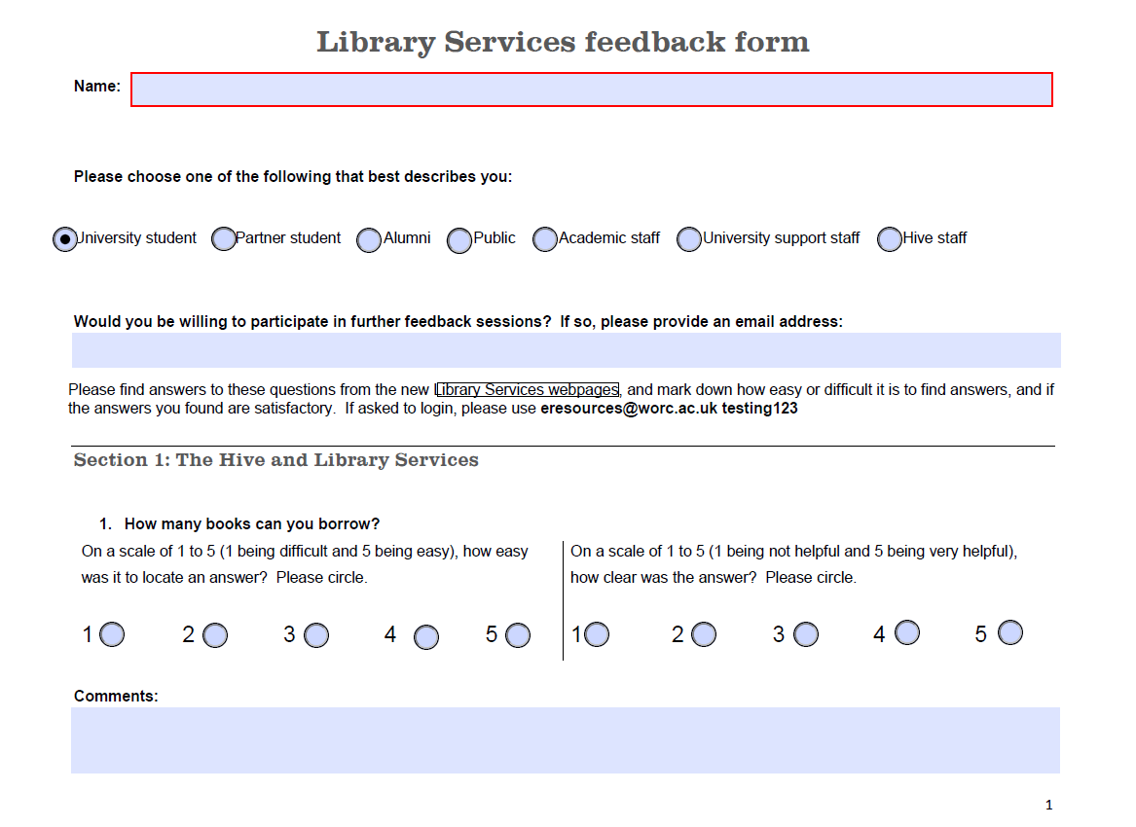
Notes:
Once all the content had been added, we started user testing. Each user would go through a series of tasks and score the ease and clarity of each while a member of the working group noted their reactions.

Slide 32
Notes:
We gathered the scores and comments and made adjustments.

Slide 33
The library team have been fantastic in their support as well as the great layout of the site. It makes it very easy to get on with using the services for research!
Much better, much clearer, more information
I think it is great! :)
Huge improvement, easier to navigate
Looks slicker, more clear and user friendly
Less links to get to things
Good to have it all in one place. Really like it. Really good.
I love using the library services
I think you have thought of everything
Notes:
Finally, we were live after 5 months of work – but we weren’t done with user testing. A pop up invited feedback, and we had 174 responses, 87-97% of which were positive. Again, we reviewed all comments and made changes.

Slide 34
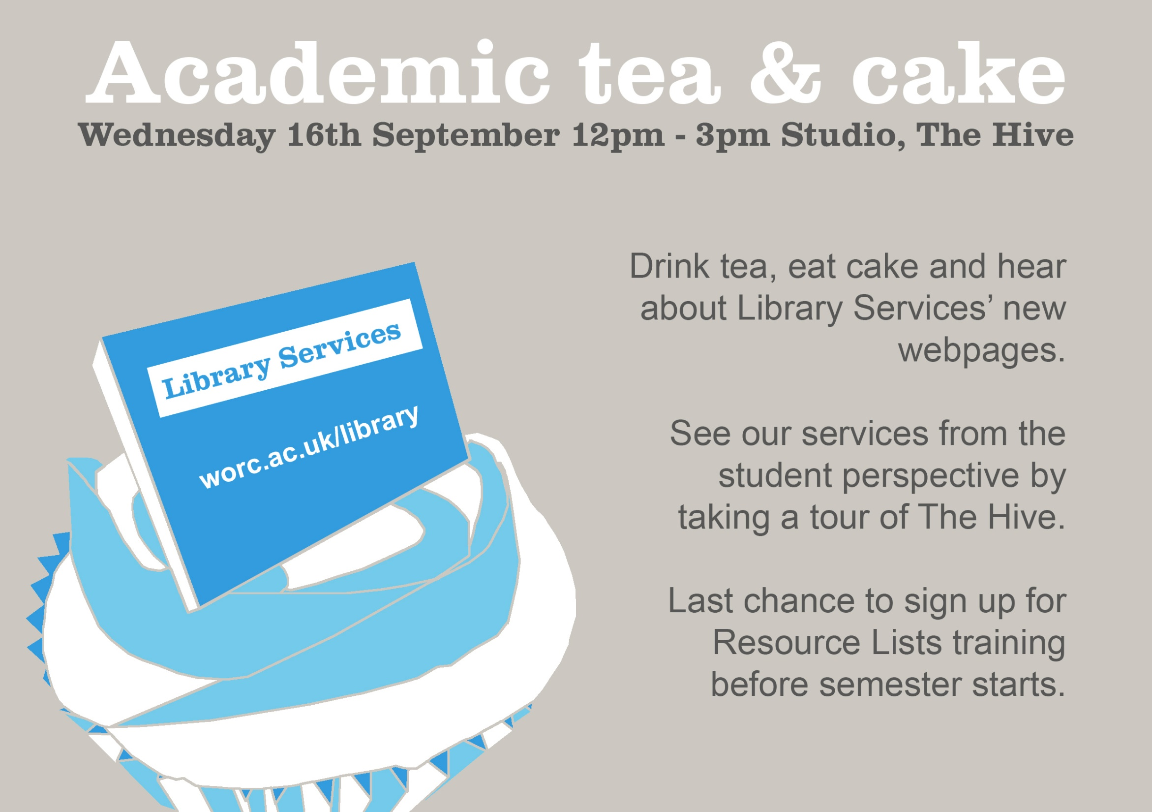
Notes:
We also ran several promotions, from an all staff email to a tea and cake afternoon.

Slide 35
Notes:
And the outcome? We attracted 204% more page views vs the previous academic year.
Usage of our large journal packages increased overall by an average of 44%, without any major changes to their titles. Subject guides page views increased approximately 35%.
The new website has also been credited with contributing to an increase of 3% to the University’s NSS score for library resources.

Slide 36
