Slide 1
A role for evocative objects within educational research: reflective practice

Slide 2
Research as a superordinate category
Qualitative – understanding, descriptive detail, depth, perspective
Quantitative – explanation, statistics, causality, breadth
Mixed methods – combination of the above – regards the distinction as normative and unhelpful (Denzin & Lincoln 2011)
Generative social research – values generating ideas, elaborative interpretation, possibility thinking, creative responses to data, burgeoning of experience, theorising – less concerned with validity and reliability

Slide 3
The landscape of educational research
Evaluation of quality may favour central members of the category e.g. Government sponsored research studies
Alternative quality criteria may have greater legitimacy where less central forms of research are categorised as part of an alternative superordinate category e.g. generative social research
Art based research

Slide 4
Creative analytic paradigm
the evocative objects model involves developing a state of being-in-relation-to the object that is both generative and divergent
a serendipitous background activity rather than an exhaustive systematic active interrogation and extraction of meaning

Slide 5
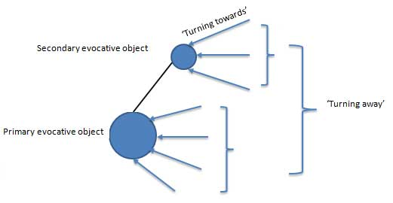
Generative divergent analysis (GDA) model

Slide 6
Satellite topics and conceptual canvas
Potential rhizomatic structure
Some satellite topics are likely to be more developed than others
Coloured circles represent evocative objects
Circles with strands are satellite topics

Slide 7
Outcomes
contributing to and increasing the complexity of the everyday professional conversation. The conversation itself is not aimed at proving or confirming anything but focuses on sharing experiences, suggesting questions and raising awareness of potential decision points, unsettling established viewpoints
“Our propensity to change practice is a function of the attractiveness of a set of ideas, rather than the rigour of a body of data-based conclusions” (Eisner, 2005, p.89)

Slide 8
Insignificant detail:- Pictorial timetable
Me. “How do the children know what they are going to do during the daytime? In some schools they have a sort of picture line or something like that.”
S. “We were… we are … it’s in the pipeline …we don’t have one yet…!”
Link to virtual tour

Slide 9
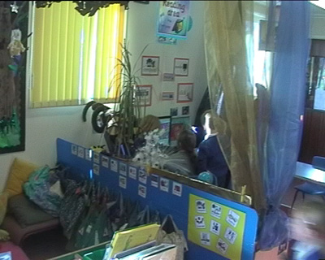
Reading area
Pictorial timeline/ timetable
Coats and bags
Notes:
1/ I didn’t notice the coats and bags until these were pointed out to me
2/ The student teacher was unaware of the pictorial timeline/timetable. When attention was focused on it she explained, not very convincingly, that there was no room at the front of the class so it had to go there!

Slide 10
Possible meanings:
Reminder
Independence
Teacher’s authority
Communication with parents
Timetable design –
e.g. size and
nature of the images
Learning support –
e.g. if relocated to maths area
‘to do’ list / message board within HighScope approach
Notes:
- Size of timeline may suggest the rigidity of the organisation of the day and the power of the teacher when changing what happens
during the day
- The nature of the images may suggest: the character of the activity

Slide 11
Applying the GDA model
Home domain: organising the day
Alternative domain: support for learning
Alternative domain: parental involvement
Alternative domain: design
Alternative domain: authority of the teacher
Alternative domains relate to fluency and flexibility – possible meanings
‘Turning towards’: children leave their book bags in the reading area and incidentally get reminded of how the day is structured

Slide 12
‘Turning away’ from the timeline
Consideration of different pedagogical approaches e.g.
Displayed timeline: ‘Reggio Emilia’ approach – Classroom as the third teacher
No timeline: ‘Montessori’ approach – Natural biorhythms of the child
Active timeline: HighScope approach – active ‘plan, do review’

Slide 13
‘Turning away’
Classroom as the third teacher: ‘Reggio Emilia’ approach – displayed timeline
Broadening the concept of reading or learning mathematical concepts
Discourse of parental involvement relates to Laclau & Mouffe (hegemony/antagonism)
Self regulation/… relates to Foucault (Insidious disciplinary technologies)
Independence/…interdependence - relates to discourse of quality re. cultural values
Structure/… independence/… relate to Derrida (binary analysis)
Home domain: organising the day
Alternative domain: support for learning
Alternative domain: parental involvement
Alternative domain: design
Alternative domain: authority of the teacher
Notes:
NB: constructivist perspective on classroom displays as resources for learning

Slide 14
In contrast to this elaborating interpretation…
the teacher’s actual intention was to locate the timetable in order to support the Asperger’s Syndrome child in her class.

Slide 15
Perspectives on Reflective practice
“a research process in which the fruits of reflection are used to challenge and reconstruct individual and collective teacher action” (Ghaye 1998 p. 5).
“a set of abilities and skills, to indicate the taking of a critical stance, an orientation to problem solving or state of mind” (Moon 1999 p. 63)
A range of recent models have been presented by Bradbury et al 2010 in Beyond Reflective Practice: new approaches to professional lifelong learning

Slide 16
Moving away from a positivist search for the truth
A major theme within reflective practice is clearly highlighted within Whitehead’s (2008) concept of ‘living theory’:
‘What can I do to improve my practice?’
The concept of ‘improvement’ is situated within a consideration of ontological values
Brown & Jones (2001) concept of postmodern action research is less directly focused on improvement
Form of critical pedagogy aimed at questioning regimes of truth
Directly connected to questions of equity and social justice

Slide 17
Turkle, S. (2007) Evocative Objects – things we think with, London, The MIT Press
Compilation of brief reflections by a range of contributors including psychologists, philosophers, designers, architects and musicians
The reflections are based on everyday objects, where the object was chosen for having some emotional and intellectual significance e.g. a cello, ballet slippers, a bracelet, a silver pin, a suitcase and apples.

Slide 18
There are 34 reflections in total, each preceded by a short extract selected by Turkle expressing a theoretical position intended to extend the depth of engagement with the objects.
The reflective pieces have been grouped in terms of the way in which the writer has related to the object e.g. ‘objects of play and design’, ‘objects of transition and passage’, ‘objects of discipline and desire’.
The final chapter revisits the reflective pieces as themselves being regarded as an evocative object also.

Slide 19
“centrepieces of emotional life” (p.6)
“the object as a companion in life experience” (p.5)
“particular objects with rich connections to daily life as well as intellectual practice” (p.7)
“provocations to thought” (p.5)
Turkle, S. (2007) Evocative Objects – things we think with, London, The MIT Press
Notes:
Harman, G. (2008) Zeroing in on Evocative Objects. Human Studies, 31, 443-457.

Slide 20
Ambiguity
The ambiguity of ‘remarkable moments’, ‘bafflements’, ‘active interpretations’ (Brown & Jones, 2001) can be productive of multiple elaborations.
"By productive ambiguity, I mean that the material presented is more evocative than denotative, and in its evocation, it generates insight and invites attention to complexity. Unlike the traditional ideal of conventional research, some alternative forms of data representation result in less closure and more plausible interpretations of the meaning of the situation" (Eisner, 2005, p180).

Slide 21
Questioning regimes of truth:
“Surely even the dullest of objects are laced with songs and legends that await their bards” (Harman 2008 p.455)
Referring to Foucault’s perspective Mac Naughton (2005) emphasised that
“our will to truth – produce[s] inequalities because it is a violence to be ‘enslaved’ within a regime of truth” (p. 43)

Slide 22
Generative social research
‘descriptive vividness’ /
‘thick descriptive detail’
reduce ambiguity, evocativeness and the need for interpretation
Moved away from the search for ‘truth’
Moved away from being confined by boundaries of legitimacy
Evocative objects

Slide 23
A tranquil lake rather than rat race river rapids model
Evocative objects support a more rounded experience
Evocative objects support a more contemplative disposition
Evocative objects support divergent thinking and creativity
Evocative objects can be used to support a relationship model which values the other and the relationship rather than being an interrogation of the data
Raising insignificant details of experience to significance

Slide 24
Extra details – may delete
The rat race, river rapids model
Research questions focus attention and filter out irrelevant details.
Research questions relate to the ideal of systematic data collection and analysis.
Research questions support a model of research valorising interrogation of the data.

