Slide 1
Prime Minister’s Challenge on Dementia Intergenerational Schools Project
Teresa Atkinson
Jennifer Bray

Slide 2
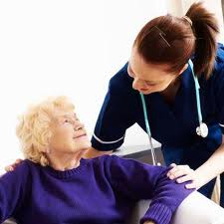

Slide 4
Building Emotional
Resilience

Slide 5
Project overview
Dementia is a growing global concern
Between 700,000 and 800,000 people living with dementia in the UK
The Prime Minister’s Challenge on Dementia developed to focus on:
Driving improvements in health & care
Creating dementia-friendly communities
Better research
Intergenerational Schools Dementia Project

Slide 6
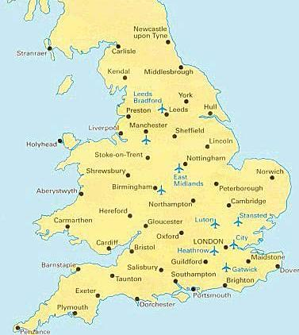
Pioneer Schools Pilot
22 Schools
Involved
19 schools delivered a dementia curriculum
13 took part in the evaluation
(6 Primary
7 Secondary)
Primary
Secondary

Slide 7
Four key areas addressed:
Understanding dementia
Caring for someone with dementia
Assistive and digital technology
Meeting someone with dementia

Slide 8
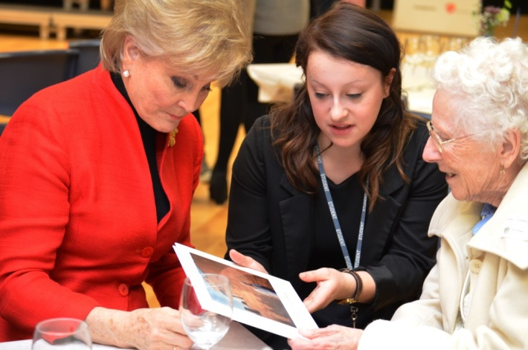
Curriculum approaches
Dementia awareness lessons (Assistive Technology, the brain, memory, ageing, living well with dementia)
Meeting someone with dementia & their carer
Debates
Life histories
Drama, art, music
Singing/choir
Tea parties
Dementia Ambassadors
Whole School Assemblies led by pupils
Northfleet Girls School, Kent

Slide 9
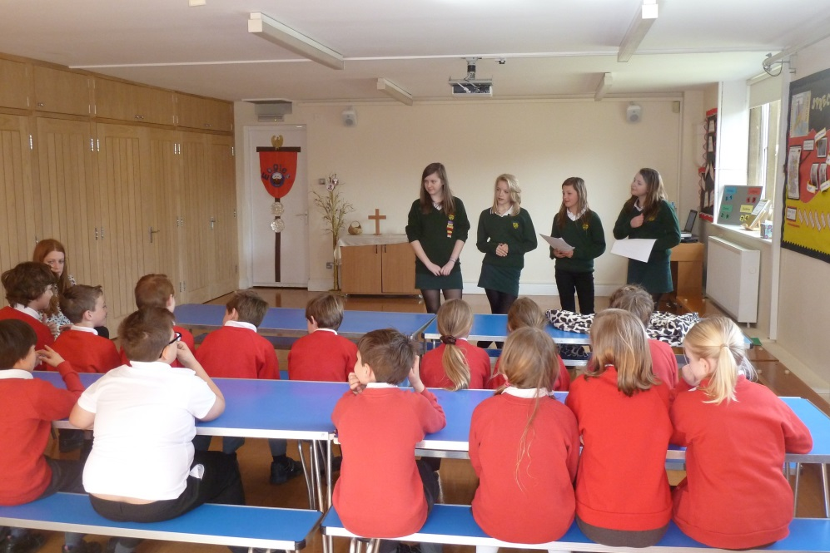
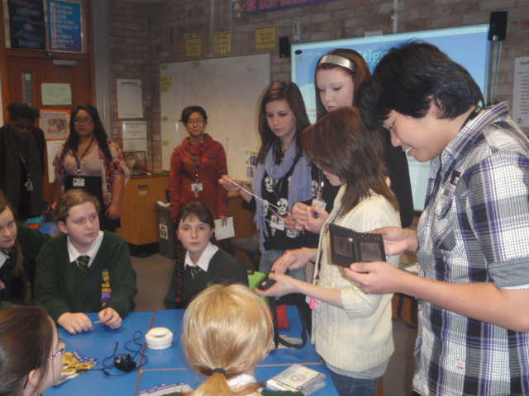
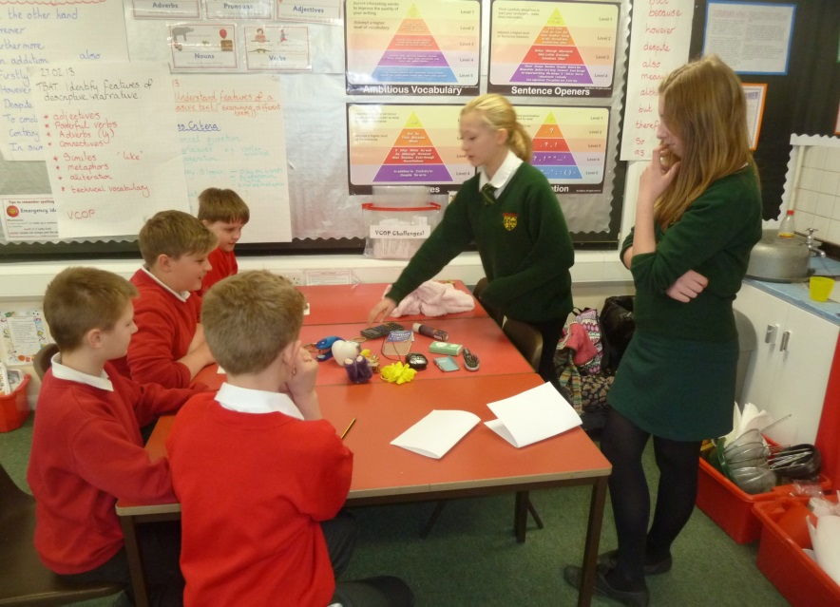
Peer to Peer Education
Gloucester College teaching Newent Secondary
Newent Secondary working
With Gretton Primary and
Harewood Junior School

Slide 10
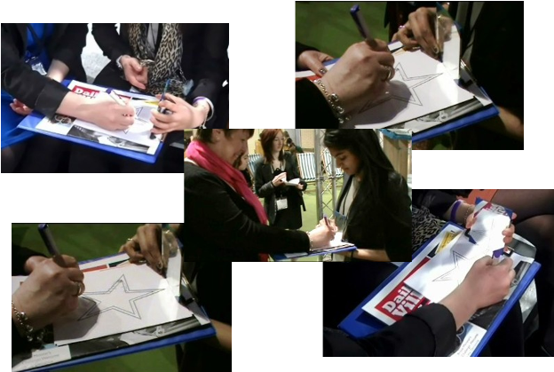
Experiencing difficulties
“it’s harder than it looks”
“it gets quite tiring,
annoying”
“Just by doing simple activities you can see how difficult it must be for them [...]
that was quite a big learning experience, ‘cause we didn’t expect it to be as bad”

Slide 11
Life story books

Slide 12
Northfleet Girls School, Kent
http://www.youtube.com/watch?v=G9HSaQ86x_A

Slide 13
Key benefits for pupils:
Increased awareness of dementia;
Reduced stigma and fear;
An appreciation of the caring role and how to support carers;
Increased awareness of how to help people with dementia to live well, and the challenges and negative attitudes they may face;
Helped pupils with family experience of dementia to understand the what is happening.
“My grandfather has dementia. I felt very strange with him when I was told because he didn’t seem like my grandfather any more. After these lessons I can understand what it is like for him and have been more able to talk with him and to see that he is still my grandfather”

Slide 14
Impact on Teachers:
Improved knowledge of dementia;
Talk more openly about dementia;
“I’ve spoken about it to people I wouldn’t have spoken about dementia to”
Understand the importance and relevance of dementia in a school setting.
“It is absolutely about children’s health and well-being ‘cause of course we’re all affected by people in our community who have dementia”

Slide 15
Impact on Wider School Community:
Greater awareness of dementia;
Parents are able to have conversations about dementia with their children;
Particularly helpful for pupils and teachers with experience of dementia;
“A number of the children and staff at the school had already been touched by family members, friends and neighbours having dementia, and were struggling to some to terms with what was happening to that person”
Pupils have a greater understanding of the responsibilities and pressures facing parents or relatives who are in a caring role, either professionally or personally.

Slide 16
Impact on Wider Community:
Being involved in the project helped some carers to see their loved ones in a different way and reconnect with them;
“It helped me to re-engage with Mum as a person, and not just somebody with a disease that needed looking after. It helped me remember the precious memories that can so easily be lost in the day to day routine of caring”
Taking part in some of the activities had emotional cognisance for some of the people with dementia involved in the project;
“There were discussions about the issues surrounding the photos, people in her life, and her likes and dislikes. Invariably, Mum had a lovely smile when relating these events and issues. She seemed so much more animated than was her usual demeanour”
Community awareness of dementia is likely to have increased due to indirect contact with projects.

Slide 17
Summary of findings
Range of interventions adopted during pilot
Successful regardless of approach
Benefits outweighed initial challenges
Suitable approach available for any school
Key elements of a successful project:
Need lead teacher with sufficient time and support
Ring-fence time in curriculum
Teachers need appropriate dementia knowledge
Share resources from pilot phase
Information sessions for teachers
Establish links within school and local community
Involve pupils and staff when developing ideas

Slide 18
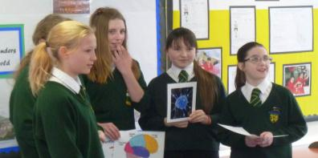
In their words
“The children are now more confident and have a greater insight into a widespread issue affecting their lives and communities.”
Ruth Robinson, Teacher
Christchurch Primary School, Gloucestershire

Slide 19
The project continues
Phase one – 22 Pioneer schools
West Midlands primer and NHS videos
11 council areas
2,000+ young people
Phase two – 100+ schools
Dementia resource suite for schools www.dementia4schools.org
60+ council areas
120,000+ young people
Phase three
Targeting slow take up and Masterclasses

Slide 20
5 opportunities
A theme to hang learning on
Cross-curriculum opportunities
Better engagement with curriculum
Supporting pupils who are vocationally focused
Dementia friendly communities
Providing a focus for local communities
Putting schools at the centre of that community
An aid to early diagnosis
Skilling-up fresh pairs of eyes to identify changes
The uninhibited imagination of children
Creating an outlet for new ways of learning and interacting with people across generations
Notes:
Cross curriculum opportunities beyond citizenship and PSHE.
Supporting pupils who are vocationally focused with appropriate styles of learning .
Providing a focus for local communities and putting schools at the centre of that community.
Skilling up fresh pairs of eyes to identify changes in behaviour and skills.
Creating an outlet for new ways of learning and interacting with people across generations.

Slide 21
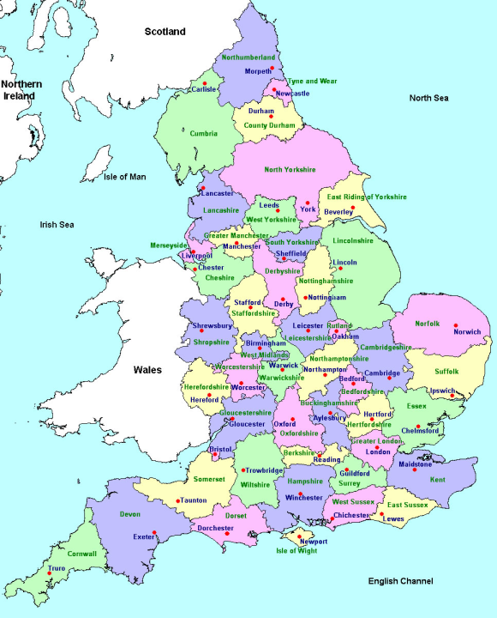
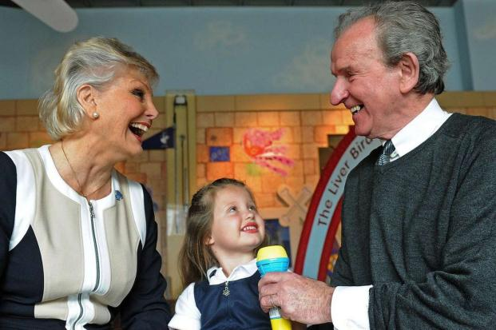
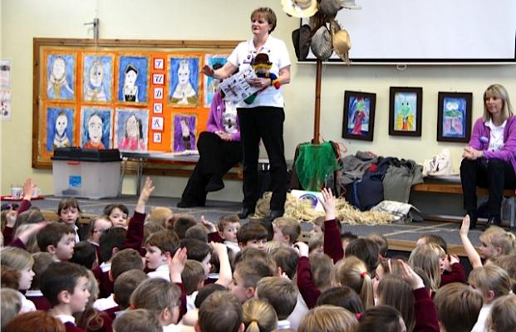
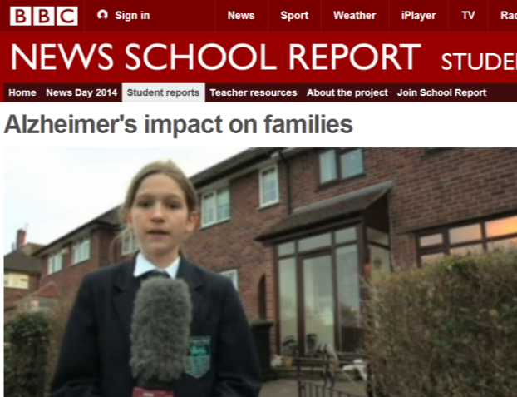
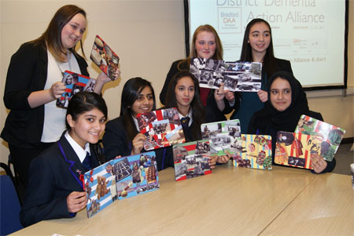
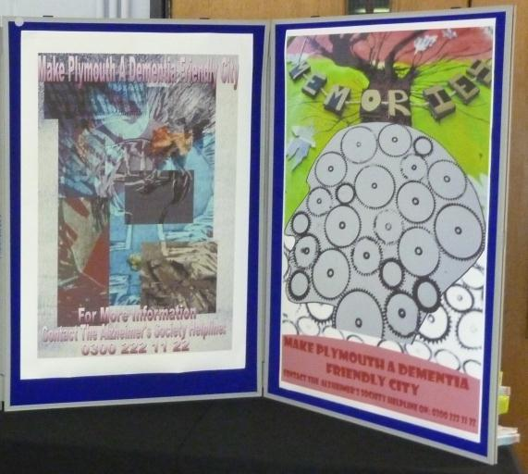
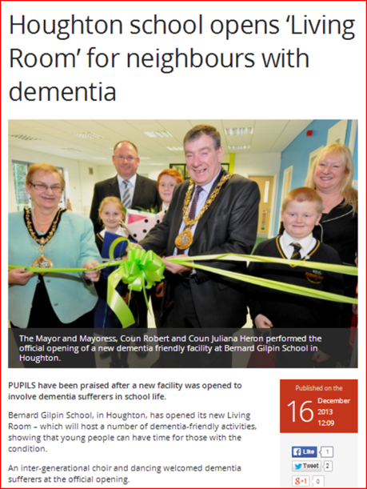
Sunderland
Bradford
Liverpool
Cheshire
Somerset
Kent
Plymouth

Slide 22
In their words
“This is such a great opportunity. I think every child should be given the chance to do this.”
“It’s so important for us to know this sort of thing; they definitely should be learning it in all schools.”
Isobel & Coral, pupils
Swanshurst School, Birmingham

Slide 23
And finally...
“People with dementia are just like other people they just need a little bit of help”
“I’m glad I now know about dementia so now I’m ready if any of my family get it”
© The Association for Dementia Studies

Slide 24
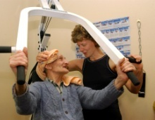
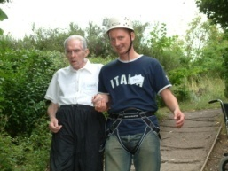
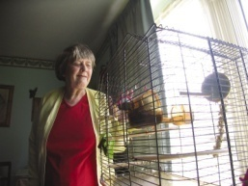
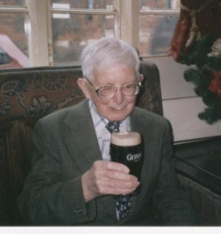
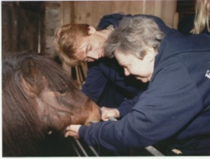
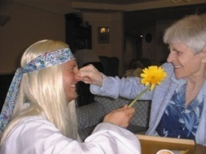
Thank you for listening!
Teresa Atkinson & Jennifer Bray
Association for Dementia Studies
University of Worcester
t.atkinson@worc.ac.uk j.bray@worc.ac.uk
http://www.worc.ac.uk/discover/association-for-dementia-studies.html
www.dementia4schools.org

