Slide 1
Mixed methods evaluation of the Intergenerational Schools Dementia Project
The challenges of working with children (and teachers)
Jennifer Bray

Slide 2
Project overview
Dementia is a growing global concern
Between 700,000 and 800,000 people living with dementia in the UK
The Prime Minister’s Challenge on Dementia developed to focus on:
Driving improvements in health & care
Creating dementia-friendly communities
Better research
Intergenerational Schools Dementia Project

Slide 3
Aims of the project
Four main aims:
Raise awareness and understanding of dementia
Appreciate the difficulties of caring for someone with dementia
Understand the role of assistive and digital technology
Meet someone with dementia
22 schools engaged in initial pilot phase
Implement dementia curriculum during 2012/2013 academic year

Slide 4
The evaluation
How do we measure the impact of the dementia interventions?
Each school used its own curriculum approach
Wide range of pupils involved (5-19)
Chose mixed approach
‘Pre’ and ‘Post’ questionnaires
Case studies
Worked with range of people to design tools

Slide 5
Questionnaires - Planned approach
Primary schools
Circle time evaluation – one per class
Secondary schools and colleges
Individual questionnaires – one per pupil
Online version not practical
Each school provided with questionnaire pack and guidelines
Intended for schools to analyse and report on own results – not feasible

Slide 6
Challenges encountered by schools
Practical issues
Who prints out the questionnaires
Time needed to complete
Some pupils caught up in exams and other commitments
Some pupils felt that they were being tested
Communication issues
Project managers/ stakeholder group
ADS
Local coordinators
13 out of 22 schools
Schools

Slide 7
Challenges encountered by us
Timescales
Different in different schools
Deadlines changed mid-project
Unhelpful schools
Difficult to contact, poor communication
Helpful schools
Added in information which altered layout
Pupils
Misreading/misunderstanding questions
Some just not interested

Slide 8
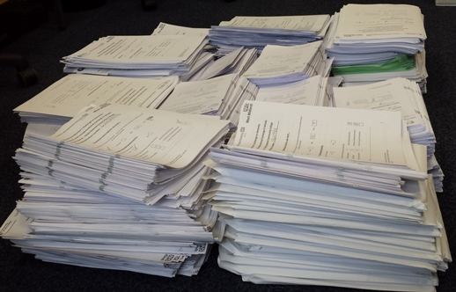
Practical issues
Number of responses
Data entry and analysis

Slide 9
But...
Positive impact of the project
Benefits for pupils
Increased awareness of dementia
Reduced fear and stigma
Appreciate caring role and how to help carers
Increased awareness of how to help people with dementia to live well
Impact on teachers, whole schools and wider community

Slide 10
Helped pupils at a personal level
“My grandfather has dementia. I felt very strange with him when I was told because he didn’t seem like my grandfather any more. After these lessons I can understand what it is like for him and have been more able to talk with him and to see that he is still my grandfather”

Slide 11
Evaluation lessons learnt
Clear lines of communication
Manage expectations
Point of contact for teachers
Different approaches for different age groups
Keep questionnaires short and focused
Appropriate language
Clear (and fixed) format
Easy to answer – tick boxes v free text
Realistic timescales
Work WITH schools

Slide 12
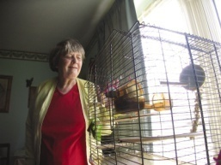
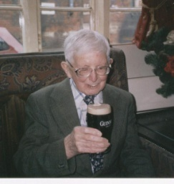
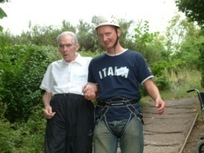
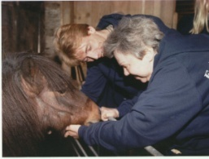
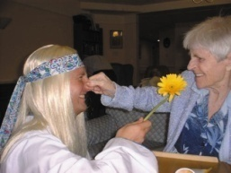
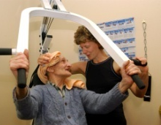
Thank you for listening!
Jennifer Bray
Association for Dementia Studies
University of Worcester
j.bray@worc.ac.uk
http://www.worc.ac.uk/discover/association-for-dementia-studies.html

