Slide 1
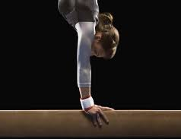
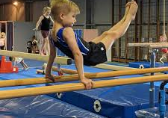
An exploration of power relations in competitive, non-elite artistic gymnastics: exploring gender disparities in artistic gymnastics in England.
Karen Broughton

Slide 2
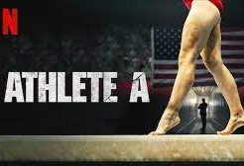
Context
More than 350,000 British Gymnastics members (British
Gymnastics, online)
Majority of British Gymnasts membership (usually around 75%) are under the age of 12 (Whyte, 2022)
‘Dark side’ of sport (Cavallerio, Wadey and Wagstaff, 2016; Douglas and Careless, 2015)
Negative experiences connected to the discourse of performance (Fraser-Thomas and Strachen, 2014)
Performance and success used to justify certain coaching behaviours (Smits, Jacobs and Knoppers, 2017)
Notes:
75% of the 350,000 British Gymnastics members are under the age of 12, with gymnastics being identified as an early specialisation sport.
Gymnastics has an acknowledged dark side to the sport, with performance and success often used to justify certain coaching behaviours, particularly at the elite end of the sport, where much of the research is situated, and where the media has recently focused their attention.
These behaviours by adults in coaching roles include shouting, isolation, threats, encouraging conflict and shaming have often been an accepted form of control and power over the athlete.

Slide 3
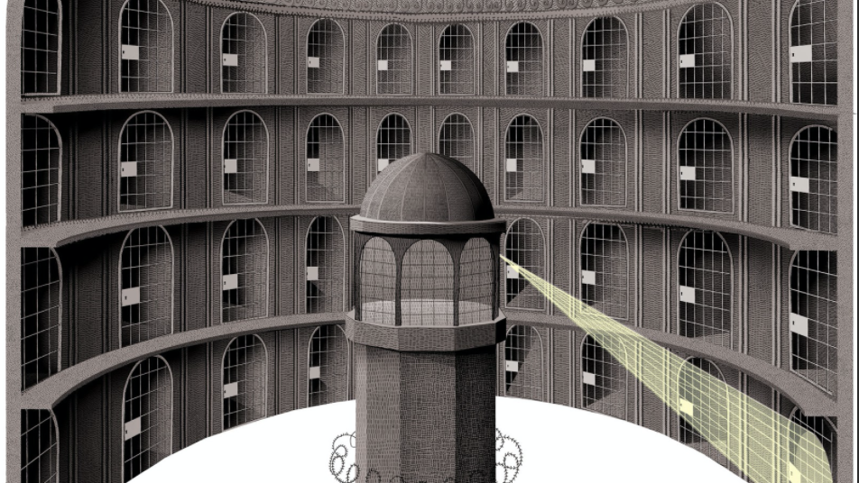
Foucault and power
Knowledge is subjective and produced and reproduced by power relations (Thomas, 1993)
Power is more effective when hidden from view (Danaher et al, 2000)
The internalisation of the panoptic gaze (self surveillance) renders surveillance as an effective disciplinary technique (Webb et al, 2004)
Wherever power exists, opportunities for resistance also exist, providing opportunities for power to be transformative and productive (Foucault, 1988)
Termed as ‘technologies of the self’: the role of the self within power relations, and how an individual makes sense of the limitations set for them within power relations (Markula and Pringle, 2006)
Notes:
This aspect of power that has informed the theoretical lens, as power is more effective when hidden from view through means such as surveillance.
Internalisation of the panoptic gaze which is used as a disciplinary technique. When we apply this to gymnastics, we see gymnasts behaving in certain, accepted ways where they are under the gaze or not of their coach.
However, power is not held by some. Foucault sees power as a web connecting all.
Power can also be transformative, with opportunities to resist.
Within the research much of this is centred on power relations in elite women's gymnastics, with stories from non elite, competitive gymnasts missing.

Slide 4
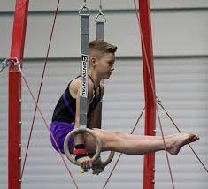
A gendered view
Focus of much of the research on power relations is on women and elite level gymnastics (Eagleman, Rodenberg and Lee, 2014;; Kerr et al., 2019; Cavallerio, Wadey and Wagstaff, 2020)
Young, compliant athletes monitor, guard and discipline themselves (Eskes et al, 1998)
Efficient, obedient and compliant athletes (Lang, 2010)
Despite some evidence from participants of Men’s Artistic Gymnasts (MAG) in The Whyte Report (2022), there is little research into MAG experiences.
Lack of research of males in female-dominated sports (Fadzal and Chung, 2018).
Notes:
Much is the current research on power relations is on elite, women in gymnastics, where we see young, compliant athletes monitoring their behaviour, dress, look to guard and discipline themselves.
They become, as Foucault termed ‘docile bodies’.
However, the Whyte Review identified that the majority of voices were female, some stories were from boys/male gymnasts, these are largely under researched.
Additionally, there is a lack of research of males in female dominated sports, of which gymnastics is classed as one.

Slide 5
Summary
The literature has clearly identified issues of power and control within gymnastics (Barker-Ruchti and Tinning, 2010; Kerr et al., 2019; Costa et al., 2022).
Coach is the key influential figure (Kerr and Barker-Rutchi, 2015).
What are the experiences of non-elite, competitive gymnasts? How does this compare to the research on power relations with elite gymnasts?
How do the experiences of women’s artistic gymnasts (WAG) compare to MAG?
Notes:
Therefore this PhD attempts to explore younger, non-elite but competitive gymnasts experiences of power within gymnastics.
Comparing female and male experiences.
Exploring power relations, to identify a real world application and hopefully further developing coach practice and awareness.

Slide 6
References
British Gymnastics (online) British Gymnastics. https://www.british-gymnastics.org/gymnasts/getting-started/british-gymnastics
Barker-Ruchti, N. and Tinning, R., (2010). Foucault in leotards: Corporeal discipline in women’s artistic gymnastics. Sociology of sport journal, 27(3), 229-250.
Cavallerio, F., Wadey, R. and Wagstaff, C.R.D. (2016) Understanding overuse injuries in rhythmic gymnastics: A 12-month ethnographic study, Psychology of Sport and Exercise, 25, 100–109. doi:10.1016/j.psychsport.2016.05.002.
Cavallerio, F., Wadey, R. and Wagstaff, C.R., (2020). Member reflections with elite coaches and gymnasts: Looking back to look forward. Qualitative Research in Sport, Exercise and Health, 12(1), 48-62.
Costa, V.R. et al. (2022) Living within and outside a disciplinary bubble: a Foucauldian analysis of Brazilian gymnasts ’ experiences in boarding school analysis of Brazilian gymnasts ’ experiences in boarding school, Sport, Education and Society, 1–14. doi:10.1080/13573322.2022.2142544.
Danaher, G., Schirato, T. and Webb, J. (2000) Understanding Foucault. Sage.
Douglas, K., and Careless, D. (2015). Life story research in sport: Understanding the experiences of elite and professional athletes through narrative. Routledge.
Eagleman, A.N., Rodenberg, R.M. and Lee, S., (2014). From ‘hollow-eyed pixies’ to ‘team of adults’: Media portrayals of Olympic women’s gymnastics before and after an increased minimum age policy. Qualitative Research in Sport, Exercise and Health, 6(3), 401-421.
Eskes, T. B., Carlisle Duncan, M. and Miller, M. (1998) The discourse of empowerment: Foucault, Marcuse and women’s fitness texts, Journal of Sport and Social Issues, 22, 317-344.

Slide 7
References
Fadzal, I.,Binte, N. J, and Ho Jin Chung, H. J. (2018). Overcoming the stereotypes of masculinity in Singaporean elite level male gymnasts." The Asian Journal of Kinesiology 20(4), 30-42.
Foucault, M. (1988) Technologies of the self. In L. H. Martin, H. Gutman. and P. H. Hutton (Eds) Technologies of the self: a seminar with Michel Foucault (pp. 16-49). Amhurst, University of Massachusetts Press.
Fraser Thomas and Strachen…..
Kerr, R. and Barker-Ruchti, N. (2015) Women’s artistic gymnastics in Australia and New Zealand: A Foucauldian examination of the relationship between sport governance and consumption, Journal of Sport and Social Issues, 39(5), 396-411.
Kerr, R. et al. (2019) Coming of age: coaches transforming the pixie-style model of coaching in women’s artistic gymnastics, Sports Coaching Review, 8(1), 7–24. doi:10.1080/21640629.2017.1391488.
Lang, M. (2010) Surveillance and conformity in competitive youth swimming, Sport, Education and Society, 15(1), 19-37.
Markula, P. and Pringle, R. (2006) Foucault, Sport and exercise: power, knowledge and transforming the self. Routledge.
Smits, F., Jacobs, F. and Knoppers, A., (2017). ‘Everything revolves around gymnastics’: Athletes and parents make sense of elite youth sport. Sport in Society, 20(1), 66-83.
Thomas, J. (1993) Doing critical ethnography. SAGE.
Webb, L., McCaughtry, N. and Macdonald, D. (2004) Surveillance as a technique of power in physical education, Sport, Education and Society, (9), 207-222.
Whyte, A.Q. (2022) An independent investigation commissioned by Sport England and UK Sport following allegations of mistreatment within the sport of gymnastics. https://www.sportengland.org/guidance-and-support/safeguarding/whyte-review

