Slide 1
University of Worcester Institute of Education Research Conference 17th May 2023
Tom Weaver, PhD candidate:
Ongoing research into Initial Teacher Education lecturers’ understanding of online teaching

Slide 2
Researcher positionality, context and aims
I am a former teacher and Initial Teacher Education (ITE) lecturer; I now teach in a different Department: I am a returning researcher
Choosing a topic: Conversations with ITE lecturers suggests some are passionate about online teaching, others are more reticent. I am curious about the conceptualisations at the foundation of these opinions as they may potentially influence the integration of online teaching in the subject of ITE for those individuals
The aim of this research thesis is to explore the different understandings of initial teacher education (ITE) lecturers in online teaching, in order to support online pedagogy and practice development in this subject
Conceptualisations of online teaching are complex in the subject of ITE because of the tacit aspects of training student to teach in schools (see Stahl, 2003) and the apprenticeship model of training (see Jarvis, 2006 & Lave & Wenger, 2001).
Revealing some of the conceptualisations of online teaching in ITE would have currency for a range of other Higher Education disciplines that are based on training for professional practice

Slide 3
Research questions
I aim to explore three different components of the phenomenon of online ITE teaching:
1. What are the different ways in which online teaching has been understood by ITE lecturers?
This will include variations in the range and complexity of activities considered to be aspects of online teaching and the nature of those activities
2. What are the different ways in which an online teacher has been understood by ITE lecturers?
This will include variations in the way that online ITE teacher identity is understood
3. What are the different ways in which online pedagogy has been understood by ITE lecturers?
This will include variations in the way online learning and teaching is understood

Slide 4
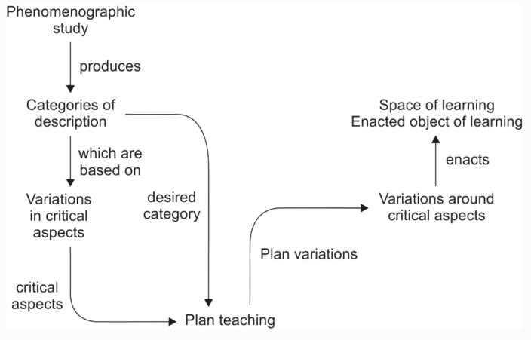
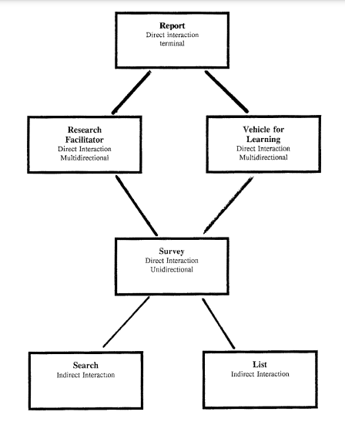
Theoretical framework
The aim of the research is to produce a phenomenographic outcome space (example from Bruce (1994), left). This can be used to develop Higher Education pedagogical approaches in Higher Education (Booth & Woollacott, 2015). Kettunen & Tynjala (2022) illustrate (above) a process for translating phenomenographic research findings into pedagogical development. The categories of description from this study could potentially suggest new approaches to online ITE teaching by describing more complex conceptualisations. This could improve the student experience of online aspects to ITE courses across the sector.

Slide 5
Policy and practice context
Globally, enrolment on online courses has shown an upward trend (World Economic Forum, 2022). In England, online teaching was first included as contact time with students in Higher Education in 2011 (see QAA, 2011). Steady development as a niche pedagogy (Horvitz et al., 2015) ensued with the emergency remote teaching during the Covid-19 pandemic providing a significant ‘gravity assist’ (Barber, 2021)
Higher Education in England is now in an emergent context which needs to consider the teaching and learning strategies that can provide high quality academic experience in the longer term (Office for Students, 2022).
In England, providers of Initial Teacher Education courses must deliver the Core Content Framework which comprise a carefully crafted in a coherent teaching sequence (DfE, 2019). Ofsted’s (2022) framework for inspecting ITE providers in England does not advocate any particular teaching approach and what is appropriate will depend on the aims of a session or activity.
PGCE qualifications leading to the award of Qualified Teacher Status can be completed entirely online (coursefindr, 2023) but currently a minority of ITE courses overall are entirely in this modality. Most ITE courses now contain elements of online or blended learning

Slide 6
Example of existing phenomenographic research for understandings of online ITE teaching
Sandoval-Cruz, Rangel, Calleros & Perales-Escudero (2020) used interviews to explore Mexican pre-service lecturers’ (n=16) conceptions about using online discussion forums (for example, Whatsapp) in blended learning. Three conceptions of online discussion forums emerged:
Going over the content (students were rehashing or summarising of the subject content in order to memorise it)
Expanding knowledge metacognitively (students were questioning, interrogating, looking for patterns and inconsistencies in the subject content, sometimes leading to curiosity and the exploration of further material)
Negotiating knowledge (presentation and questioning of claims, expressing agreements and disagreements, writing and reading of posts are intertwined)

Slide 7
Example of existing phenomenographic research for understandings of the online ITE teacher
Montenegro (2018) used semi structured interviews (n=15) with Chilean ITE educators to describe variation in the conceptualisation of modelling. Data analysis revealed four interrelated categories:
Learning good teaching practices
Learning pedagogical interactions
Learning to teach connected to the school classroom
Learning a congruent teaching approach (replication of pedagogical approaches in a school setting)

Slide 8
Example of existing phenomenographic of online ITE pedagogy
Forbes (2012) used a phenomenographic methodology to explore New Zealand ITE students’ and staff conceptions of asynchronous online discussion. Data was collected from face to face and online focus groups and semi-structured interviews (n=16). Data was analysed to produce three themes, each with three sub-themes:
Purpose in discussion
Metaphors, preparation via meta-discussion and weaving of personal, professional and scholarly sources
Presence in discussion
Participation, communication and formative interaction
People in discussion
Relational connections, community and leadership capacity
Summary: no UK based phenomenographic study. No phenomenographic studies that cover the broader phenomena of online teaching, the online teacher and pedagogy proposed in this research.

Slide 9
The phenomenographic methodological approach
Phenomenography takes a qualitative and interpretative approach to research (Cossham, 2017; Marton & Booth, 1997; Säljö, 1988) which has been used a range of Higher Education contexts (Entwhistle, 1997)
In this view, experiences of a phenomenon exist as meaning that is revealed when people talk and interact (Svensson, 1997). These experiences can be varied and the range of different conceptualisations of a phenomenon can be mapped (Marton, 1986). The role of a phenomenographic researcher is to reveal these subjective experiences (Akerlind, 2018)
Semi-structured interviews are the main data collection tool (Ashworth & Lucas, 2006) and data is analysed to reveal differences in the way a phenomenon is described by participants
The aim is to present different conceptualisations as an outcome space (Green & Bowden, 2009; Sjostrom & Dahlgren, 2002). This is a visual diagram that shows the relationship between the different ways of understanding (Svensson, 1997)

Slide 10
Data collection and recruitment
I am at the data collection stage and about to start recruiting ITE lecturers to take part in my research
The interviews are designed to support reflection: you do not need to come with fully formed ideas about online teaching
There is no ‘right’ answer: the more different perspectives I have the more I can explore the variations that exist
I am exploring understanding, I will not be asking anyone to evaluate or judge the quality of their online teaching
If you are interesting in taking part you can contact t.weaver@worc.ac.uk for further information

Slide 11
References
Anagnostopoulos, D., Levine, T., Roselle, R. & Lombardi, A. (2018). Learning to redesign teacher education: a conceptual framework to support program change, Teaching Education, 2(1), 61 – 80.
Ashworth, P. & Lucas, U. (2006). What is the ‘world’ of phenomenography? Scandinavian Journal of Educational Research, 42(4), 415 – 431.
Barber, M. (2021). Gravity Assist: Propelling higher education towards a brighter future. Available at https://ofslivefs.blob.core.windows.net/files/Gravity assist/Gravity-assist-DTL-finalforweb.pdf
Coomey, M. & Stephenson, J. (2001). Online learning: it is all about dialogue, involvement, support and control – according to the research. In Stephenson, J. (Ed.) (2001). Teaching and learning online: pedagogies for new technologies. Kogan Page.
Cossham, A. F. (2017). An evaluation of phenomenography. Library and Information Research, 41(125), 17 – 31.
Coursefindr (2023). https://coursefindr.co.uk/online/articles/studying-an-online-pgce-distance-learning-teacher-training/
DfE (2019). ITT Core Content Framework. Available at https://assets.publishing.service.gov.uk/government/uploads/system/uploads/attachment_data/file/974307/ITT_core_content_framework_.pdf
Entwhistle, N. (1997). Introduction: Phenomenography in Higher Education. Higher Education Research & Development, 16(2).
Horvitz, B.S., Beach, A.L., Anderson, M.L. et al. Examination of Faculty Self-efficacy Related to Online Teaching. Innov High Educ 40, 305–316 (2015).
Jarvis, P. (2006). Practice based and problem based learning. In Jarvis, P. (Ed.) (2006). The theory and practice of teaching, (2nd Ed.). Routledge.
La Velle, L., Newman, S., Montgomery, C. & Hyatt, D. (2020). Initial teacher education in England and the Covid-19 pandemic: challenges and opportunities. Journal of Education for Teaching, 46(4), 596 – 608
Lave, J. & Wenger, E. (2001). Legitimate peripheral participation in communities of practice. In Harrison, R., Reeve, F. Harrison, A. & Clarke, J. (Eds.). Supporting Lifelong Learning Volume 1: Perspective on learning. (1st Edition). Routledge.

Slide 12
Lee, M-H. & Tsai, C-C. (2010). Exploring teachers’ perceived self efficacy and Technological Pedagogical Content Knowledge with respect to the education use of the World Wide Web. Instructional Science: An International Journal of the Learning Sciences, 38(1), 1 -21.
Marton, F. and Booth, S. (1997). Learning and awareness, Lawrence Erlbaum.
Office for Students (2022b). Blended Learning Review. Available at https://www.officeforstudents.org.uk/media/dc1c3c84-269a-4c40-8f87-15bfae0fcced/blended-learning-review-panel-report.pdf
QAA (2011). Explaining Contact Hours. The Quality Assurance Agency for Higher Education. Available at: www.qaa.ac.uk/docs/qaa/quality-code/contact-hours-guidance
Säljö, R. (1988). Learning in educational settings: Methods of inquiry. In P. Ramsden (Ed.), Improving learning: New perspectives (32-48). London: Kogan Page.
Salmon, G. (2000). E-moderating: The key to teaching and learning online. Kogan Page.
Sharpe, R. & Beetham, H. (2010). Understanding students’ use of technology for learning: Towards creative appropriation. In Sharpe, R., Beetham, H. & De Freitas, S. (2010). Rethinking learning for a digital age: How learners are shaping their own experiences. Routledge.
Stahl, G. (2003). Meaning and interpretation in collaboration. Paper presented at the Designing for change in networked learning environments: Proceedings of the International Conference on Computer Support for Collaborative Learning (CSCL ’03), Bergen, Norway.
Svensson, L. (1997). Theoretical Foundations of Phenomenography. Higher Education Research & Development, 16(2), 159 – 171.
World Economic Forum (2022). Available at https://www.weforum.org/agenda/2022/01/online-learning-courses-reskill-skills-gap/

