Slide 1
Who is it open for? The impact of digital poverty on the move to open
@Dr_Sarah_P
RLUK: Mapping the new open for research libraries
14th March 2022
Dr Sarah Pittaway, Head of Library Academic Engagement, s.pittaway@worc.ac.uk
With thanks to Dr Stephanie Jones, Hive Library Manager, sjones1@worcestershire.gov.uk

Slide 2
A provocation
In academic libraries, by “open” we are largely, implicitly, referring to scholarly information that is freely available to other scholars
Or at least a certain type of person: someone who is educated and is digitally included
@Dr_Sarah_P

Slide 3
The Hive is a partnership between the University of Worcester and Worcestershire County Council UW is not an RLUK institution
@Dr_Sarah_P

Slide 4
What integration looks like
One set of staff
Full range of customers
Shared resources
Skills support
Fully shared spaces
@Dr_Sarah_P

Slide 5
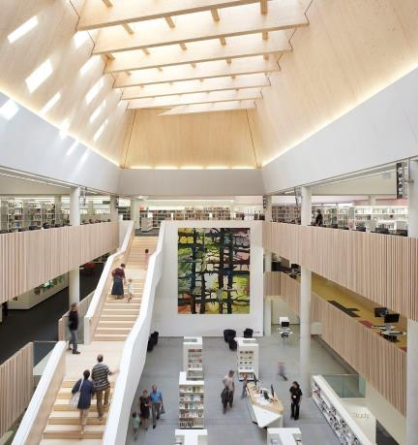
The point of The Hive is that it shouldn’t matter who you are - but during the pandemic it did
@Dr_Sarah_P

Slide 6
Lockdown
On 24th March 2020, The Hive closed its doors
@Dr_Sarah_P

Slide 7
We saw a magnification of digital need as everything moved online
@Dr_Sarah_P

Slide 8
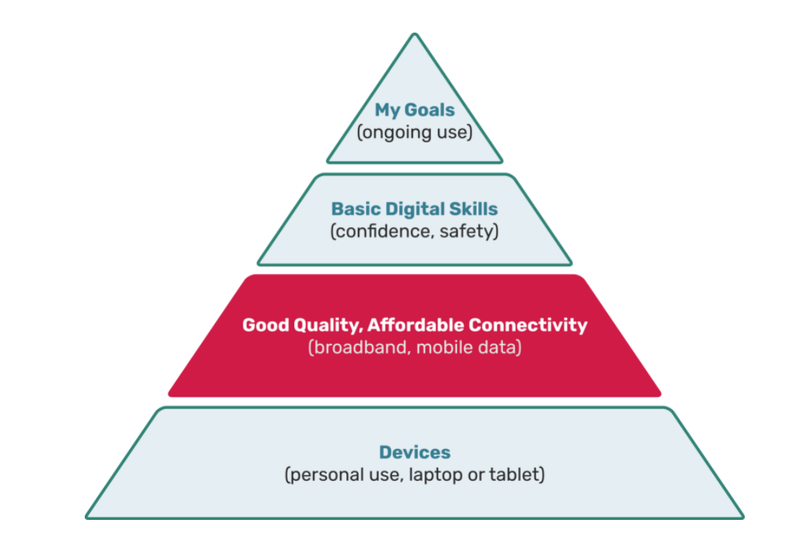
A useful framework: the digital exclusion pyramid from the Good Things Foundation
@Dr_Sarah_P

Slide 9
Our customers have very different digital spaces
@Dr_Sarah_P

Slide 10
Building a public digital offer
Worcestershire Library Connect Bubbles, webinars and online events helped with confidence and connections, but who weren’t we reaching?
@Dr_Sarah_P

Slide 11
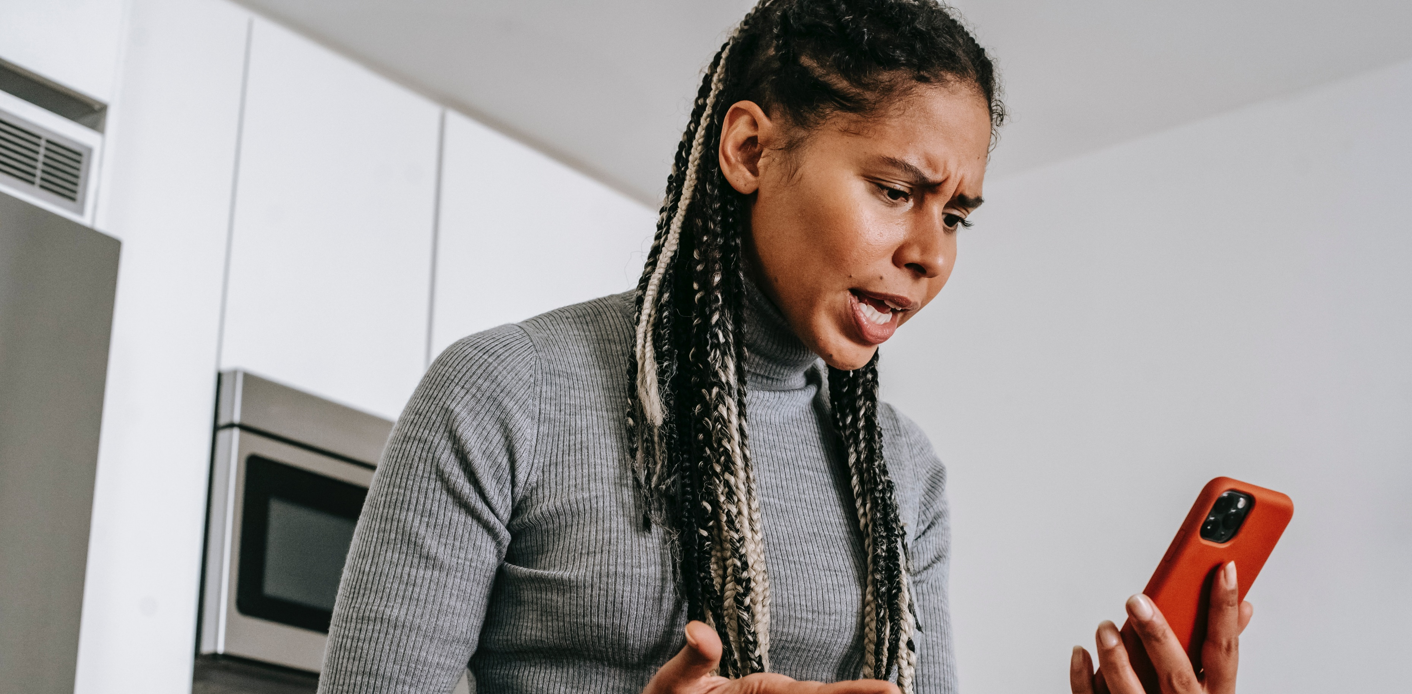
Here2Help
Staffing Here2Help brought us into contact with people with no technology and/or no skills to use it
@Dr_Sarah_P

Slide 12
Moving our students online was easier
@Dr_Sarah_P

Slide 13
Different partners, different guidance: the challenges of academic exemption
In autumn 2020, further lockdowns made us draw more distinction between our customer groups
@Dr_Sarah_P

Slide 14
The things we did for our students had implications for openness to others
@Dr_Sarah_P

Slide 15
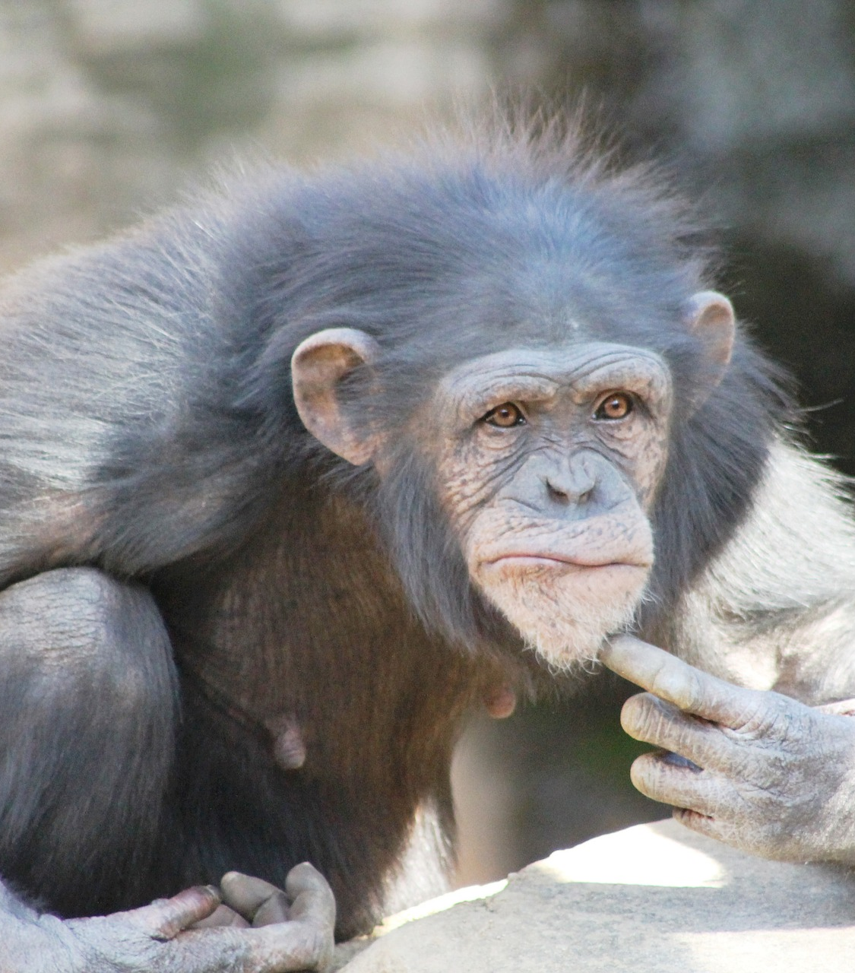
Questions for reflection
Where do RLUK libraries fit into this picture?
And when we refer to open, who exactly is it open for?
@Dr_Sarah_P

