Slide 1
Applying for a new job remotely
Priya Mehta
Academic Liaison Librarian
University of Worcester

Slide 2
Some background information…
Began my role at UW in September 2020 - have only been on site twice, and met two of my team
I was furloughed from May-September 2020 - I had plenty of time for applications!
Applied for 2 jobs during this time, and was offered interviews for both

Slide 3
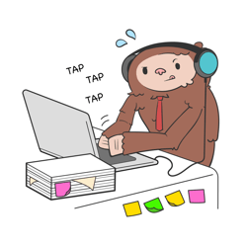
The application process
Not that much different to applying for a job in ‘normal times’!
In both applications, remote learning/teaching wasn’t explicitly mentioned
However, I mentioned remote teaching in my application
Silver lining of the pandemic - shows how adaptable you are

Slide 4
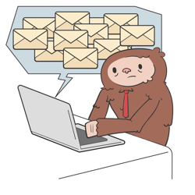
Pre-interview communication
Clear communication and instructions are important for making a good impression to candidates
Especially when it comes to technology!
Candidates will likely be worried about the technology going wrong, especially when being asked to do presentations
Some examples….

Slide 5
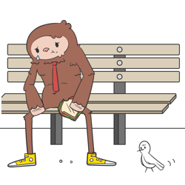
A not so good example
“Applicants will need to have downloaded Teams- and we will call them at the time of their interview to allow them to join.”
Questions I was left with:
How will they call me?
On the phone?
On Teams? – will I need a login for Teams?
Should I set up a personal account?
Will I get a link to join?

Slide 6
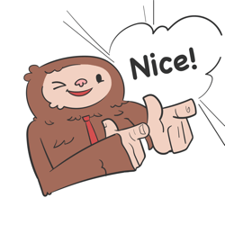
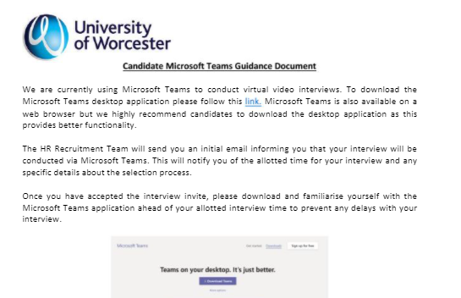
A good example
“We are not testing your expertise with MS Teams, although you will need to familiarize yourself with it with it prior to interview.”
“You will be sent two Teams meeting requests: one for your teaching session followed by another for your interview.”
“Shortly before your scheduled teaching session and interview time a member of the panel will send an email to your registered email address. This email will contain a link to invite you to join the meeting; please follow the instructions to join the meeting as soon as this email is received. We would advise you to download the Microsoft Teams desktop app, as the functionality is superior to that found in the web browser version. Please find attached a guidance document for using Microsoft Teams.”

Slide 7
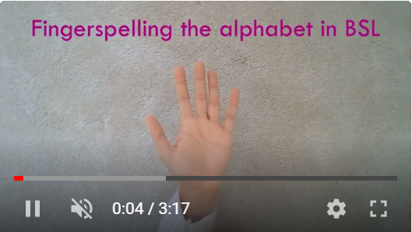
Preparing for the interview presentation
“A 10-12 minute microteach on something unrelated to information literacy/library skills”
Film yourself so you know how it looks (on the device you’ll use for the interview)
Ask family/friends to give you feedback – they might notice things that you don’t
Consider using other methods e.g. I created a short video because it was hard to show my hands clearly on screen

Slide 8
Before the interview…
Technology
Charge your laptop fully beforehand & have headphones with you
Notes
Use notes – I had a few post its stuck around my screen (at eye level) to remind me to mention certain things
Dress
Dress like you would for a face-to-face interview – head to toe!
Software
Test the software beforehand so you know how to share your screen etc.
Research
When doing research on the company, have a look specifically to see what they’ve done since the pandemic – how have they adapted?

Slide 9
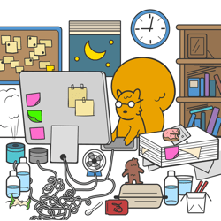
During the interview…
Option to blur your background
Distracted by your own face? You can hide your own view of your face on Zoom, but not on Teams – you could stick a post it over it. But think about if you need to see yourself for presentations
Try not to worry about things out of your control – external noise, pets etc. If they interviewers aren’t understanding – do you want to work with them?

Slide 10
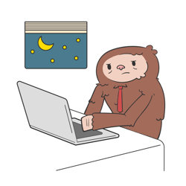
My interview experience
Presentation first, then interview
The presentation panel was made of three members of the wider team – and there was supposed to be a student
The two interviewers made me feel comfortable by telling me not to worry about the doorbell!
No virtual tour – I didn’t think about having one. Maybe a video to watch beforehand would be better with an opportunity for candidate to ask questions during the interview?

Slide 11
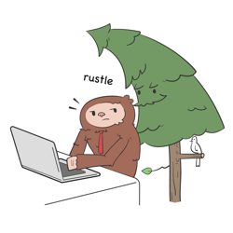
How do you know if you’re making the right decision?
I cancelled the interview from the ‘not so good’ example for various reasons. BUT one of them was the lack of organisation and clarity about the presentation – gave me a bad impression.
In comparison, Worcester were very organised and clear – they were also friendly and reassuring online.
A good question to ask might be – “how do you support new staff members remotely and help them get to know the team?”

Slide 12
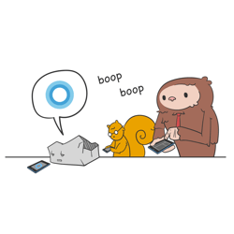
tips for recruiters
Treat the applicants as if they have never used that software before
Be as clear as possible about how the interview will be started
Reassure them at the start of the interview that interruptions/internet issues don’t matter
Candidates can’t see if you’re making notes, so let them know you’re doing that
Smile ☺

Slide 13
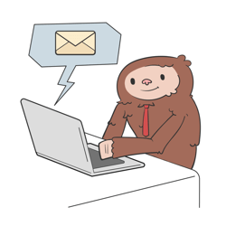
Tips for candidates
Control what you can in your environment, don’t worry about what you can’t
Use the online environment as an opportunity to show different skills
Utilise the software to make yourself more comfortable (hiding your face/background)

Slide 14
Thanks for listening!

