Slide 1
Conscious competence as a New Teacher Educator (NTE)
David Woodward
Senior Lecturer Secondary Physical Education
University of Worcester
d.woodward@worc.ac.uk
@Woodward_PE

Slide 2
My Background
PE Teacher for 12 Years
Variety of roles
Professional Mentor in charge of Initial Teacher Training (ITT) within the school
‘Historical focus’ on training teachers

Slide 3
This time last year……..
18th April 2018 – Started my current role
May 10th and 11th 2018 – Attended TEAN
‘Becoming a teacher educator’ sessions delivered by Pete Boyd, Liz White, Jean Murray and Kim Harris
Ambition

Slide 4
Rationale for Presentation
‘Becoming a teacher educator is an exciting and challenging experience. Because the teacher educator will usually have established a strong and successful career as a practitioner, the process involves critical changes in professional practice and identity.’ (Boyd, Harris and Murray, 2011, p6).

Slide 5
My reflections as a first year NTE
Journey
Small steps
You know more than they do
Learning from others; others learning from you

Slide 6
What is conscious competence?
‘Conscious competency – the mark of a competent instructor’ – Robinson (1974)
The origins of the conscious competence model are uncertain
The conscious competence theory and models look to explain the process and stages of learning a new skill (or behaviour, ability for example)
Stage 1 ('unconscious incompetence'), passing through Stage 2 ('conscious incompetence') and Stage 3 ('conscious competence'), ideally to reach Stage 4 (‘unconscious competence').
Notes:
Although the origins of the ‘conscious competence’ model are somewhat uncertain, the model remains essentially a very simple and helpful explanation of how we learn in stages. Very simply, learners are thought to begin their skill development at Stage 1 ('unconscious incompetence'), passing through Stage 2 ('conscious incompetence') and Stage 3 ('conscious competence'), ideally to reach Stage 4 (‘unconscious competence'). The simplicity of this model reinforces the need to ensure that as you work with students, you need to assess their stage of development rather than make ill-founded assumptions.

Slide 7
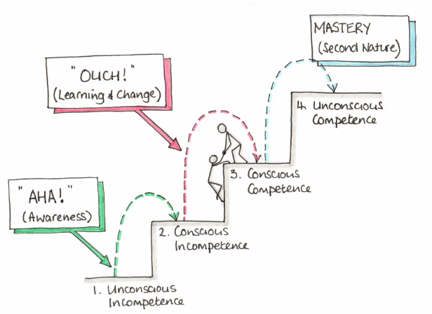
Life Coaching Centre (2017)

Slide 8
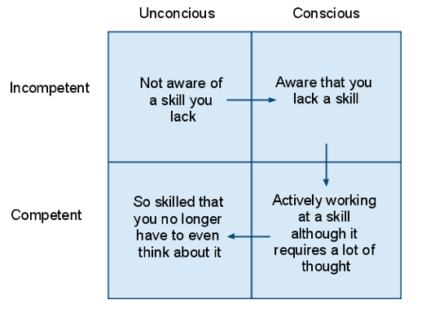
Conscious competence
unconscious competence
Unconsciously competent people will have a really hard time teaching someone else (Casakli, 2019)

Slide 9
Being a NTE
Boyd, Harris and Murray (2011) point out three priorities for most NTE’s
Survival
Shifting the lens
Laying the foundation
Induction as a three year process - must be individualised

Slide 10
Individualisation
Creating a new professional identity (Murray and Male, 2005; Tait, 2017)
Moving away from a ‘dual role’ (Boyd and Tibke, 2012)
The different roles/ institution and subsequent requirements

Slide 11
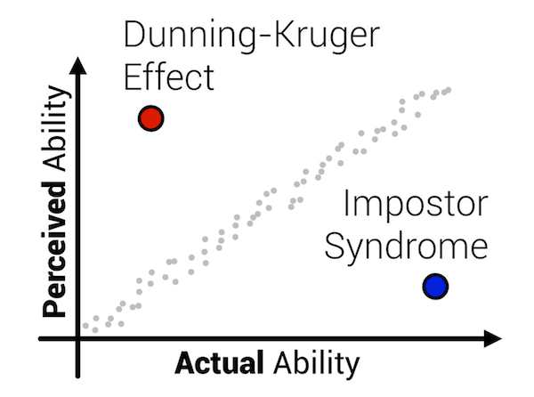
Further research
Impostor syndrome – See Kacper (2013)
Dunning- Kruger effect related to cognitive bias – see Kruger and Dunning (1999)

Slide 12
Other sectors
Novice to expert (Benner, 1984 cited in Hargreaves and Lane, 2001) looked at nursing practice and development of expertise.
The process of transition (Fisher, 2012)

Slide 13
Notes:
to add extra emotional perspective. When someone becomes conscious of incompetence, emotions of 'anxiety', 'happiness', 'fear' and or 'denial' may be experienced. Feelings of 'threat' (to previous learning), 'guilt' (at departing from previous learning) and possibly 'depression' (at having to relearn) can arise until a firm commitment is made to the new learning. If the commitment to the new learning is not strong, feelings of 'hostility' or 'disillusionment' can arise.

Slide 14
Final Thoughts
WHY
‘stimulating yet flexible work environment, hoped to influence the profession, had been influenced by educators, and sought change and challenge in their careers.’ (Evans, 2018, p61).
SHARE
Compton, A., Crawley, J., Curtis, F., Douglas, A.S., Eaude, T., Jackson, A., Philpott, C., Plater, M., Powell, D. Sewell, A. & Vincent, K. (2019) ‘What are the characteristics of a professional teacher educator? A think piece’, TEAN journal 11(2), pp. 3-11.

Slide 15
References
Boyd, P. , & Tibke, J. (2012). Being a school-based teacher educator: Developing pedagogy and identity in facilitating work-based higher education in a professional field. Practitioner Research in Higher Education, 6(2), 41–57. https://doi.org/10.1016/S0020-7489(00)00091-2
Boyd, P., Harris, A., and Murray, J., (2011). Becoming a teacher educator: guidelines for induction. Bristol: The Higher Education Academy, Subject Centre for Education, ESCalate.
Casali, D.T. (2019). ‘Conscious competence makes the best teachers’, Intense minimalism, 25 February, available at: https://intenseminimalism.com/2019/conscious-competence-makes-the-best-teachers/ (Accessed: 04 May 2019)
Hargreaves, J. and Lane.D (2001). Delya's story: from expert to novice, a critique of Benner's concept of context in the development of expert nursing practice. International journal of nursing studies, 38 (4), 389-394
Kacper, J. (2013). ‘An Academic With Impostor Syndrome’, The chronicle of higher education, 02 April, available at: https://www.chronicle.com/article/An-Academic-With-Impostor/138231 (Accessed: 04 May 2019)
Kruger, J., & Dunning, D. (1999). Unskilled and unaware of it: How difficulties in recognizing one's own incompetence lead to inflated self-assessments. Journal of Personality and Social Psychology, 77(6), 1121-1134. http://dx.doi.org/10.1037/0022-3514.77.6.1121
Life Coaching Centre, (2017). ‘Developing New Skills – The Conscious Competence Ladder’,, The Life Coaching Centre Blog , 12 January, available at: http://lifecoachingcentre.co.uk/conscious-competence-ladder/ (Accessed: 04 May 2019)
Evans, J., (2018). Why We Became Nurse Educators: Findings From a Nationwide Survey of Current Nurse Educators. Nursing Education Perspectives, [Online]. 39/2, 61-65. Available at: https://journals.lww.com/neponline/Abstract/2018/03000/Why_We_Became_Nurse_Educators___Findings_From_a.3.aspx (Accessed 4 May 2019).
Fisher, J. (2012) ‘Process of personal transition’ [Online]. Available at: www.businessballs.com/personalchangeprocess.htm (Accessed: 4 May 2019).
Murray, J., & Male, T. (2005). Becoming a Teacher Educator: Evidence from the Field. Teaching and Teacher Education, 21 (2), pp. 125-142.
Robinson, W.L. (1974). Conscious competency--The mark of a competent instructor. Personnel Journal (pre-1986), 53(000007), pp. 537
Tait, V. (2017) Teacher Educator and Teachers in Training: A Case-Study Charting the Development of Professional Identities. Teaching in lifelong learning: a journal to inform and improve practice, 8 (1). ISSN 2040-0993

