Slide 1
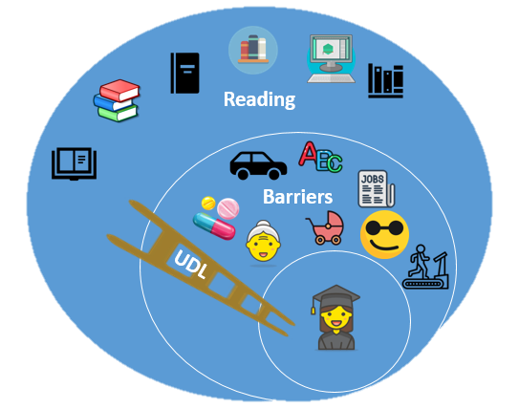
Audiobooks, accessibility tools & Universal Design for Learning: breaking down barriers
Dr Sarah Pittaway (s.pittaway@worc.ac.uk, @Dr_Sarah_P) & (Michelle Malomo, m.malomo@worc.ac.uk)
The research
The challenge
Can audiobooks and accessibility tools make a difference to student engagement with reading and enhance academic success? We are putting this to the test by embedding accessibility tools into Resource Lists from the School of Education.
Students face a whole range of issues that affect their ability to engage with reading for their degree, from visual impairments, care or work responsibilities or commuting.
The solution?
Universal Design for Learning (UDL) makes anticipatory adjustments that benefit all students, removing barriers for those who have particular issues. Those students no longer have to declare issues or identify themselves as ‘different’ to their cohort as their needs are already catered for.
The results
Early results show some use (30 clicks from 200 students). Next steps are to survey students about their experiences and develop an evidence base.

