Slide 1



Dr Paul Golz
Mental Health & Wellbeing
Identifying and supporting through assessment
Notes:
Mental Health Difficulties
Give them the task

Slide 2

Background
Offer two degrees
  Dance
  Physical Education and Dance
Based at the University’s Severn Campus
World-renown for inclusive sport
Notes:
We currently run two degrees – Dance and a Physical Education and Dance and we have usually 25-30 students in each year on both courses. The exact numbers vary from year to year.
We’re based at the University’s Severn Campus and we’re one of the only users of the Riverside Building. This is a fantastic open plan space right on the river.
The University has a big focus on inclusive sport and we are the partner university of many national and international organisations, such as Paralympics organisations
So inclusion was very much on our minds when we wrote these degree, especially mental wellbeing.

Slide 3


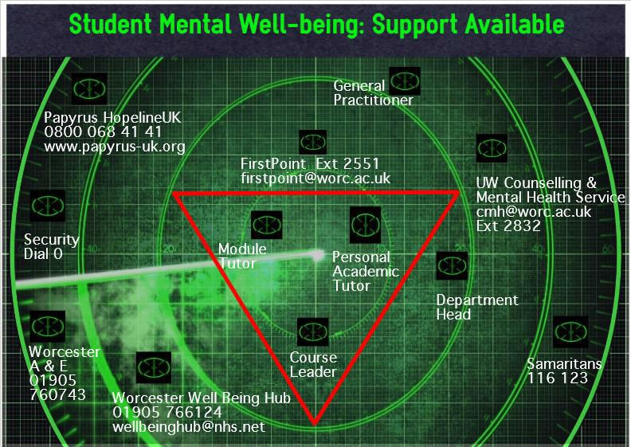
Mental Wellbeing Eco-system
Disclosing a mental health & wellbeing issue will not affect your degree, nor will it affect the way staff or students treat
you at UW.
Made Riverside a “Mental Wellbeing Zone”
Sport/dance specific drop-in sessions
Spiral induction / Personal Academic Tutors
Infographics
Specific sessions
Counselling
Mental health workshops
Notes:
Within the UK there is a feeling that student mental ill health is on the rise – the Association of University & College Counselling (2011) reported an increase in the number of cases of mental ill-health they deal with,
However there is currently no evidence that student mental health is significantly worse than those of a similar age who do not attend university (Macaskill 2013)
There are significant risk factors to starting University, such as living away from home for the first time, having to make new friends, handle finances, adjusting to new learning regimes and creating a new identity as a student (Scanlon, Rowling, & Weber, 2011)
We wanted to make our building a mental wellbeing zone, in a UDL (universal design for learning) approach - Gordon, D., Meyer, A. & Rose, D. 2015;2014;, Universal Design for Learning: Theory and Practice, CAST Professional Publishing, Peabody
All our PATS are mental health first aid trained and safe suicide trained.

Slide 4


Did it work?
Mental health and wellbeing has no boundaries…….We all have a certain responsibility to promote mental health and wellbeing in the domains within which we operate.
(Castle & Buckler, 2018)
80% retention Y1->2
PATs reporting high incidences of “crisis”-levels of mental ill-health
Low use of services, even when directed
Mitigating circumstances claims based on MH up 23%
Notes:
We lose around 20% of our students in our first year with the majority reporting mental health difficulties
The university average is around 8%
So what went wrong?

Slide 5
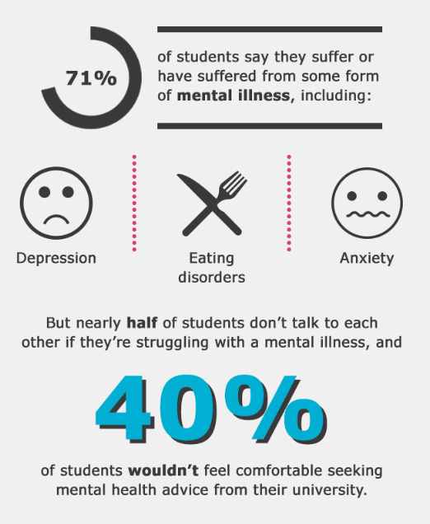
So what went wrong?
Stigma is a powerful force in preventing university students with mental health difficulties from gaining access to appropriate support…most students did not disclose their mental health problems to staff at university. This was primarily due to fear of discrimination during their studies and in professional employment
Martin (2009)
Notes:
Well actually we know and it’s not a problem unique to our university. Students don’t feel comfortable talking about their problems, especially to people they’ve just met (REF).
When they do finally talk, it is often not the optimal time for support.
Students don’t understand the signs and know when they need to get support.

Slide 6

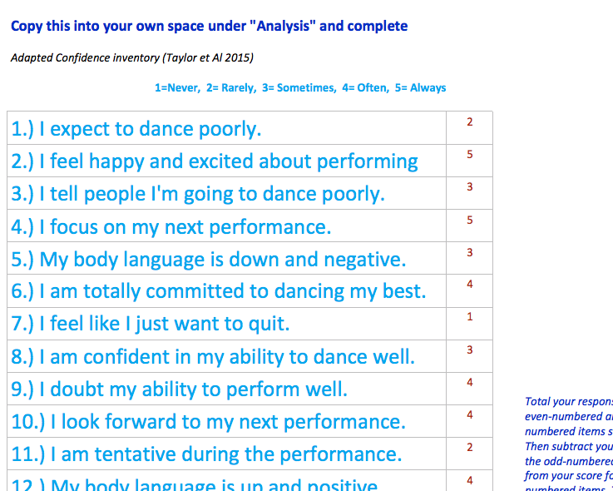
Using assessment
  Analyse your personal training and development needs
Level 4 Dance technique module
Series of worksheets around:
  Motivation
  Confidence
  Self-talk
  Identifying negative thoughts and behaviours
  Identifying emotions and the causes
  Nutrition, sleep and mood
Taylor, J. and Estanol, E. (2015b) Dance psychology for artistic and performance excellence. Champaign, Illinois: Human Kinetics.
Notes:
We know that students are motivated by assessment. In fact it is one of the biggest motivator of behaviour at HE - Rosanne Coutts*, Wendy Gilleard and Robert Baglin (2011)
So if we want students to look at their mental wellbeing, we need to train them in it.

Slide 7

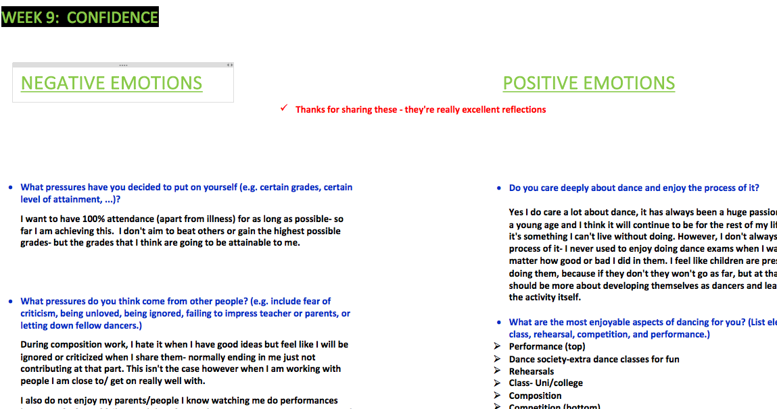
Technology
Students can’t see each others work
Module leader can see work as it is created
Students revisit work
Notes:
The probem with some assessment is that you don't see the work until they submit it by which time it's too late.
Created with OneNote
The ability to see the work and their reflections is really useful at catching students who might be struggling.
These can be followed up through feedback through OneNote, suggesting talking to their peer mentor or through a meeting with their academic tutor depending on the severity.
We can also encourage students to revisit their work which can lead to better or deeper reflections
It can also lead to further training within sessions

Slide 8

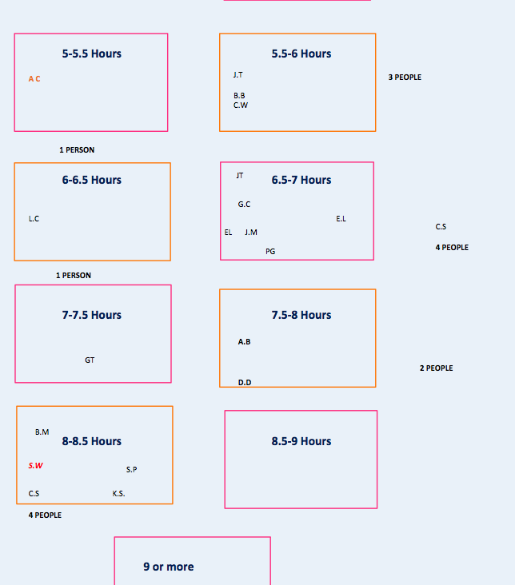
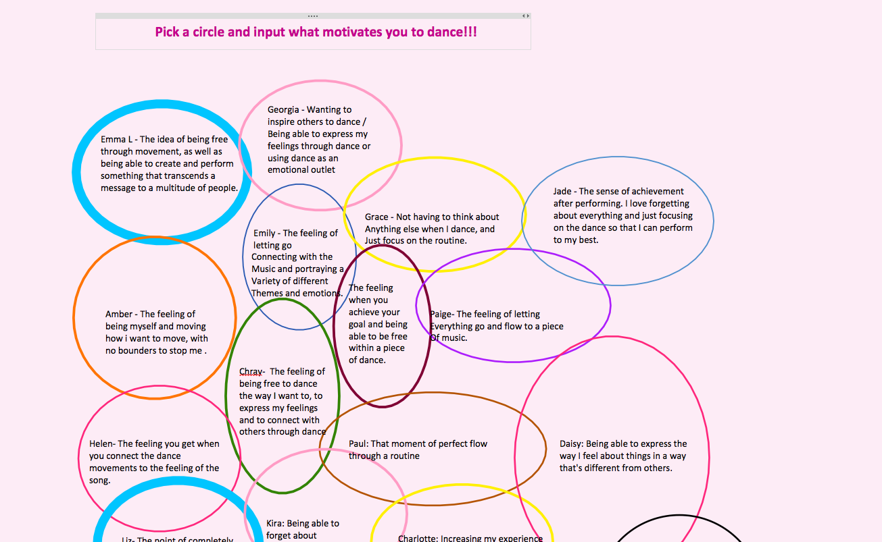
Encourage talking
Notes:
(Pinfold, Thornicroft, Huxley, & Framer, . [Crossref], [PubMed], [Web of Science ®], [Google Scholar]) and suggests that workshops based in particular settings that draw on the personal narratives of people with mental health problems can have an impact on reducing stigma and creating a more open culture. Creating a peer support system where students can talk to other students who have had mental health problems also emerged from the study as a recommendation to take forward, as well as the idea of a universal buddying system mentioned earlier. Linking mental well-being with physical well-being would be another way of promoting a culture of positive attitudes towards mental health.

Slide 9
Did it work?
“I feel as though I've grown more confident this year. Even though I had a bad start and wanted to leave at the beginning I feel that the support I had from my tutors/lecturers helped steer me in the right direction when I wasn't sure what I wanted. The friends I've made on the course have also taught me to feel more comfortable in myself regarding mental health and it's nice knowing that my teachers understand the situation and accept that sometimes I can't give 100% in class or need a day off to cope with what I have going on.”
100% of students engaged with the portfolio
90-100% of students shared through the collaboration space (task dependent)
MH based retention issues down to 12%

Slide 10

What next
DACP1001: Dance Technique - Continue portfolio assessment
DACP1002: Dance Composition - Choreography assessment mental wellbeing*
DACP1004: Dance, Health and Wellbeing - offer MH “research project” with themselves as subjects
DACP2001: Somatic Technique – reflective portfolio
Notes:
To be fair many of them chose to do mental health anyway

Slide 11
Somatic training
2nd year module around embodied approaches and dance training
Has traditionally led to emotional journeys
Peer support has been part of this but not fully utilised
This year this element is assessed.
Brodie and Lobel (2012)
Notes:
Continuing into second year we wanted to build on this work: somatic practices looks at a more embodied approach to learning dance and we also consider how our own attitudes and expectations can affect our training. This can lead to some quite emotional journeys (I think I around 90% of my tutorials ended in tears at one point).
This year we’ve introduced peer support. We’ve had that before as part of trainingsuppor tthey get frm a peer. How working with someone else can help understand your own journey

Slide 12

The Motif Programme

Slide 13
Thank you

Slide 14
﻿Association of University & College Counselling. (2011). Annual survey of counselling in further and higher education, 2006/07. Rugby: British Association of Counselling and Psychotherapy
Castle, P. & Buckler, S. (2018) Psychology for Teachers (2nd edition), SAGE publishing
Gordon, D., Meyer, A. & Rose, D. (2015), Universal Design for Learning: Theory and Practice, CAST Professional Publishing, Peabody
Pinfold, V., Thornicroft, G., Huxley, P. & Farmer, P. (2005). Active ingredients in anti-stigma programmes in mental health. International Review of Psychiatry, 17(2): 123–31
Taylor, J. and Estanol, E. (2015b) Dance psychology for artistic and performance excellence. Champaign, Illinois: Human Kinetics
Coutts, R., Gilleard, W. and Baglin, R. (2011) ‘Evidence for the impact of assessment on mood and motivation in first-year students’, Studies in Higher Education, 36(3), pp. 291–300. doi: 10.1080/03075079.2010.523892.
Scanlon, L., Rowling, L. and Weber, Z. (2007) ‘“You don’t have like an identity you are just lost in a crowd”: Forming a Student Identity in the First-year Transition to University’, Journal of Youth Studies, 10(2), pp. 223–241. doi: 10.1080/13676260600983684.
Macaskill, A. (2018) ‘Undergraduate mental health issues: the challenge of the second year of study’, Journal of Mental Health. Taylor & Francis, 27(3), pp. 214–221. doi: 10.1080/09638237.2018.1437611.Martin, J. M. (2010) ‘Stigma and student mental health in higher education’, Higher Education Research and Development, 29(3), pp. 259–274. doi: 10.1080/07294360903470969.
Macaskill, A. (2013) ‘The mental health of university students in the United Kingdom’, British Journal of Guidance & Counselling, 41(4), pp. 426–441. doi: 10.1080/03069885.2012.743110.
Martin, J-M (2010) Stigma and student mental health in higher education, Higher Education Research & Development, 29:3, 259-274,

