Slide 1
Not just “the help”: library services as professional colleagues
Dr Sarah Pittaway
The Hive @ University of Worcester
s.pittaway@worc.ac.uk
@Dr_Sarah_P

Slide 2
Devices at the ready!
https://PollEv.com/sarahpittawa327
www.menti.com
@Dr_Sarah_P

Slide 3
https://PollEv.com/sarahpittawa327 - breaking the ice & testing the software
@Dr_Sarah_P

Slide 5
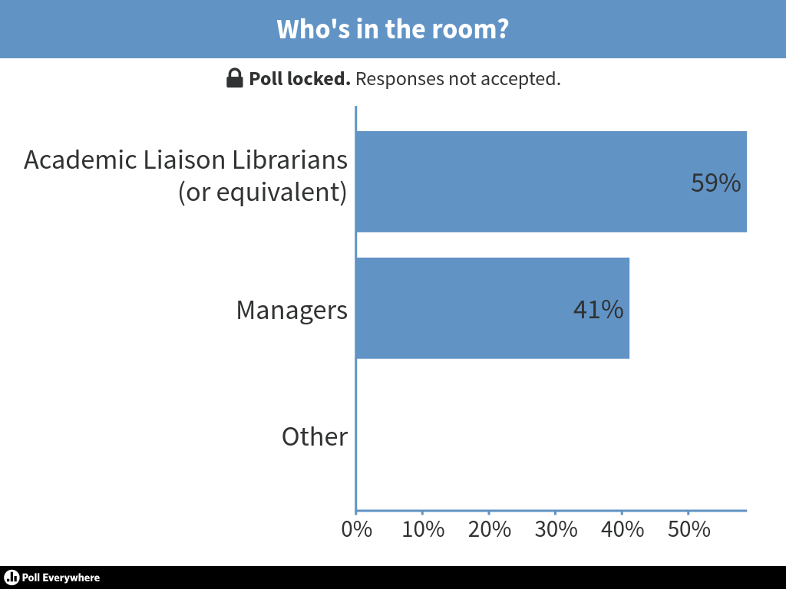

Slide 6
What do I mean by ‘professional peers’ and ‘the help’? Why are these definitions important?
@Dr_Sarah_P

Slide 7
“It’s what librarians do all day – we answer questions!”
@Dr_Sarah_P
Do we? Don’t we also – ask questions, teach, negotiate, advocate, write, present, influence strategy…?

Slide 8
(paraphrased) “If I’m helpful, then they [academic staff] will want to
talk to me in future, but if I’m not they won’t engage”
But helpful here means ‘do their reading lists for them’
@Dr_Sarah_P

Slide 9
Our time and expertise is sometimes disrespected…Back in my first job, I was just starting a jigsaw activity with an English 101 class when the instructor said “I don’t want them doing that. That doesn’t sound useful.”
Meredith Farcas, https://meredith.wolfwater.com/wordpress/2017/10/11/the-ballad-of-the-sad-instruction-librarian/, accessed 26th October 2017
@Dr_Sarah_P

Slide 10
www.menti.com use the code 70 84 61 Discussion time – what do delegates think about definitions so far?
@Dr_Sarah_P

Slide 12
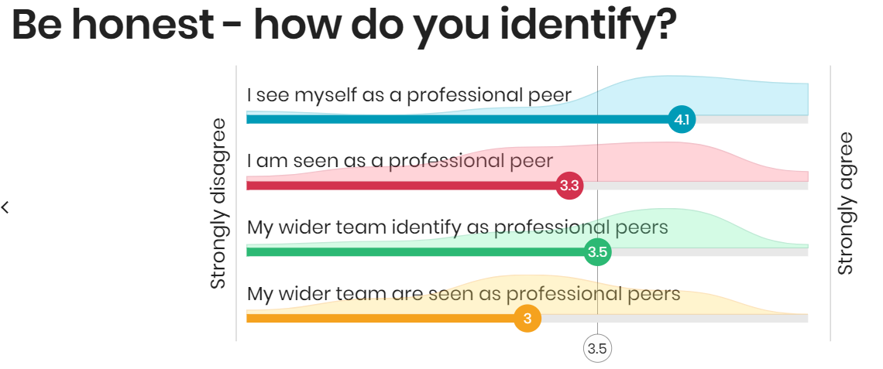

Slide 13
Your identity
Me
You identify as professional but your team is seen as support
Professional
You identify as professional and your team is seen as professional
Perception of your team
Support
Professional
You identify as support and your team is seen as support
You identify as support but your team is seen as professional
@Dr_Sarah_P
Support

Slide 14
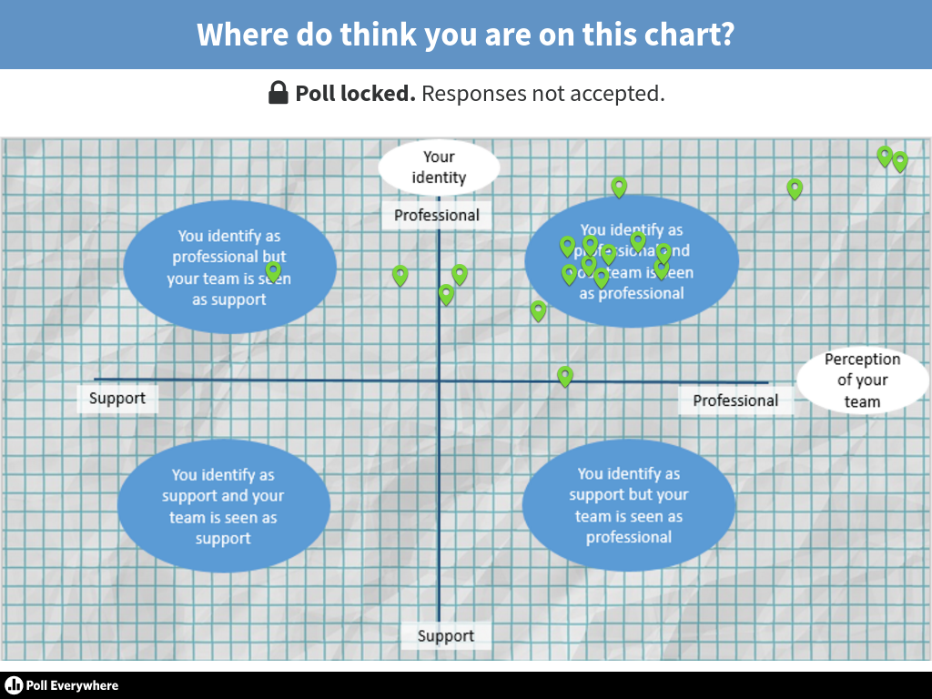

Slide 15
On to some advice
@Dr_Sarah_P

Slide 16
It may sound obvious but…
@Dr_Sarah_P

Slide 17
Evidence you / your team’s commitment to learning and teaching
@Dr_Sarah_P

Slide 18
Pedagogic research can empower you / your teams
@Dr_Sarah_P

Slide 19
And it really doesn’t have to be difficult!
@Dr_Sarah_P

Slide 20
It may be a cliché, but leadership courses can be effective
@Dr_Sarah_P

Slide 21
You could relaunch your teams
@Dr_Sarah_P

Slide 22
@Dr_Sarah_P
Whatever you do, thinking beyond the library is key …
#BlindinglyObviousKlaxon

Slide 23
www.menti.com (code 70 84 61) What will delegates take back with them?
@Dr_Sarah_P
Notes:
I will…stop/start/continue

Slide 26
?
@Dr_Sarah_P

Slide 27
Credits
From Flickr, under Creative Commons licence:
Slide 1 - Roland Skof-Peschetz, CC BY-NC 2.0
Slide 4 - library_mistress CC BY-SA 2.0
Slide 5 - UBC Library Communications CC BY-NC-ND 2.0
Slide 6 - Anthony Albright CC BY-SA 2.0
All other images copyright free from Pixabay https://pixabay.com/

