Slide 1

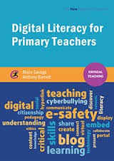
Moira Savage & Anthony Barnett
University of Worcester
Digital literacy, employability and graduate attributes for primary trainee teachers
If you would like to join us please visit:
https://ltseclearningconversations.wordpress.com/technology-enhanced-learning-projects/enhancing-employability-through-digital-literacy-project/
#thelearningconversation
Notes:
MS introduce us and how they can stay in touch

Slide 2

➔
Employability x 2
Purpose of study…
“Computing also ensures that pupils become digitally literate – able to use, and express themselves and develop their ideas through, information and communication technology – at a level suitable for the future workplace and as active participants in a digital world”.

Slide 3
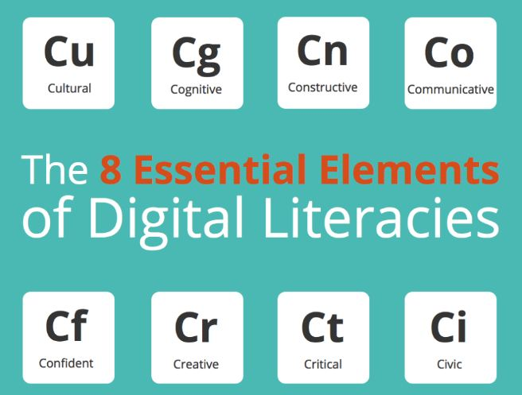
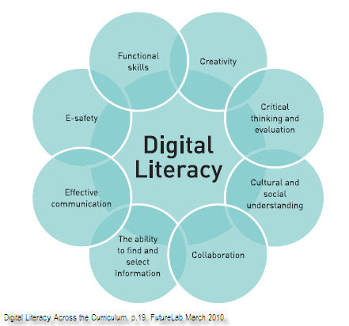

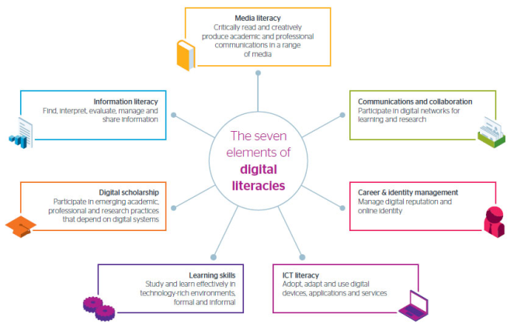

Belshaw 2011
Belshaw- DL is a condition not a threshold… cultural, contextual…
Higher Education Review: Themes for 2015-16 http://www.qaa.ac.uk/en/Publications/Documents/HER-Themes-Guidance-15-16.pdf
Student Employability &
Digital Literacy
JISC
Notes:
MS drivers include:
QAA Review themes
UW Careers
UW TEL Strategy
Definitions of digital literacy
Teachers Standards
Notions of producers and consumers

Slide 4
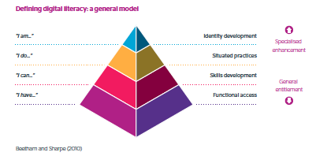
lived experienced
http://digitalcapability.jiscinvolve.org/wp/files/2014/09/JISC_REPORT_Digital_Literacies_280714_PRINT.pdf

Slide 5
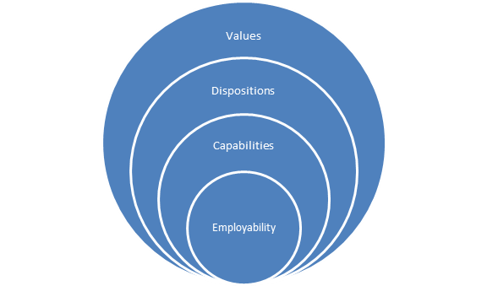
exploration of the links between employers, their representative bodies and higher education providers to inform their use, and maintain the relevance, of digital technologies in their provision
Higher Education Review: Themes for 2015-16 http://www.qaa.ac.uk/en/Publications/Documents/HER-Themes-Guidance-15-16.pdf
Student Employability &
Digital Literacy
exploration of the links between employers, their representative bodies and higher education providers to inform their development, and maintain the relevance, of the digital literacy of their students
VDC-E model
exploration of how providers support students to develop digital literacy and digital skills that are flexible and adaptable to evolving work markets
Notes:
MS- meeting the challenge of flexible, adaptable and evolving- need to go beyond capability … Values & dispositions

Slide 6
Freedom of (self) expression
Knowledge democracy
Intellectual property
Responsible choices
Conduct- social responsibility & ethical principles (Hobbs 2010)
Emotional responses:
Fear of technology,
Fear that children will know more…
Emotive vocabulary- ‘I survived’- oppositional
Taking social action (Hobbs 2010)
willingness/ to engage in co-construction/ collaboration processes
Belshaw- DL is a condition not a threshold, cultural, contextual,
Emergent sub-cultures
Mindset- being a producer of digital content as well as a consumer
Confidence…experimentation…forgiveness
JISC- need for a fluid conceptualisation… situated practices
Notes:
MS

Slide 7

What is employability?
Developing the VDC-E model
“skills, understandings and personal attributes – that make graduates more likely to gain employment and be successful in their chosen occupation, which benefits themselves, the workforce, the community and the economy” (Yorke, M & Knight, P 2006)
“…the capacity of the graduate to function in a job and be able to move between jobs, thus remaining employable throughout their life.” (http://www.employability.ed.ac.uk/What/ )
Notes:
AB --- Yorke, M & Knight, P (2006) Embedding Employability into the Curriculum, York, Higher Education Academy (cited in Watson, R & Scott, I (2012) University of Worcester Guide to Supporting Student employability
AB http://www.employability.ed.ac.uk/What/ the capacity of the graduate to function in a job and be able to move between jobs, thus remaining employable throughout their life.

Slide 8
USEM - Knight & Yorke’s model (2006)
Current employability models
“Understanding
Skilful practices (including deployment of skills)
Efficacy beliefs (including students views of themselves)
Meta-cognition (including self-awareness and a capacity to reflect on learning)” (http://www.employability.ed.ac.uk/What/ )
Notes:
AB

Slide 9
DOTS – Law & Watts 1977
“Decision learning – decision making skills
Opportunity awareness – knowing what work opportunities exist and what their requirements are
Transition learning – including job searching and self presenting skills
Self awareness – in terms of interests, abilities, values, etc.” (Watts, 2006, p 9/10).” (https://www.uclan.ac.uk/students/employability/futures/files/Dacre_Pool__Sewell_2007_CareerEDGE_Article.pdf )
Notes:
AB

Slide 10
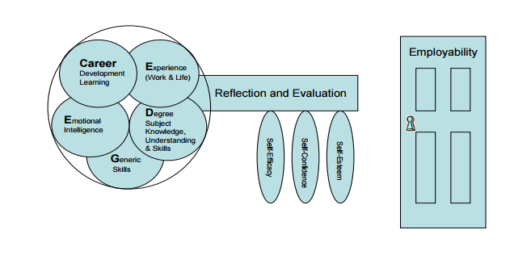
The CareerEDGE model
The key to employability
Notes:
AB https://www.uclan.ac.uk/students/employability/futures/files/Dacre_Pool__Sewell_2007_CareerEDGE_Article.pdf

Slide 11
Values, Dispositions & Capabilities model (VDC-E) – specifically identifies links to digital literacy
Generic skills identified within the CareerEDGE model:
“imagination/creativity • adaptability/flexibility • willingness to learn • independent working/autonomy • working in a team • ability to manage others • ability to work under pressure • good oral communication • communication in writing for varied purposes/audiences • numeracy • attention to detail • time management • assumption of responsibility and for making decisions • planning, coordinating and organising ability
• ability to use new technologies (not included in the list above but mentioned in many others and an important element)” (Source – see below – relates to Pedagogy for Employability Group (2004 p. 5 included in source)
E.g. Setting alarms & reminders on iPhone to improve time management
Notes:
AB https://www.uclan.ac.uk/students/employability/futures/files/Dacre_Pool__Sewell_2007_CareerEDGE_Article.pdf

Slide 12
Linking to digital literacy
VDC-E model
Current models
Digital values
Values
Efficacy beliefs
Self awareness
Emotional intelligence
e.g. respects intellectual property and data protection when online
Dispositions
Digital dispositions
e.g. has a sceptical and critical perspective on digital content
Capabilities
Opportunity awareness
Meta-cognition
Digital capabilities
Employability
Understanding
Skilful practices
Decision learning
Transition learning
Generic skills
Experience
e.g. able to manage digital identity; able to use presentation software; able to make effective use of search engines
Savage & Barnett (2015)
Digital Literacy for Primary Teachers
Notes:
AB

Slide 13
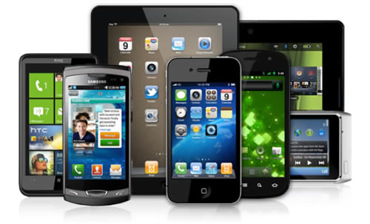


A teacher is expected to demonstrate consistently high standards of personal and professional conduct … Uphold public trust in the profession and maintain high standards of ethics and behaviour (DfE, 2011).
The Teachers’ Standards emphasise acknowledging individual ‘dispositions, understanding of how pupils learn’, and ‘factors that can inhibit pupils’ ability to learn and how best to overcome these’ (DfE, 2011, pp 11–13).
Another important strand in the Teachers’ Standards relates to ‘having regard for the need to safeguard pupils’ well being, in accordance with statutory provisions’ (DfE, 2011).

Slide 14
References
Belshaw, D (2011) What is ‘Digital Literacy’? [online] Available at: neverendingthesis.com/dougbelshaw-edd-thesis-final.pdf (accessed 31 October 2014).
Belshaw, D (2013) Digital Literacies. [online] Available at: www.slideshare.net/dajbelshaw/etmooc-t3-s1-digital-literacies-with-dr-doug-belshaw (accessed 31 October 2014).
Department for Education (2011) Teachers’ Standards: Guidance for School Leaders, School Staff and
Governing Bodies.
Department for Education (2013) The National Curriculum in England: Framework Document.
Hobbs, R (2010) Digital and Media Literacy: A Plan of Action. [online] Available at: www.knightcomm.org/wpcontent/uploads/2010/12/Digital_and_Media_Literacy_A_Plan_of_Action.pdf
(accessed 8 August 2014).
Joint Information Systems Committee (2014) Developing Digital Literacies. [online] Available at: www.jiscinfonet.ac.uk/whole-infokit/?infokit=11013 (accessed 31 October 2014).
Payton, S and Hague, C (2010) Digital Literacy in Practice: Case Studies of Primary and Secondary
Classrooms. Futurelab. [online] Available at: www2.futurelab.org.uk/resources/documents/project_reports/digital_literacy_case_studies.pdf (accessed 31 October 2014).

Slide 15
Moira Savage http://www.worcester.ac.uk/discover/moira-savage.html
Dr Anthony Barnett http://www.worcester.ac.uk/discover/anthony-barnett.html)
https://ltseclearningconversations.wordpress.com/technology-enhanced-learning-projects/enhancing-employability-through-digital-literacy-project/
#thelearningconversation

