Slide 1
Assuring the quality of the Assessment Only Route: a provider’s perspective
Catriona Robinson & Isabelle Schäfer
Friday 8th November 2013

Slide 2
Qualified or not qualified? That is the question!
Notes:
On the one hand qualified teachers are no longer necessary in academies/free schools and yet on the other those that have been teaching for a number of years (at least 2yr+) now are being encouraged to obtain qualified status… so what does it all mean? Another couple of his ‘pop-up’ initiatives!
Grade 3 classification ok to recruit physicists and mathematicians

Slide 3
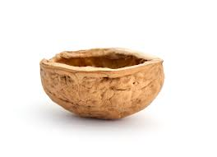
In a nutshell…
What is the assessment only route and who is involved?
Assessment only – no training!
Experienced unqualified teachers
Maximum 12 week assessment period
Responsible for planning, teaching and assessing at least classes of 15 pupils
UW involved in the pilot project
59 providers
Notes:
CR

Slide 4
What are the quality assurance considerations? Would you invite the individuals to interview? What are your reasons?
Notes:
CR & IS
Give out mini pen portraits (3 Primary/ 3 Secondary)
Information to come from application, phase, experience, school context, inspection grade.
Attendees to evaluate the mini pen portrait
QA considerations may include school inspection grade, mentoring etc.

Slide 5
AO route timeline
AO application by UW
Stage 1 interview at UW( written task, interview, portfolio of evidence discussed)
Stage 2 interview in school (lesson observed by AOM, UW tutor, AO coordinator)
Initial assessment report completed by UW tutor. Response to initial assessment report completed by AOM and action plan completed by AOM and AOT.
Notes:
IS

Slide 6
AO route timeline continued
The AOT starts the 12 week assessment period when all conditions have been met.
The AOT sends the UW tutor an updated action plan half-way through the assessment period.
Final assessment visit: 2 joint lesson observations. Portfolio and commentary marked in school.

Slide 7
Assessment action plans

Slide 8
AO areas for development
There is a tendency to “capture an answer” and move on.
- Encourage pupils to reflect on the progress they have made
- Manage transitions.
- Model activities.
- Give pupils regular feedback… and encourage pupils to respond to feedback.
- Evaluate lessons.

Slide 9
One AOT’s perspective
Notes:
Play from 5mins and 05 secs to the end

Slide 10
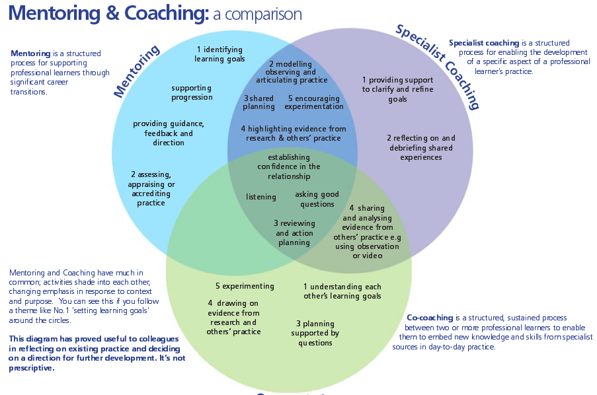
(CUREE 2005:p.5)

Slide 11
High clarity
High rapport | - Open dialogue - Shared expectations - Openness to mutual benefit - Sense of urgency | - Task focused - Debate rather than dialogue | Low rapport
 | - Friendship - Lack of direction - Opportunistic in dealing with issues - Short term perspective but … may be long term relationship | - Going though the motions
 | Low clarity
Clutterbuck and Raggins (2002) cited by Megginson and Clutterbuck ( 2005 p.18)

Slide 12
Conclusion
Key quality assurance considerations for providers are:
Quality of school/dept
Quality of mentoring
Coverage of curriculum
Opportunities to meet the standards
Experience of individuals
Deep subject knowledge
Attainment against the standards

Slide 13
Any questions?

Slide 14
References
CUREE (2005) National Framework for mentoring and Coaching [Online]. Available from: http://www.curee.co.uk/files/publication/1219925968/National-framework-for-mentoring-and-coaching.pdf. [Accessed: 07th November 2013]
Megginson, D. and Clutterbuck, D. (2005) Techniques for Coaching and Mentoring. London, Elsevier Butterworth-Heinemann.

