Slide 1
ACADEMIC INTEGRITY: WHOSE WRITING IS IT? CAN WE STOP THE PLAGIARISM PANDEMIC?
EDULEARN23
Plagiarism & Academic Dishonesty
Helen Hope and Joanne Lewis
University of Worcester, UK.
Notes:
HH
Who we are, where we come from

Slide 2
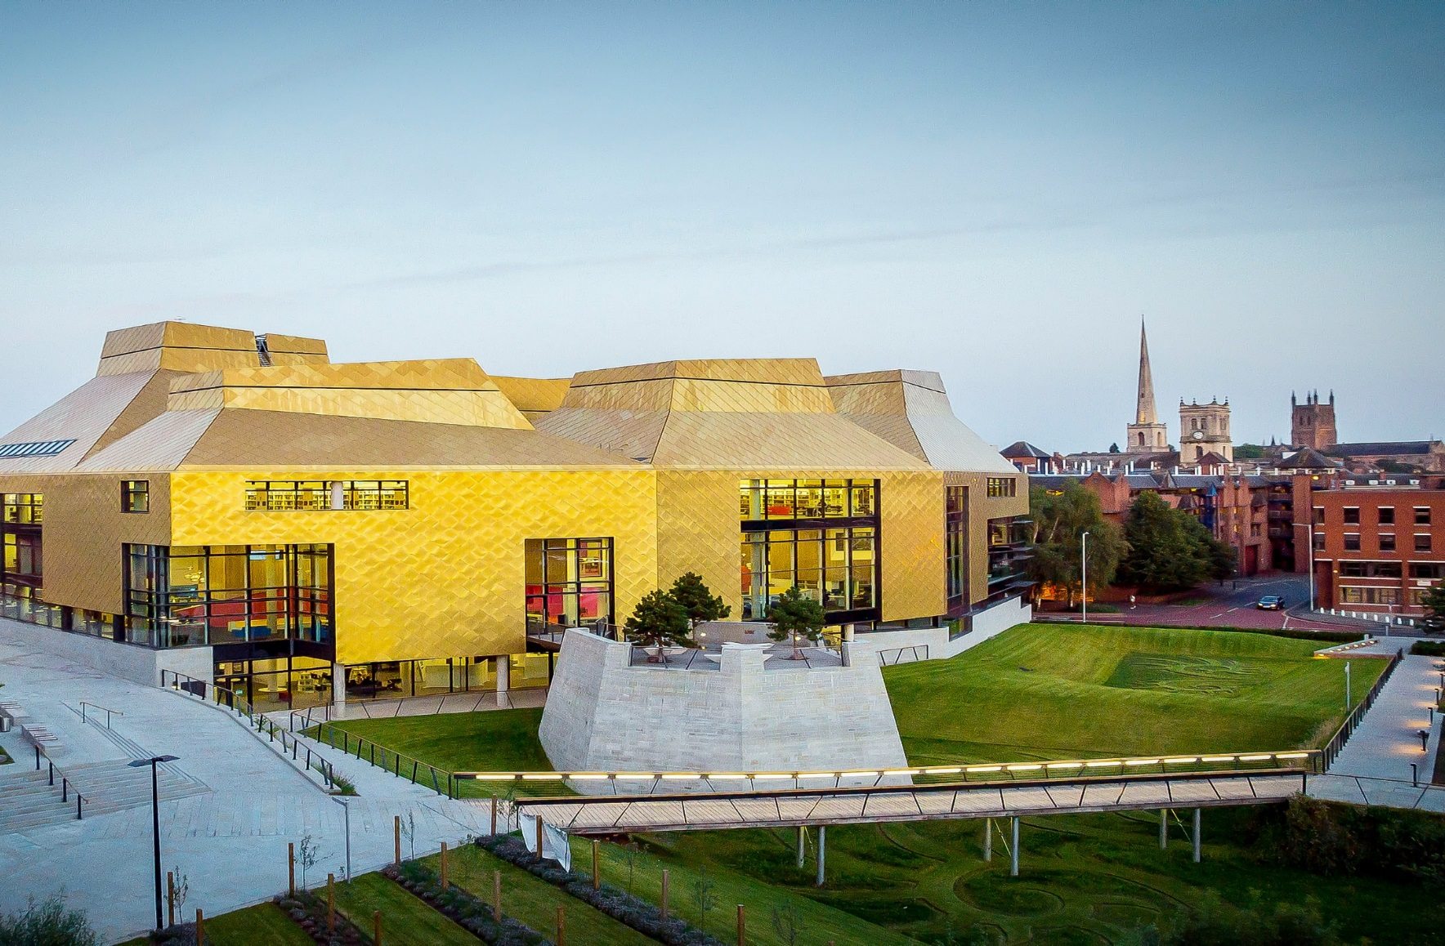
West Midlands University
This Photo by Unknown author is licensed under CC BY-ND.
Notes:
HH cathedral city with a river, racecourse and cricket ground, tudor buildings. Ye olde English city.
Just over 8000 students (small) compare us to Birmingham who have 65k
Add some Worcester context – majority of our courses are vocational focussed (teachers, nurses, midwives, sports educators, arts and drama - courses being applied in nature. Small research portfolio.
Learning and teaching is what we do.
Strong identity within our local community.

Slide 3
Academic Integrity Definition
Academic integrity can be defined as the commitment to uphold the key principles of responsibility, respect, and fairness, on the part of the academic community.
This definition includes students, for whom observing the values of academic integrity is a part of their becoming members of the academic community.
(International Center for Academic Integrity, 2021)
Notes:
JL
In 2022 Laurie McNeil wrote a chapter for an Academic Integrity book entitled Changing Hearts and Minds: Pedagogical and Institutional Practices to Foster Academic Integrity. In this chapter she discussed looking at closing the gap between academics expectations of AI and students understanding of those expectations and to make explicit what is often treated as assumed understanding. This approach was intended to help students develop more robust knowledge and appreciation of AI as a core element of the academic community to which they now belong.

Slide 4
The UK Headlines
The Telegraph in January 2017 reported that 20,000 UK university students were buying essays and dissertations from essay mills
In 2018 an online league table for essay mills (UK Topwriters) collated 635 available essay mill websites. In 2023 this has increased to 1090. https://uktopwriters.com/best-essay-writing-services/
In 2018 research by Swansea University indicated that 1 in 7 international students may have paid someone to help write their assignment.
September 2021, the BBC News reported that the writing of 'contract cheating' assessments was mainly being completed by Kenyan ghost writers.
In May 2022, the Skills and Post-16 Education Bill criminalised essay mills
In November 2022, open AI was launched and has continued to develop at a fast pace.
Notes:
JL
The majority of UK institutions use Turnitin.
These are just some of the headlines that have circulated over the past 5/6 years. This does not even start to touch upon the upsurge of headlines surrounding Artificial Intelligence and the concerns that this is raising not only within HEI's but in all areas of life. Whilst all headlines don't have the academic credentials of academic research, there is a recognition that this problem has been growing for some time and that the use of essay mills, and AI is embedded in our culture. Therefore how we address this issue is integral to maintaining HEI currency and the value system of our academic community.

Slide 5
University of Worcester
Governance
Process
Policy
Culture
Notes:
HH
Three themes
Identifying the needs/concerns around AI within the UoW.
Policies in practice in place – where they consistent and rigorous enough?
The need for cultural change regarding ethical practice of students.
In terms of governance – recognizing AI as a core value of the university. (Khan, Priya and Tuffnell (2022)
Policy – moving away from a punitive policy to one that has education as its aim. (using academic integrity violations as ‘teachable moments’ Orr 2018)

Slide 6
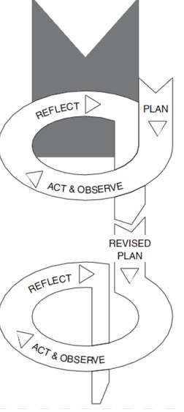
An action research approach.
"Action research builds on the past, and takes in the present, with a view to shaping the future." Coghlan (2019, p.87)
Utilised Kemmis & McTaggart's (1988) action research model.
Notes:
HH
Common model used to create educational change.

Slide 7
Reflect
June (2019) our first AI case together and the first inter academic school collaboration.
Discussion over coffee!
We had concerns about how AI worked within the university, in particular. fairness, consistency, student and staff experience and ethical considerations.
AI process for students was a task rather than an ethical 'way of being'.
(Downes 2017, Parkinson et al 2022)
Notes:
JL
The starting point for many research projects starts with a niggle which grows into a question, concern, curiosity which is exactly where this piece of research started over a discussion regarding an academic case which just didn't feel right, fair or just for both the student and the university. The niggle was with regards to the application of a punitive AI policy which sought to punish rather than educate students. Parkinson et al (2022) wrote about the costs of academic misconduct to HEI's in terms of students not being able to continue in their studies by being excluded from the module or the course and the impact of the lost revenue to HEI's. There was also the emotional and physical cost to peers, the sense of fairness and justice against the backdrop that their peers were purchasing assignments and being rewarded with higher grades. Also the institutions reputation is at stake and it's reputation within the wider national and international academic community.

Slide 8
Governance | Processes | Culture
Sign up for the QAA Academic Integrity Charter. | Introduce blocking for contract cheating websites. | Developed training workshops for students and staff.
Review and rewrote the academic misconduct policy. | Automation of the AI process from paper forms to online. | Across university collaboration through forums.
Annual AI report produced for university and each school. | Review of process for appeals and higher penalties at university committees. | Created support systems.
Work with school senior management teams. | Introduced more academic integrity staff in each school. | Kept up to date with development in AI, e.g., LLMs.
Notes:
HH - collaboration was key – worked across the university, all subjects, all levels
Created dialogue with all parties, sense of ownership. Doesn’t belong to one department or one area.

Slide 9
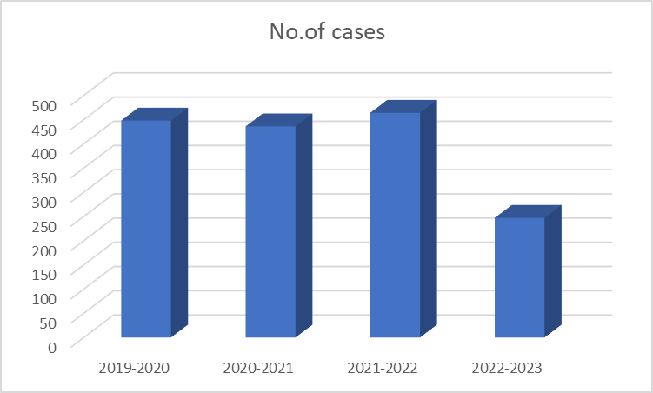
IMPACT – Can we stop the plagiarism pandemic?
Reduction in cases from 464 to current of 247.
Reduction in serious penalties from 86 – 18.
Study Skills AI website hits.
Notes:
JL
The University is starting to see the immediate impact of the measures we have outlined. However, a full evaluation does need to take place over a number of years to fully understand and appreciate the longer term impact. Initial indicators are that the number of Academic Misconduct cases have significantly fallen with particular focus on the most serious penalties which can prevent a student from progressing with their studies or being removed from their course and the university.
The student Academic Integrity training workshop is now the 2nd most popular website on the Study Skills site, second only to the Academic Writing workshops, seeing over 4000 visits in just 6 months.

Slide 10
Reflect
Developing successful Academic Integrity strategies
Embedding ethical culture in HEI's
Educational not punitive approach
How do we learn to live alongside Artificial Intelligence
Using Authentic Assessment Design
Sustainable practice
(Youannou 2014; Eaton 2019, Hossain 2020)
Notes:
JL
There is an acceptance that academic misconduct has, does and will continue to take place. Punitive 'find and punish' measures have some limited success in addressing the issue but it doesn't provide an educational approach. HEI's have to reflect on their own practice and be clear on the learning and teaching environment that they wish to foster (Youanna 2014) . Hossain (2020) discusses educating students in becoming Academic Integrity Literate (AIL), Eaton (2021) advocates that AIL is the foundation of ethical teaching and learning and becoming a valued member of the academic community. Eaton (2019) explains that 'Academic Integrity Literacy is an inseparable combination of values, behaviours, ethical decision making and skills necessary for academic success'.
HH -

Slide 11
Any questions? Thinking time?
Contact us:
h.hope@worc.ac.uk
j.lewis@worc.ac.uk

Slide 12
References
Bracken, S. and Novak, K. (2019) (eds) Transforming higher education through universal design for learning: an international perspective. London, Routledge
ChatopenAI (2023) What is the best way to change the culture of an organisation? [Written]. Available at: https://www.chat.openai.com/c/0343c5d0-165d-4d44-8751-21d19087591a (Accessed: 23rd May 2023)
Coghlan, D. (2019) 'Demystifying action research' in Zuber-Skeritt, O. and Wood, L. (eds) Action learning and action research genres and approaches. Bingley, Emerald Publishing, pp.83 - 96. DOI 10.1108/9781787695375 (Accessed: 12th June 2023)
Davis, M. (2022) 'Examining and improving inclusive practice in institutional academic integrity policies, procedures, teaching and support'. International Journal for Educational Integrity 18, 14. Available at: https://doi.org/10.1007/s40979-022-00108-x (Accessed: 7th May 2023)
De Souza, D. (2022) Academic integrity report. London Higher. Available at: www://https://londonhigher.ac.uk/wp-content/uploads/2022/07/Academic-Integrity-Report-2.pdf (Accessed: 4th April 2023)
Downes, M. (2017) University scandal, reputation and governance. International Journal for Educational Integrity 13, 8. Available at: https://doi.org/10.1007/s40979-017-0019-0 (Accessed: 19th May 2023)
Draper, M., Birch, Z., Croombs, M., and Marano, E. (2022) 'Revisiting academic integrity from a student perspective. Quality Compass'. 5. Available at: https://www.qaa.ac.uk/docs/qaa/news/quality-compass-revisiting-academic-integrity-from-a-student-perspective.pdf (Accessed: 8th April 2023)
Hulbert, A., McKenzie, A., Orr, J., and Roberts, C. (2021). The fundamental values of academic integrity 3rd edition. Delaware, International Center for Academic Integrity [ICAI]. Available at: https://www.academicintegrity.org/the-fundamental-values-of-academic-integrity (Accessed: 6th April 2023)
Eaton, S.E. (2021) 'Academic integrity and literacy' , in L. Hunt and D. Chalmers (eds) University teaching in focus: a learning-centred approach. London: Routledge pp.163-178

Slide 13
References
Iverson, H.L., Lewis, M.A. and Talbot III, R.M., 2008. Building a framework for determining the authenticity
of instructional tasks within teacher education programs. Teaching and Teacher Education, 24(2), pp.290
302. Available at: https://doi.org/10.1016/j.tate.2007.09.003 (Accessed: 12th June 2023)
Kansara, R. and Main, E. (2021) 'The Kenyans who are helping at the world to cheat'. BBC News, 9th September Available at: https://www/bbc.co.uk/news/blogs-trending-58465189 (Accessed: 12th June 2023)
Kemmis, S. and McTaggart, R. (1988) The action research planner. Melbourne Burwood, Deakin University Press
Khan, Z.R., Priya, J., & Tuffnell, C. (2022) Culture of Integrity – An Institutional Response to Integrity during Covid-19. International Journal of Academic Integrity. 18 (27). https://doi.org/10.1007/S40979-022-00118-9 (Accessed 9th June 2023)
Lee, G. (2019) 'Universities catch less than one per cent of 'bought in' essays, own records suggest'. Available at: http://www.channel4.com/news/factcheck/factcheck-universitiescatch-less-than-one-per-cent-of-bought-in-essays-own-records-suggest (Accessed: 3rd April 2023)
McNeill,L. (2022) Changing hearts and minds: pedagogical and institutional practices to foster academic integrity. In: Eaton, S. E., and Hughes, J.C. (eds.) Academic integrity in Canada: an enduring and essential challenge. Switzerland, Springer, pp. 487-504. Available at: https://doi.org/10.1007/978-3-030-83255-1 (Accessed: 16th April 2023)
Newman, C. (2018) 'Latest study reveals sharp rise in essay cheating globally, with millions of students involved'. Swansea University Press Office, 30th August. Available at: https://www-2018.swansea.ac.uk/press-office/newsarchive/2018/lateststudyrevealssharpriseinessaycheatinggloballywithmillionsofstudentsinvolved.php
(Accessed: 15th April 2023)
Orr, j. (2018) Developing a campus Education Seminar. Journal of Academic Ethics. 16. p.195 – 209. https://doii.org/10.1007/s10805-018-9304-7 (Accessed 9th June 2023).

Slide 14
References
Parkinson, A. L., Hatje, E., Kynn, M., Kuballa, A.V., Donkin, R. and Reinke, N.B. (2022) Collusion is still a tricky topic: student perspectives of academic integrity using assessment-specific examples in a science subject. Assessment & Evaluation in Higher Education. Available at: https://doi.org/10.1080/02602938.2022.2040947 (Accessed: 18th May 2023)
Stone, A. (2022) 'Student perceptions of academic integrity: a qualitative study of understanding,
consequences, and impact'. Journal of Academic Ethics. Available at: https://doi.org/10.1007/s10805-022-09461
5 (Accessed: 14th April 2023)
The Quality Assurance Agency for Higher Education (QAA) (2020) Academic integrity charter for the UK higher education. The Quality Agency for Higher Education. Available at: https://www.qaa.ac.uk/docs/qaa/about-us/academic-integrity-charter.pdf?sfvrsn=93f0d181_8 (Accessed: 12th April 2023)
The Quality Assurance Agency for Higher Education (QAA) (2022) Contracting to cheat in higher education: how to address essay mills and contract cheating. 3rd edition. The Quality Agency for Higher Education. Available at: https://www.qaa.ac.uk/docs/qaa/guidance/contracting-to-cheat-in-higher-education-third-edition.pdf?sfvrsn=2fbfa581_14 (Accessed: 17th April 2023)
Youanna, A. (2014) Academic integrity: perceptions and practices in secondary school humanities classes. Student Research Project. University of Toronto. Available at: http://hdl.handle.net/1807/67070 (Accessed: 26 June 2023)
Yorke, H. (2017) 'More than 20,000 university students buying essays and dissertations as Lords call for ban on ‘contract cheating’. The Telegraph, 13th January Available at: https://www.telegraph.co.uk/education/2017/01/13/2000-university-students-buying. (Accessed: 20th April 2023)

