Slide 1
ACADEMIC INTEGRITY: WHOSE WRITING IS IT? CAN WE STOP THE PLAGIARISM PANDEMIC?
UoW L & T conference 2023
Helen Hope and Joanne Lewis
Notes:
Who we are, where we come from

Slide 2
Session Structure
Academic Integrity in context
UoW Academic Integrity
Actions taken to address Academic Integrity
Impact of actions
On reflection
Future considerations and recommendations
Notes:
HH - review session structure in brief

Slide 3
Academic Integrity Definition
Academic integrity can be defined as the commitment to uphold the key principles of responsibility, respect, and fairness, on the part of the academic community.
This definition includes students, for whom observing the values of academic integrity is a part of their becoming members of the academic community.
(International Center for Academic Integrity, 2021)
Notes:
JL to do this
Academic Integrity is not just about Governance, Policy and Process although they are integral to upholding the academic principles which this definition alludes to. This definition captures the importance of working with integrity, ethical principles and riggour. It raises the importance of the individuals understanding and application of these key principles outlined in this definition and how this not only indicates that the individual works ethically for themselves but also for their peers the HEI and the academic community. Becoming part of this community encompasses all of these principles listed in this definition and it is the role of AI to protect these principles and uphold them. For some students part of the experience of studying at HE level is about acknowledging these ethical principles and discovering their ethical compass. At a students graduation both staff and students want to feel confident that every student who is receiving their degree has met all of the principles listed in this definition.

Slide 4
Academic Integrity in Context Headlines
In 2017 it was reported that 20,000 UK university students were buying essays and dissertations from essay mills
In 2018 UKTopWriter reported 635 available essay mill websites which rose to 1090 in 2022.
In 2018 research by Swansea University indicated that 1 in 7 international students may have paid someone to help write their assignment.
Notes:
JL to do this
These are just some of the headlines that have circulated over the past 5/6 years. This just not even start to touch upon the upsurge of headlines surrounding Artificial Intelligence and the concerns that this is raising not only within HEI's but in all areas of life. Whilst all headlines don't have the academic credentials of academic research, there is a recognition that this problem has been growing for some time and that the use of essay mills, and AI is embedded in our culture. Therefore how we address this issue is integral to maintaining HEI currency and the value system of our academic community.

Slide 5
AI progress timeline
Milestone
Milestone
Milestone
Milestone
AI portal piloted with Education and Psychology.
AI portal rolled out across the university
AIT’s work with SU and LTQ on university paper and recommendations.
First university Lead academic integrity tutors appointed.
07
09
02
04
Focus on Staff, Students, Data & Systems
Today
Presentation of findings so far and next stages in the process.
Milestone
Milestone
Milestone
Milestone
Milestone
Jo Lewis forms new academic integrity forum.
Recommendation paper to LTSE Committee
Signed up for QAA academic integrity charter
Dream team back together
Training launched for staff and students.
Met with HoS.
Milestone
Milestone
01
03
05
Training materials for staff and students created and piloted.
New Academic policy to go to ARC.
06
10
07
11
Sept
Jan
April
June
Sept
Jan
April
June
Sept
Jan
April
June
Sept
Oct
Feb
June
AY 2019 - 2020
AY 2020 - 2021
AY 2021-2022
AY 2022-2023
Notes:
HH to do this

Slide 6
Actions and Impact
Actions | Impact
Signed up to the Academic Integrity Charter – August 2021 | University demonstrate that they uphold the values of academic integrity
Worked with IT to block contract cheating websites | Over 1000 websites unable to be accessed via university Wifi and computers.
Introduced a Support Forum for AIT’s on Teams | Support network for AIT’s sharing knowledge and expertise (40 members)
Developed an Academic Integrity Portal | Streamlined administration process of referrals, administered by AIT's
Met with all Schools SMT’s to review AI cases and establish benchmarks | Annual reporting on AI cases by School. Good practice initiatives discussed and implemented.
Streamlined AMC panel mtgs – 3 permanent Chairs established plus rota for panel members | AMC meetings arranged regularly over a period of months and staffed
Notes:
JL to do this
SMT’s have more awareness of expectations of their role regarding AI cases.
Business School has implemented a project to reduce AI cases
Worked closely with 2 Schools on training and implementation of consistent AI procedures
Streamlined administration process of referrals. Reduced workload. And on PAS teams and case referral time.
There has been a decrease this year so far in cases within schools and at university level.

Slide 7
Actions and Impact
Actions | Impact
Worked with the TEL Team to develop a staff Academic Integrity training workshop via LearnUpon | Launched Oct 2022 – 227 staff completed the training. Training mandatory for all new starters and currently pursuing it to become mandatory for all academic staff
Worked with the UoW Library Services staff to develop an Academic Integrity online workshop on Study Skills | Launched Oct 2022 – currently 3913 views of AI page, 2nd most popular page after Academic Writing
Delivered a number of AI training workshops to new AIT's – 36 AI staff | Ease on workloads and increase in consistency of process and practice
Established an Artificial Intelligence Forum for Academic Integrity staff to discuss a strategy & policy | Forum has 13 members across the School and Departments to work collaboratively on the impact of AI
Rachel Kyte and Matt Harris have develop a workshop on Artificial Intelligence for staff | Delivered a series of workshops to staff
Review and rewrite the Academic Misconduct Policy | Working collaboratively across university departments to rewrite the policy – implemented September 2023
Notes:
JL to do this
SMT’s have more awareness of expectations of their role regarding AI cases.
Business School has implemented a project to reduce AI cases
Worked closely with 2 Schools on training and implementation of consistent AI procedures
Streamlined administration process of referrals. Reduced workload. And on PAS teams and case referral time.
There has been a decrease this year so far in cases within schools and at university level.

Slide 8
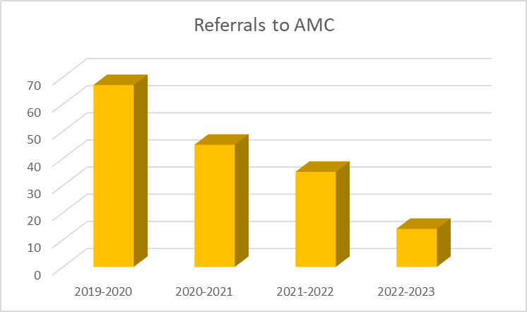
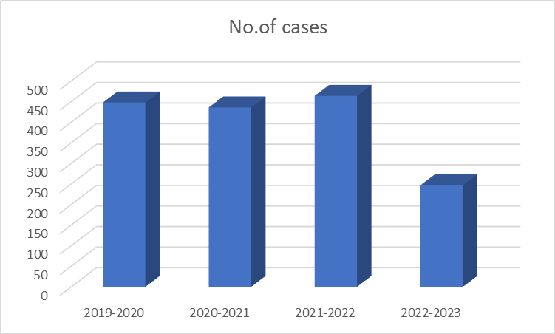
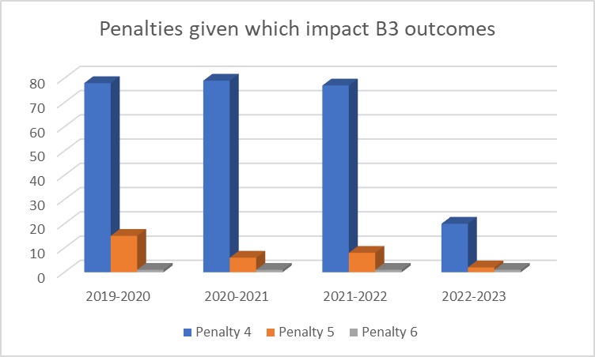
IMPACT – Can we stop the plagiarism pandemic?
Notes:
HH to do

Slide 9
To change the culture of an organisation, the best way to start is by taking the following steps:
On reflection . . .
Assess the current culture. Identify strengths and areas that require improvement.
Define the desired culture
Communicate the vision
Lead by example
Involve employees
Provide resources and training
Align policies and procedures
Recognize and reward desired behaviours
Address resistance and barriers
Monitor progress and adjust
ChatopenAI (2023)
Notes:
HH to do

Slide 10
Future Actions & Considerations
Sustainable practice – embedding Academic Integrity policy, process and practice into the culture of the university.
Write a policy on Artificial Intelligence in line with QAA
Using the Universal Design for Learning framework to continue to develop more inclusive approaches to Academic Integrity
Authentic Assessment Design
Notes:
HH notes
Report out today from the Tony Blaire Institute says that “What is certain is that our institutions are not configured to deal with science and technology, particularly their exponential growth. It is absolutely vital that this changes.”
JL to do 3 and 4
No 3: Universal Design for Learning -
Bracken and Novak (2019)
Universal Design for learning is an educational framework based on research in the learning sciences that guides the design and development of inclusive educational systems that accommodate and challenge all students and foster the development of innovative technologies and critical next generation skills. Embracing the core principles of UDL increase accessibility and engagement, increase retention and attainment and improve the outcomes for all students.
UDL Framework built on 3 principles:
Provide multiple means of engagement
Provide multiple means of representation
Provide multiple means of action and expression – to assess if students have learnt the content, lecturers must assess using multiple strategies so students have options regarding the type of assessment and ways in which they can present evidence of learning, providing students with multiple means of action and expression ensures that students can incorporate critical next generation skills and authentic assessments in their learning journey.
Authentic Assessment Design
Iverson, Lewis and Talbot (2008) developed a framework for determining the authenticity of assessments:
5 criteria -
Authentic professional activity
Performed and assessed in an authentic environment or received by an authentic audience
Developed high-order thinking through complex challenges
Requires self-reflection
Is formative, feeds into subsequent tasks or task

Slide 11
References
Bracken, S. and Novak, K. (2019) (eds) Transforming higher education through universal design for learning: an international perspective. London, Routledge
ChatopenAI (2023) What is the best way to change the culture of an organisation? [Written]. Available at: https://www.chat.openai.com/c/0343c5d0-165d-4d44-8751-21d19087591a (Accessed 23rd May 2023)
Davis, M. (2022) 'Examining and improving inclusive practice in institutional academic integrity policies, procedures, teaching and support'. International Journal for Educational Integrity 18, 14. Available at: https://doi.org/10.1007/s40979-022-00108-x (Accessed 7th May 2023)
De Souza, D. (2022) Academic integrity report. London Higher. Available at: www://https://londonhigher.ac.uk/wp-content/uploads/2022/07/Academic-Integrity-Report-2.pdf (Accessed 4th April 2023)
Draper, M., Birch, Z., Croombs, M., and Marano, E. (2022) 'Revisiting academic integrity from a student perspective. Quality Compass'. 5. Available at: https://www.qaa.ac.uk/docs/qaa/news/quality-compass-revisiting-academic-integrity-from-a-student-perspective.pdf (Accessed 8th April 2023)
Hulbert, A., McKenzie, A., Orr, J., and Roberts, C. (2021). The fundamental values of academic integrity 3rd edition. Delaware, International Center for Academic Integrity [ICAI]. Available at: https://www.academicintegrity.org/the-fundamental-values-of-academic-integrity (Accessed 6th April 2023)
Iverson, H.L., Lewis, M.A. and Talbot III, R.M., 2008. Building a framework for determining the authenticity of instructional tasks within teacher education programs. Teaching and Teacher Education, 24(2), pp.290-302. Available at: https://doi.org/10.1016/j.tate.2007.09.003 (Accessed 12th June 2023)
Lee, G. (2019) 'Universities catch less than one per cent of 'bought in' essays, own records suggest'. Available at: http://www.channel4.com/news/factcheck/factcheck-universitiescatch-less-than-one-per-cent-of-bought-in-essays-own-records-suggest (Accessed 3rd April 2023)

Slide 12
References
Newman, C. (2018) 'Latest study reveals sharp rise in essay cheating globally, with millions of students involved'. Swansea University Press Office, 30th August. Available at: https://www-2018.swansea.ac.uk/press-office/newsarchive/2018/lateststudyrevealssharpriseinessaycheatinggloballywithmillionsofstudentsinvolved.php
(Accessed 15th April 2023)
Stone, A. (2022) 'Student perceptions of academic integrity: a qualitative study of understanding, consequences, and impact'. Journal of Academic Ethics. Available at: https://doi.org/10.1007/s10805-022-09461-5 (Accessed 14th April 2023)
The Quality Assurance Agency for Higher Education (QAA) (2020) Academic integrity charter for the UK higher education. The Quality Agency for Higher Education. Available at: https://www.qaa.ac.uk/docs/qaa/about-us/academic-integrity-charter.pdf?sfvrsn=93f0d181_8 (Accessed 12th April 2023)
The Quality Assurance Agency for Higher Education (QAA) (2022) Contracting to cheat in higher education: how to address essay mills and contract cheating. 3rd edition. The Quality Agency for Higher Education. Available at: https://www.qaa.ac.uk/docs/qaa/guidance/contracting-to-cheat-in-higher-education-third-edition.pdf?sfvrsn=2fbfa581_14 (Accessed 17th April 2023)
Tony Blair Institute for Global Change (2023) A New National Purpose: AI promises a World-Leading Future of Britain. Available at: https://www.institute.global/insights/politics-and-governance/new-national-purpose-ai-promises-world-leading-future-of-britain (Accessed 13th June 2023)
Yorke, H. (2017) 'More than 20,000 university students buying essays and dissertations as Lords call for ban on ‘contract cheating’. The Telegraph, 13th January Available at: https://www.telegraph.co.uk/education/2017/01/13/2000-university-students-buying. (Accessed 20th April 2023)

