Slide 1
Title page
Resource List Engagement: measuring usage, staff and student experiences
Talis Insight, 29 April 2021
Kristy Millard, Reading Resources Coordinator
Madalene George, Student Engagement Coordinator

Slide 2
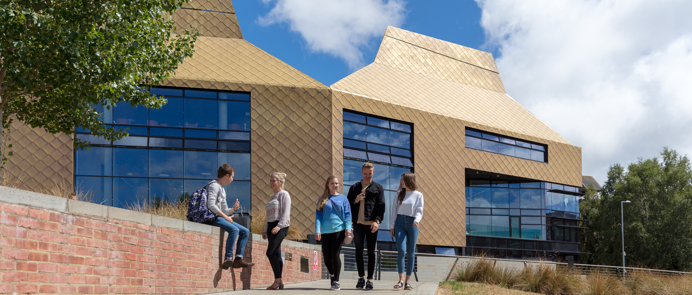
The Hive, Worcester
University of Worcester Library Services at The Hive

Slide 3
The Project
The Project
Delivered collaboratively across Library Services and academic teams
Gathered rich qualitative data about staff and student experiences
Combined data from the Talis Advanced MIS with internal data

Slide 4
Aims
Aims
To gain insight into how Resource Lists are used
To learn more about how engagement with Resource Lists may support student success
To showcase a variety of best practice whilst recognising different disciplines, assessment types and pedagogical approaches

Slide 5
Delivery
Delivery
Worked with IT to identify MIS events to combine with internal data
Collaborated with Heads of Departments from four Academic schools
Conducted three student focus groups and four informal staff interviews
Analysed data from 38 modules delivered in Semester 1, 2019

Slide 6
Outcomes
Outcomes

Slide 7
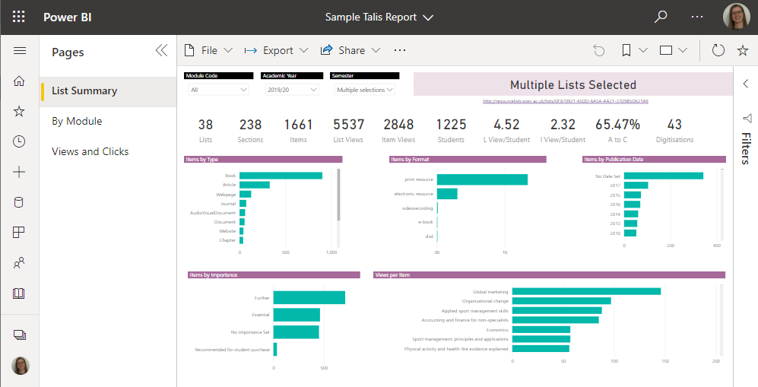
Interactive dashboard
Interactive dashboard

Slide 8
Top Tips infographic
Top tips infographic

Slide 9
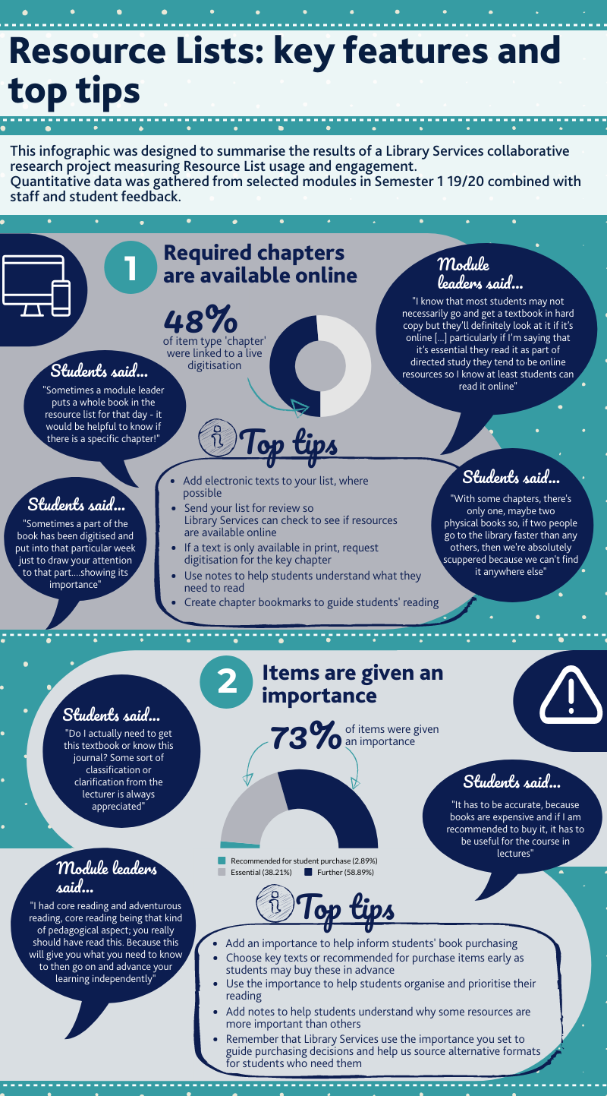
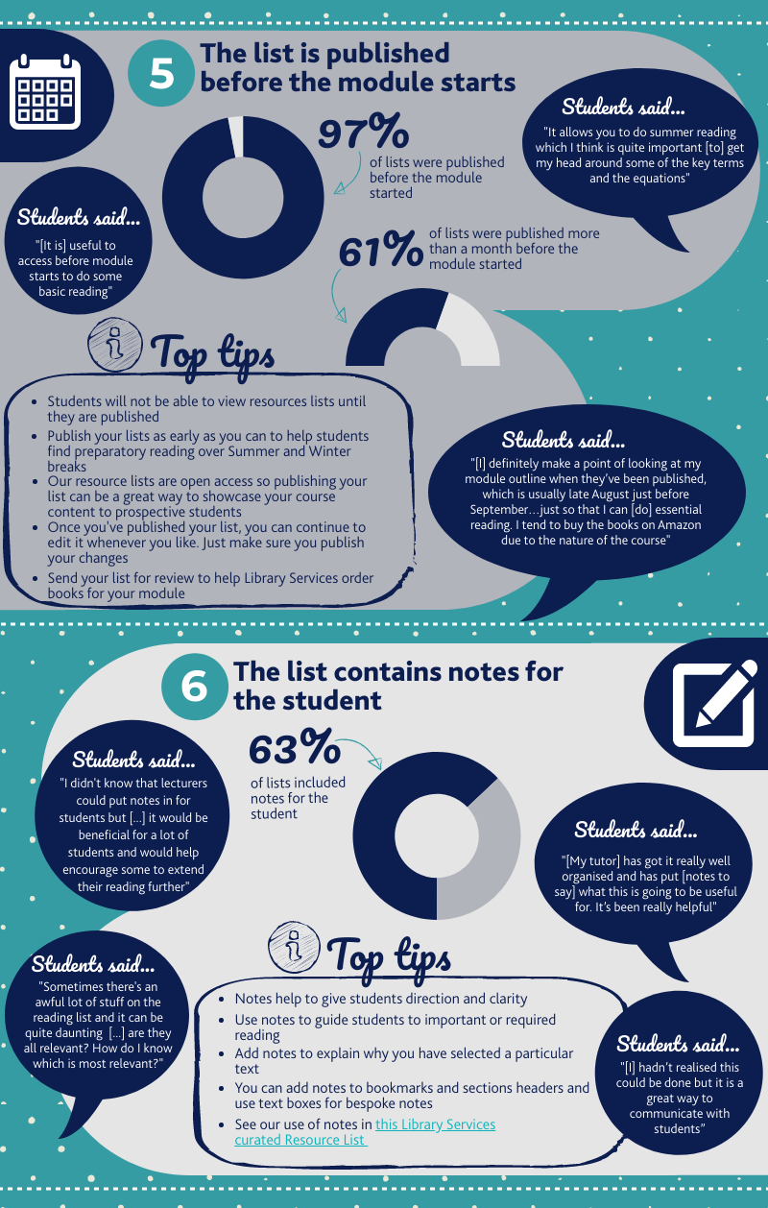
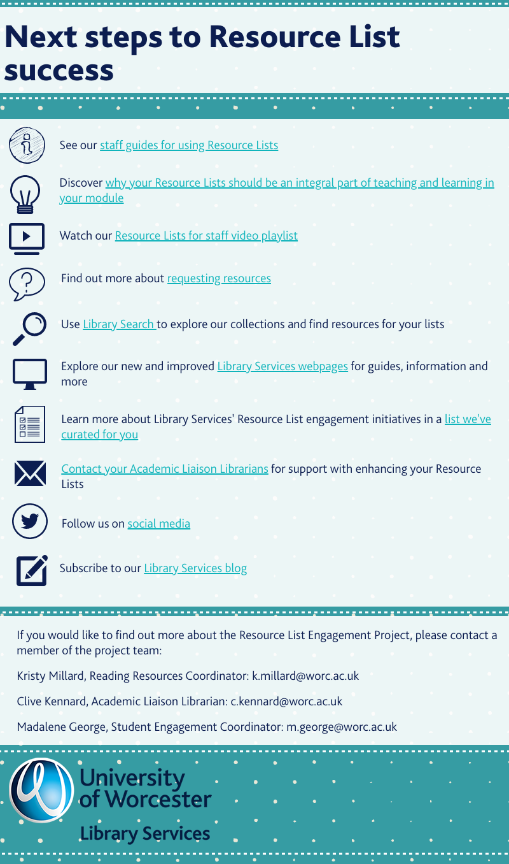
Full infographic
Top tips infographic

Slide 10
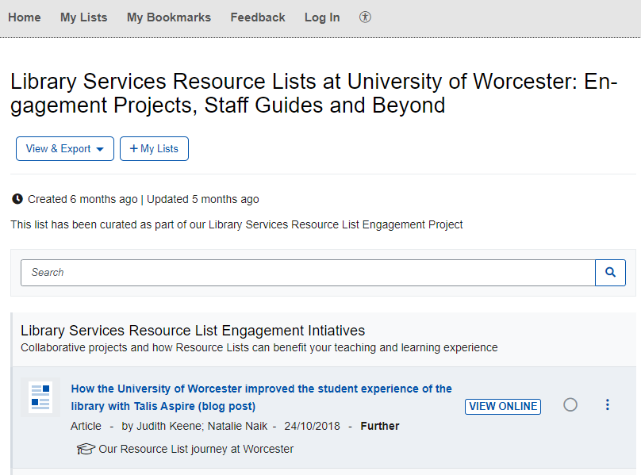
Curated Resource List
Curated Resource List

Slide 11
Impact
Impact
"This looks interesting in terms of the way the information is presented and what is included. I really like it and I am looking forward to delving into it more deeply"
“Interesting activity to be involved in and made me think further about the resources available at the university”
"Wow! Those top tips in the infographic – all the things I say to staff but now with added evidence!!"
Staff participant
Student participant
Academic Liaison Librarian

Slide 12
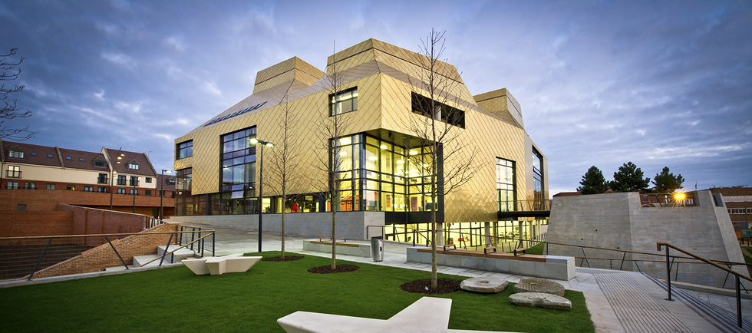
Presenter details
Kristy Millard k.millard@worc.ac.uk
Madalene George m.george@worc.ac.uk
library.worc.ac.uk

